Slide 1


Out-of-School Time Nutrition & Physical Activity Initiative (OSNAP)
Facilitator Training
Prevention Research Center on Nutrition and Physical Activity at the Harvard T.H. Chan School of Public Health

Slide 2
Starting Off
Name
Organization and role
Favorite out-of-school time experience (summer camp or after school)
Give the group a movement

Slide 3
Training Objectives
Participants will be able to…
Explain the scientific rationale behind the OSNAP Goals for out-of-school time (OST)
Communicate the OSNAP model to help OST programs increase opportunities for children to eat healthy and be active
Identify, locate and use the OSNAP resources and tools with OST programs to support programs
Support OST programs in evaluating their efforts
Facilitate a series of collaborative learning community sessions with OST program staff
Notes:
Here are our objectives for the day. By the time you leave today, we should have accomplished all of these things…
[talk through objectives]

Slide 4
Today’s Agenda
Time | Task
10:15am - 11:00 am | OSNAP Background OSNAP Goals OSNAP Model Levels of Behavior Change OSNAP Glossary of Terms Nutrition & physical activity background
11:00 am – 11:30 am | OSNAP Materials OSNAP Implementation Guide Learning Community Facilitator Handbook OSNAP and Food & Fun websites Binder / CD
11:30 am – 12:30 am | OSNAP Process Recruitment of programs Assessments Logistics and CEUs

Slide 5
Today’s Agenda (cont.)
Time | Task
12:30 pm – 1:00 pm | Lunch Break
1:00 pm – 3:30 pm | OSNAP Process (cont.) Learning Communities Technical Assistance Assessment Follow Up
3:30 pm – 3:45 pm | Additional Trainings Food & Fun Other trainings
3:45 pm – 4:00 pm | Closing

Slide 6
OSNAP Initiative Goals:
Identity and support lasting and cost-effective policy and practice strategies that promote:
  Increased access to healthy foods and beverages
  Increased physical activity opportunities
  Reduced screen time in out-of-school-time (OST) settings.
Brings together OST program providers to learn from one another and set goals to meet the OSNAP Goals

Slide 7
Why out-of-school time programs to promote nutrition and physical activity?
Afterschool programs serve 7.8 million children annually for an average of 5.6 hours per week
Afterschool and other out-of-school time programs are ideal settings for promoting healthy nutrition and physical activity environments
About half of Boston school-age children & youth ages 5-18 participate in out-of-school program (nearly 40,000 kids!)
600+ organizations with 1,400+ program opportunities across Boston (afterschool & summer)
Notes:
When we thought about places that have an impact in kids’ lives, we realized how important
afterschool programming is.
Out-of-school time (OST) programs, including afterschool programs, serve 7.8 million children annually for an average of 5.6 hours per week
Thus, your programs are ideal settings for promoting healthy nutrition and physical activity environments.
Source: https://afterschoolalliance.org/documents/AA3PM-2020/National-AA3PM-2020-Fact-Sheet.pdf

Slide 8
Types of healthy changes programs can make
Child behaviors
  Encouraging kids to eat more fruits and vegetables or participate in physical activity
Program practices
  Changing the day-to-day operations, like serving water at the table during snack time or offering more options for physical activity.
Informal policies
  Changing the informal written plan of action for the program on schedules or snack menus or in trainings.
Formal policies
  Changing the formal written plan of action for the program, for instance state law and regulations or the rules in written documents like parent handbooks and staff manuals.
Health Communication
  Sharing health information, practices or policies with families, program partners, and children.
Notes:
Let’s talk about what kinds of changes you can do around these ideas to make your program an even healthier place for kids to be.
These are all ways of promoting healthy changes, and they can all be very useful.
[read through list and the example/description]
Keep these in mind as we look at some examples…. [next slide]

Slide 9
The OSNAP Model
Assess
Learn
Identify
Implement
Communicate
Track
Re-Evaluate
Notes:
The OSNAP Initiative follows a series of steps to help programs identify where they could make changes regarding physical activity and nutrition; this process can be seen as a series of steps in a continuous improvement process that programs either work through as circumstances change or in addressing different aspects of physical activity and nutrition. The process involves assessment of practices and policies to identify specific areas to work on, opportunities to learn both about physical activity and nutrition, as well as strategies to address these areas, time to try out strategies for improvement/change, then opportunities for feedback with both the OSNAP facilitator and other programs, opportunities to both re-evaluate strategies as well as ongoing practices and policies. We’ll be going through each of the steps in the process during today’s training.

Slide 10
Why Implement the OSNAP Model?
Evidence-based
  Water served and consumed
  Policy change
  Healthier foods consumed
  Vigorous activity
77% of OSNAP participants rate learning community sessions as very helpful; 22% as somewhat helpful
Helps programs meet federal, state and local regulations and policies

Slide 11
OSNAP Goals support MA Regulations
The Massachusetts Child Care Regulations cover….
Adequate space for physical activity
Encouraging outdoor play
Requiring physical activity
Encouraging a variety of foods be served at snack
Requiring child participation in food preparation
Making water freely available
Requiring physical activity and nutrition curricula
Provision of nutrition training to staff
Staff making positive statements about healthy eating
Prohibiting withholding food or outdoor time as punishment
Parents must be informed of changes to the menu
Notes:
OSNAP can also help you meet state regulations for child care facilities in Massachusetts. For example, The Massachusetts Child Care Regulations cover…
[read list]
[NOTE: if you are in a state other than Mass., identify which licensing standards for agencies serving children 5-12 match the OSNAP objectives]

Slide 12
OSNAP Goals support federal & district objectives
Water regulations within schools
  Healthy, Hunger-Free Kids Act of 2010 states programs participating in the National School Lunch Program and CACFP should make safe drinking water available to children, throughout the day, including at meal times, in the location where meals are served
School Wellness Committees
Notes:
In addition to state regulations, the goals of OSNAP also align with national requirements and possibly objectives in your school district as well. After-school providers and child care programs receiving CACFP funds, are required to have clean, safe, drinking water available for the children throughout the day.
Additionally, many local wellness committees are working on similar goals.
More detailed info, FYI:
School meal programs -- Sec. 203.Water (NSLP/SBP)
Requires schools to make free potable water available where meals are served.
The Healthy, Hunger-Free Kids Act of 2010 (the Act), Public Law 111-296, establishes a requirement to make potable water available to children in the Child and Adult Care Food Program (CACFP). The purpose of this memorandum is to provide guidance on the implementation of this provision.
Section 221 of the Act added a new provision to the Richard B. Russell National School Lunch Act (42 U.S.C. 1766(u)). This new provision requires child care centers, family day care homes, at-risk afterschool programs, and shelters participating in CACFP to make drinking water available to children, as nutritionally appropriate. Throughout the day, including at meal times, water should be made available to children to drink upon their request, but does not have to be available for children to self-serve. While drinking water must be made available to children during meal times, it is not part of the reimbursable meal and may not be served in lieu of fluid milk.

Slide 13
OSNAP Glossary of Terms:
A handy reference for key terms used in OSNAP and their meanings.
Commercial Broadcast TV/Movies
Digital Devices
Groups of children
Instructional Computer/Digital Device
Moderate physical activity
OST or Out-of-School Time
Outside drinks and food
Screen Time
Sugary Drinks
Trans fats
Vigorous physical activity
Water served
Whole grains
Notes:
Refer to handout in binder

Slide 14
Defining Terms
Whole grains
Sugary drinks
Screen time

Slide 15
Learning Objective 1: OSNAP Goals
Provide all children with at least 30 minutes of moderate to vigorous physical activity every day.
Offer 20 minutes of vigorous physical activity 3 times per week.
Do not serve sugary drinks at the program.
Do not allow sugary drinks to be brought in during program time.
Serve water every day.
Offer a fruit and/or vegetable option every day at snack.
When serving grains (like bread, crackers, and cereals), serve whole grains.
Eliminate commercial broadcast and cable TV and movies.
Limit computer and digital device time to homework or instructional (i.e., teacher led) time.
Notes:
Here are the OSNAP standards again, just to refresh your memory.

Slide 16
OSNAP Goals
Scientific Background

Slide 17
Staying Active
Goals
Provide all children with at least 30 minutes of moderate to vigorous physical activity every day (include outdoor activity if possible).
Offer 20 minutes of vigorous physical activity at least 3 days per week.
Why is it important?
Kids need at least 60 minutes of physical activity every day.
Regular physical activity is important for preventing chronic diseases like heart disease, diabetes, high blood pressure, and osteoporosis.
Suggested strategies
Schedule at least 30 minutes of physical activity every day.
Have kids vote on their favorite active games to improve participation.
Key messages
Moving your body is fun and helps your body be healthy and strong.
All types of activities like playing, dancing, and sports are good for you.
Doing activities that make you sweat and breathe hard will make you strong and keep your bones and heart healthy.
Notes:
So here are our two physical activity related goals. [read goals]. You notice that we make a point to note outdoor activity. In general, outdoor spaces are more open and it is often easier for kids to be more physically active. We encourage taking kids outside to play in all kinds of weather, and I have a specific chart that shows what temperatures and conditions are safe to take kids outside in, if you’re interested.
Physical activity is really important for kids, and national guidelines say that kids need at least 60 minutes of physical activity every day. We know that you don’t spend all day with kids, but we’re suggesting that kids can get half of that time during the afterschool hours.
Regular physical activity is important for preventing chronic diseases like heart disease, diabetes, high blood pressure and osteoporosis
A couple things that we have found that help with this goal are…[read suggested strategies].
A final, but really important thing to emphasize here is how we talk about being healthy with kids. The messages that you all give are an important part of getting kids excited about physical activity an nutrition. We know that weight can be a sensitive topic, so we try to avoid say things like “we do this so we can be skinny.” Instead, we frame the messages around health and fitness. So here are some examples of things that you can say to kids that underscore how good it is to be active without bringing up weight or body image. [read Food & Fun key messages]

Slide 18
Healthy Beverages
Goals
Do not serve sugary drinks.
Do not allow sugary drinks to be brought in during program time.
Why is it important?
Sugar-sweetened drinks (including soda, sweetened teas, fruit drinks, energy drinks, and sports drinks) are the top source of added sugar in children’s diets.
Drinking sugary beverages is associated with obesity and type 2 diabetes in kids.
They provide a lot of calories with little to no nutritional benefit.
Suggested strategies
Create a policy that restricts sugary drinks brought from home.
Turn off the vending machine during the afterschool program time.
Key messages
Eating and drinking too much sugar is not healthy for your body and it can cause cavities.
Juice is not as healthy as it seems. It can have as much sugar as soda. Limit juice to 4 ounce or less
Notes:
Sugary drinks are drinks with sugar added to them or any 100% juice greater than 4 ounces (a half a cup) in size. They include soda, sweetened iced teas, fruit punches, fruit drinks (such as lemonade), sports drinks, and sweetened water (e.g. Vitamin water).
Our goal is to keep these out of the afterschool environment. This means not serving big juices or other sugary beverages, as well as not letting kids bring them in from outside to be consumed during program time. This might be things like a Capri-Sun they packed from home, a soda or juice drink they bought at the corner store before the program, or a program partner having a pizza and soda party.
[read goals and “why is it important”]
So two things you could think about doing would be [read suggested strategies].
And here again are our healthy messages around beverages.
Eating and drinking too much sugar is not healthy for your body and it can cause cavities.
Juice is not as healthy as it seems. It can have as much sugar as soda. For example, Minute Maid Orange Juice and Coca-Cola Classic both have 41g of sugar in 12 ounces.
[Note to facilitator: see “How Sweet is it?” bonus slide for even more information]
Source: http://www.hsph.harvard.edu/nutritionsource/files/how-sweet-is-it-color.pdf

Slide 19
Healthy Beverages
Goal
Serve water every day.
Why is it important?
Water is the best way to keep kids hydrated.
It is calorie-free and almost cost free from the tap!
Suggested strategies
Build water breaks into your program schedule.
Serve water in a pitcher with cups in the snack area every day; drinking from water fountains often doesn’t provide children with enough water.
Key messages
Water is the best thirst quencher.
Water and low-fat milk are the best drinks to have at snacks and meals.
Drink water when you are thirsty.
Notes:
The previous slide was all about sugary drinks – but then you might wonder what to serve the kids to keep them hydrated. The answer is -- water!! Our goal is to have water offered as a drink everyday during snack time. And by “offering” it, we mean that children should be able to take a serving of water back to their seats with them. So having a water fountain around doesn’t quite count --- unless you have cups or water bottles that the kids can fill up!
[read goals and “why is it important”]
So two things you could think about doing would be [read suggested strategies].
And here are some things to say about around drinking water.

Slide 20
Fruits and Vegetables
Goal
Offer a fruit and/or vegetable option every day at every meal and snack.
Why is it important?
Fruits and vegetables contain vitamins, minerals, and fiber that keep kids and adults healthy.
Fruits and vegetables protect against heart disease, stroke, high blood pressure, and some cancers.
Suggested strategies
Talk with food service managers to make sure the fruits and vegetables served at your program match the planned menus.
Use taste tests to learn kids’ fruit and vegetable preferences.
Key messages
Eat 5 or more fruits and vegetables (combined) each day.
Just take a bite! Don’t be afraid to try a new fruit or vegetable – chances are you’ll like it.
Fruits and vegetables come in lots of colors. Try to eat as many different colors as you can.
OSNAP doesn’t consider juice a fruit or vegetable
Notes:
The next set of goals focuses on fruits and vegetables. Here, we ask that you offer a fruit or vegetable option every day. Fresh fruits and veggies are great, but you can also serve frozen fruit and veggies, fruit cups, dried fruit, and canned fruit and veggies.
Eating fruits and vegetables is important because fruits and vegetables contain vitamins, minerals, and fiber that keep kids and adults healthy. These things protect against heart disease, stroke, high blood pressure, and even some cancers.
Changing the food that you serve can seem like a big challenge. We suggest that you check with food service managers to make sure the fruits and vegetables served at your program match the planned menus. If you’re adding more fruits and veggies to the menu, consider using taste tests to learn what the favorite ones are – that means less waste, and more kids eating nutritious foods!
The messages here are [read key messages].

Slide 21
Focus on Whole Grains
Goal
When serving grains (like bread, crackers, and cereals), serve whole grains. Whole grains should be listed as the first ingredient.
Why is it important?
Whole grains contain fiber, vitamins, and healthy fats that can lower your risk for heart disease and diabetes.
They can also help you feel full longer.
Suggested strategies
Select breads, crackers, and, cereals that list a whole grain as the first ingredient on the label. Examples are whole wheat, barley, oats, and rye.
Select foods containing at least 3 grams of fiber and 5 grams of sugar or less per serving.
Key messages
Whole grains and products made with whole grains are healthy for your heart and whole body.
Whole grain products offer more fiber and vitamins than refined grains.
Notes:
A lot of the snacks that you serve are probably grain-based. Things like cereal, chips, popcorn, crackers, granola bars, and pretzels are all grain products. One of the OSNAP goals is to serve whole grains instead of refined grains. When something is made with whole grains, it means the grain, which could be wheat, oats, rye, corn, or others, is less processed and it has more of the healthy stuff like fiber, which is reduced in processed grains. Fiber-rich foods make good snacks because they help you feel full for a longer time than their refined counterparts. Whole grains also have vitamins and healthy fats. It can be tricky to tell which foods count as “whole grain” foods. For OSNAP, we say a food is a whole grain food if whole grains are listed as the first ingredient. For wheat, whole wheat should be listed as the first ingredient. Things like “enriched wheat flour” are NOT whole grains. Oats and corn can be little trickier because they don’t always say whole, but usually if these grains are the first ingredient, it’s a whole grain product. [can fast forward here to next slide, talk about nutrition labels, then return]
Sometimes companies add more sugar to whole grain products, so we recommend selecting foods that have at least 3 grams of fiber per serving and less than 5 grams of sugar. Products meeting these goals might not be readily available through your food vendor, but we have lists of products that are whole grain, common snack products that kids still enjoy.
Here are some healthy messages that help point out other fats that are better for you. [read key messages]

Slide 22
Limit Inactivity
Goal
Eliminate use of commercial broadcast and cable TV and movies.
Limit computer and digital device time to homework or instructional time (instructional is defined as academic, teacher-led programming).
Why is it important?
TV watching may influence kids to make unhealthy food choices because they see a lot of ads for foods that are high in sugars and calories.
Time in front of the screen can lead to overeating, less physical activity, and overweight.
Suggested strategies
Set a program policy banning televisions and movies.
Try new indoor active games from Food & Fun if weather limits outdoor play time or as a special treat on Fridays.
Key messages
Moving your body keeps you fit.
Do something active instead of watching TV, playing video games, or spending time on the computer.
Notes:
Our next set of goals is around screen time. When we say screen time, we mean electronic devices that have a screen – that could be a TV, computer, video game, handheld PSP, and even a smartphone.
Our goals are to [read goals].
Reducing screen time is important for two reasons. One, kids are exposed to a ton of advertisements in media. This could be commercials, product placement in TV shows and movies, online pop-up ads, or even internet games designed by food companies. All of these things are designed to get people to eat or drink a certain product, and that product usually isn’t a healthy one! So we want to limit screen time so that we limit kids’ exposure to these ads.
Secondly, time spent in front of screens is time that kids aren’t running around and being active. We know that computers are a useful educational tool, and that some of you may work at programs where teaching kids to use computers or having kids do homework on the computer is a big part of why parents send their kids to you. So we’re asking that you focus on cutting out any of that non-instructional time. We can also give you some tips on ways to get kids active even during homework time in a computer lab.
Some ideas for strategies are …. [read suggested strategies].
And here are a couple healthy messages… [read key messages].

Slide 23
Updates to the OSNAP Goals
“Do not serve foods with trans fats” is no longer included as an OSNAP goal due to the Food and Drug Administration's (FDA) ban on trans fats in the United States.”
  In 2015, the FDA declared partially hydrogenated oils (the main source of artificial trans fat) as unsafe for use in human food.
  Food manufacturers had three years to remove partially hydrogenated oils from their products.
Given this policy success, afterschool programs should now be in compliance with this OSNAP Goal.
Trans fat remains prevalent in some countries where inexpensive partially hydrogenated oils have become staples not only for the food industry, but also for home use.
  If you are implementing OSNAP outside of the US where there are no regulations on trans fats, learn more: https://www.hsph.harvard.edu/nutritionsource/what-should-you-eat/fats-and-cholesterol/types-of-fat/transfats/
Notes:
“Do not serve foods with trans fat” is no longer included as an OSNAP standard due to the Food and Drug Administration's (FDA) ban on trans fats in the United States. In 2015, the FDA declared partially hydrogenated oils (the main source of artificial trans fat) as unsafe for use in human food. Food manufacturers had three years to remove partially hydrogenated oils from their products. Given this policy success, afterschool programs should now be in compliance with this OSNAP standard. However, trans fat remains prevalent in some countries where inexpensive partially hydrogenated oils have become staples not only for the food industry, but also for home use. If you are implementing OSNAP outside of the US where there are no regulations on trans fats, make sure to include the tips and lessons on the topic. To learn more, visit: https://www.hsph.harvard.edu/nutritionsource/what-should-you-eat/fats-and-cholesterol/types-of-fat/transfats/

Slide 24
OSNAP Goals Review

Slide 25
OSNAP Goals Review
Name at least one thing that OSNAP goals suggest eliminating
Notes:
A: commercial broadcast TV/movies, non-instructional screen time, sugary drinks (can also accept refined grains)

Slide 26






Which of these drinks are OSNAP-approved?
Notes:
A: only the seltzer and water. Others are all sugary

Slide 27
OSNAP Goals Review
True or False:
Sugary drinks (including soda, sweetened teas, fruit drinks, and sports drinks) are the top source of added sugar in children’s diets.
Notes:
True!
Also, drinking sugary beverages is associated with obesity in kids.
They provide a lot of calories with little to no nutritional benefit.

Slide 28
OSNAP Goals Review
What are the OSNAP goals for physical activity (hint: for who, for how long, and how frequently?)
Notes:
A: Provide all children with at least 30 minutes of moderate to vigorous physical activity every day. Offer 20 minutes of vigorous physical activity 3 times per week

Slide 29
OSNAP Goals Review
Does this snack menu meet OSNAP goals? Why or why not?
Monday – carrot sticks, hummus, whole grain crackers, water
Tuesday – low-fat milk, banana, water
Wednesday – whole grain cereal, milk
Thursday – broccoli spears, salsa, water, yogurt
Friday – popcorn, 100% juice (6oz), apple slices
Notes:
No – but almost!
Prompt participants to evaluate each day when giving evidence.
Overall:
Good: When serving grains, they served whole grains.
Problems: had a fruit or veggie on only 4 of the 5 days (OSNAP calls for every day)
Served water on 3 of 5 days
Served a sugary drink (over 4oz of juice) on Friday
Day by day --
Day 1: good
Day 2: good
Day 3: missing fruit/veg and water
Day 4: good
Day 5: sugary drink – cut to 4oz, and need to serve water too.

Slide 30
OSNAP Goals Review
Name two health-related concerns associated with watching commercial television.
Notes:
A: 1. ads for foods high in sugar and calories can influence food choices
2. Time in front of the screen is almost always inactive time, not active time
3. [more relevant at home] eating in front of the TV can lead to overeating

Slide 31
OSNAP Goals Review
Fill in the blanks:
Children should eat at least ____ servings of fruits and vegetables daily. However, most U.S. children are only eating about ____servings each day. Serving 100% fruit juice does not substitute for whole fruit because juice does not contain __________.
Notes:
5
2.5
fiber
[note that this info is on the web standards, but not in the ppt slides – not sure how want to cover it]
http://osnap.org/resources/environmental-standards/

Slide 32
OSNAP Goals Review
True or False:
Gatorade and other sports drinks are better than water for keeping kids hydrated.
Notes:
False. Water is the best way to keep kids hydrated; other sports drinks have added sugars that kids don’t need.

Slide 33
OSNAP Goals Review
What is the recommended amount of physical activity that kids should get every day, and what are two benefits of regular physical activity?
Notes:
A: 60 min
Regular physical activity is important for preventing chronic diseases like heart disease, diabetes, high blood pressure and osteoporosis

Slide 34
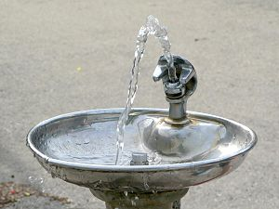
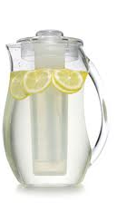
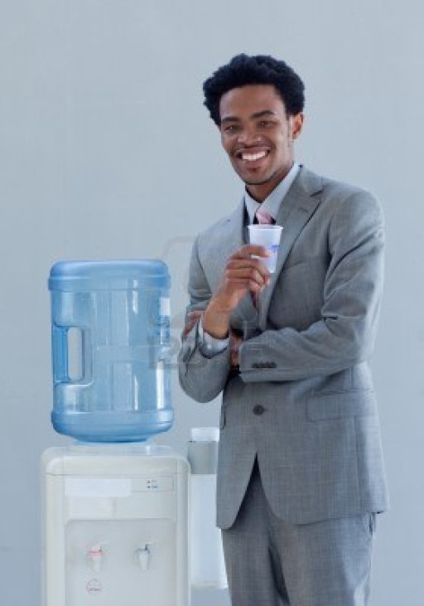
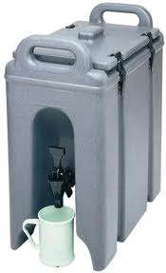
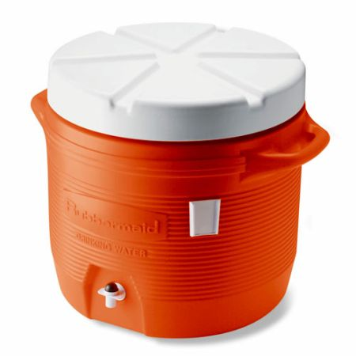

OSNAP Goals Review
Which of the following are ways of serving water at snack?
Notes:
All but the water fountain

Slide 35
End of Review

Slide 36
Learning Objective 2: OSNAP Materials
Implementation Guide
Learning Community Facilitator Handbook
OSNAP Website & My OSNAP portal
Food & Fun Website

Slide 37
The OSNAP Implementation Guide
A step-by-step guide for improving nutrition and physical activity in out of school settings
Designed with both afterschool program site directors and OSNAP Coordinators in mind
Provides materials for programs to use directly with children and families, such as the Food & Fun Afterschool curriculum
Directs users to training templates and action planning guides to get OST program staff on board, organized, and excited to promote healthy practices and policies

Slide 38
Learning Community Facilitator Handbook
Handbook is a supplement to “The OSNAP Guide.”
The OSNAP Implementation Guide walks through the entire OSNAP approach and change process
The facilitator’s handbook specifically provides information on leading the Learning Community portion of the OSNAP program.

Slide 39
OSNAP Website: www.osnap.org
Houses OSNAP tools, materials and resources, including Learning Community materials
My OSNAP Portal
  Includes interactive assessments, reports and action plan builder
  Allows programs to store information to return to to make changes, update information, re-assess

Slide 40
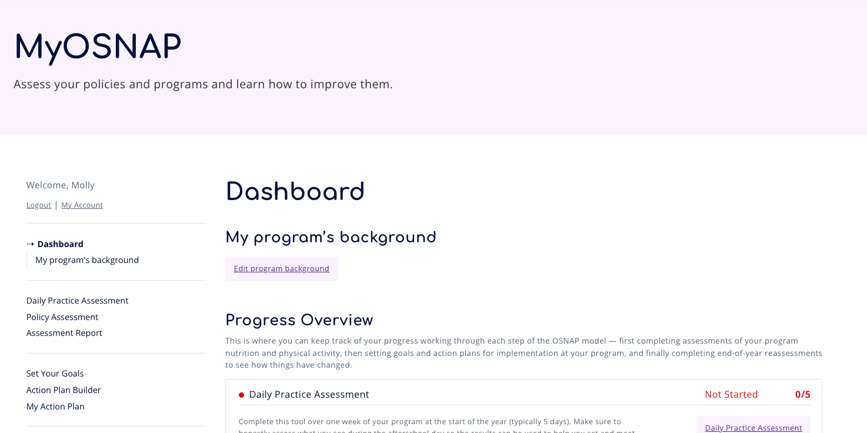
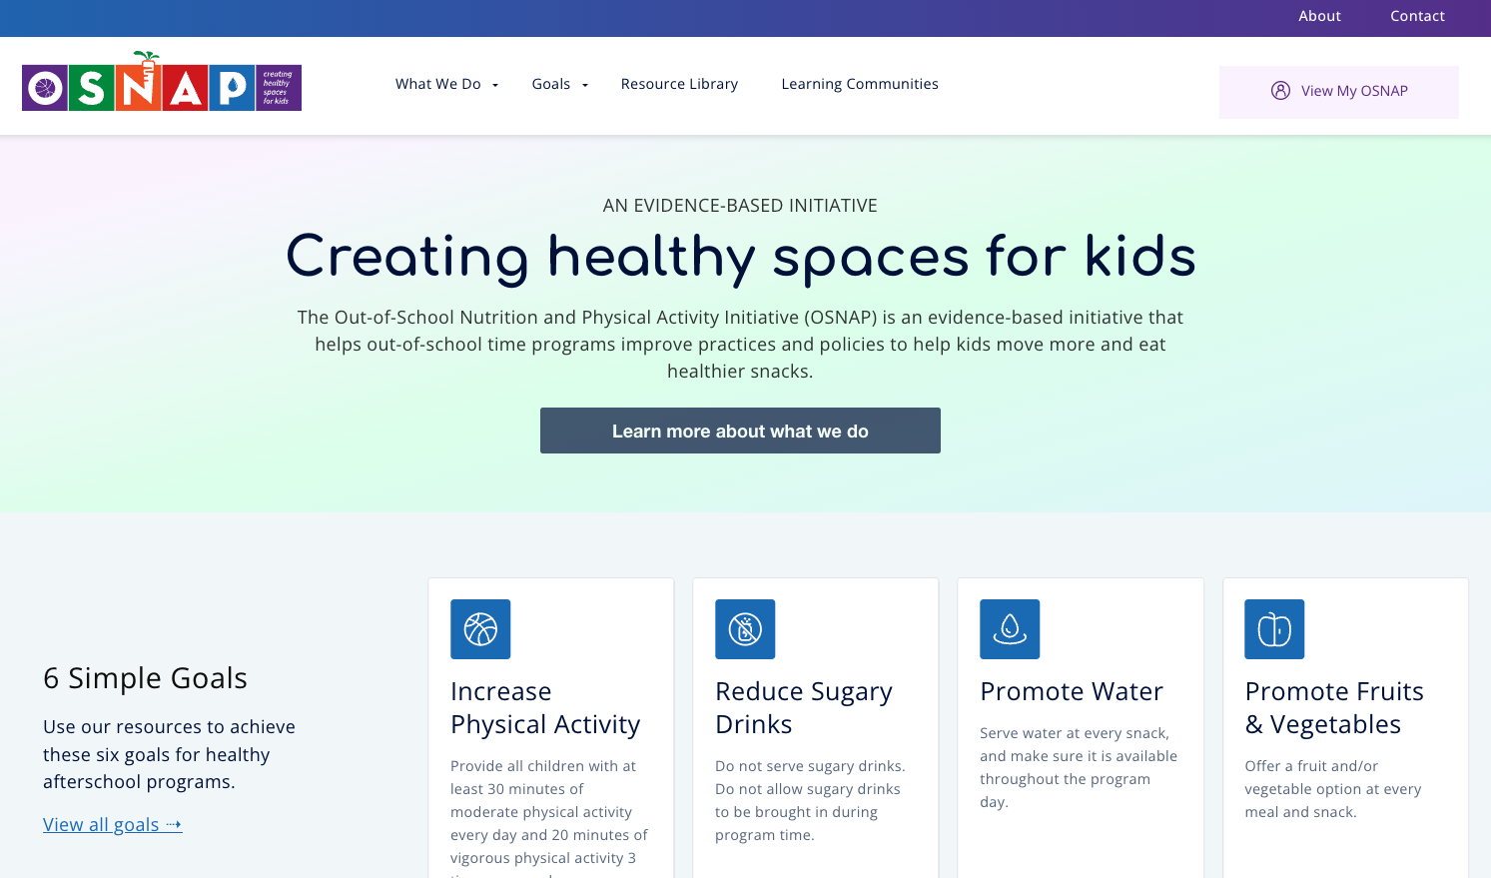
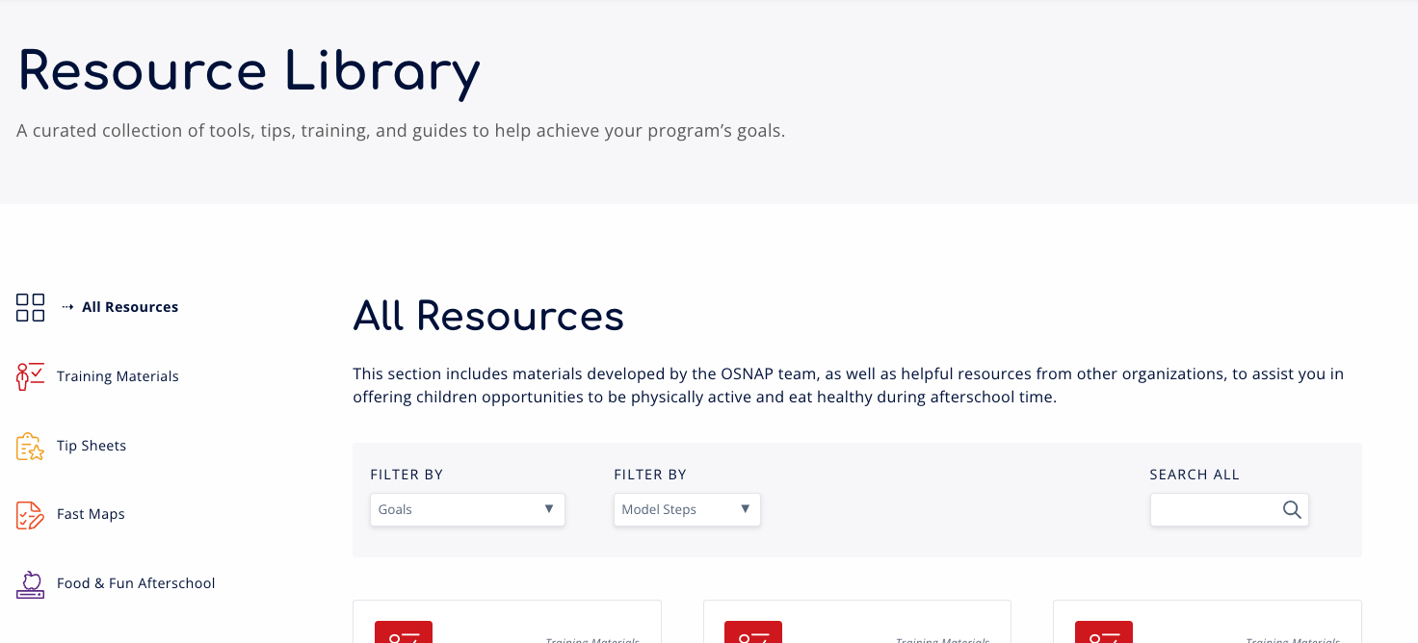
OSNAP Website: www.osnap.org

Slide 41
Explore the OSNAP website

Slide 42
Food & Fun Afterschool Curriculum
Curriculum Components
Afterschool activities for kids
Parent communications
Nutrition and physical activity planning and tracking tools
  Monthly nutrition and physical activity planning tool
  Family engagement planning tool
  Observe what’s going on at your program and others!
Notes:
The Food and Fun Afterschool Curriculum is one support for making YMCA programs a healthy place for kids. The curriculum components include afterschool activities for kids, parents communications, and nutrition and physical activity planning and tracking tool. In this part of the training, we’ll spend the most time talking about the afterschool activities for kids and the parent communications. We’ll also refer to the environmental standards for nutrition and physical activity in out-of –school time that guide the health messages in this curriculum. In training #2, you’ll find out more about our planning and tracking tools.
Point out 2 example units
Hold up/pass around handouts and newsletters that correspond
Hold up/pass around 2 planning and tracking tools/mention that there are more

Slide 43
Food & Fun Afterschool Curriculum
The Basics
Designed for children in grades K-5
Focused on 7 simple science-based healthy eating and physical activity environmental standards
11 units with over 70 activities to pick and choose from
Encourages healthy behaviors through active play, literacy and math skills development, creative learning, and hands-on snack time activities
User-friendly, flexible format and instructions
Lesson extensions make activities easily adaptable across program settings and diverse populations
Notes:
Note to trainer: Read through bullets

Slide 44
Food & Fun Website www.foodandfun.org
Houses Food and Fun curricula, including:
  Units and activities for children
  Parent communication
  Training videos
  Resources and tools

Slide 45

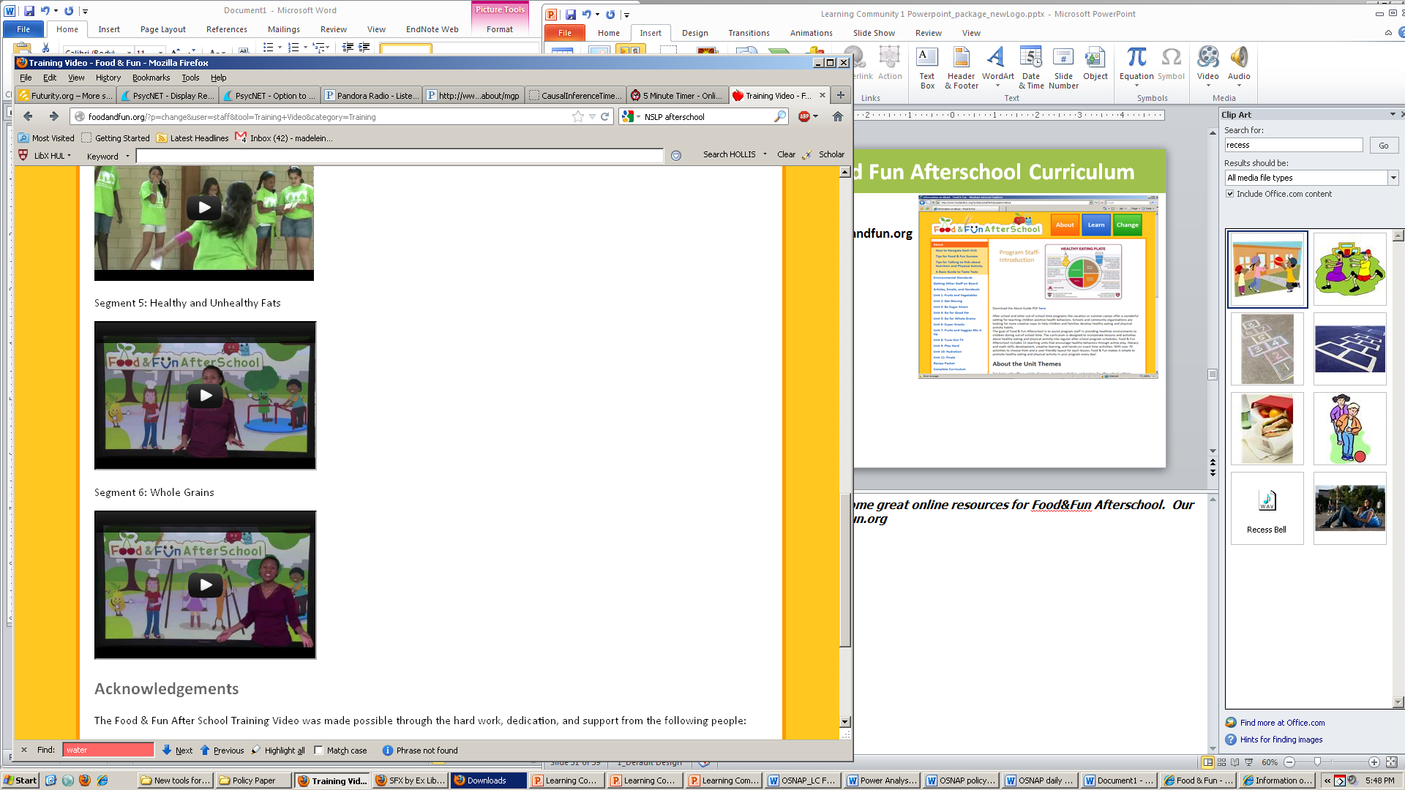
Food & Fun Website www.foodandfun.org
Notes:
We’ve recently developed some great online resources for Food & Fun Afterschool. Our website is http://foodandfun.org. There, you can find all of the Food & Fun lessons, as well as training videos linked to our YouTube Channel.

Slide 46
Explore the Food & Fun website

Slide 47
Food & Fun Training
Optional 1 hour training with program staff
PPT slides available; also use video from website
Key to run through some of the interactive lessons/units with staff

Slide 48
Learning Objective 3: OSNAP Implementation
Recruit Programs
Assessment Period
Learning Communities
Technical Assistance
Follow up Assessment Period

Slide 49
Recruiting Programs
Consider partner organizations to recruit from
Listservs, professional development announcements, etc.
In-person or phone meeting
Resources
  OSNAP Recruitment Letter
  OSNAP Initiative Overview one-pager
  Registration form
  Memorandum of Understanding

Slide 50
Learning Objective 4: Assess
Assess
Learn
Identify
Implement
Communicate
Track
Re-Evaluate

Slide 51
Program Assessment
Daily Practice Assessment: what are programs currently providing related to nutrition and physical activity?
  Prior to Learning Community 1
Policy Assessment: what do programs communicate (in writing) to parents, staff and children about nutrition and physical activity?
  Collect policies prior to/at Learning Community 1
  Part of Learning Community 2

Slide 52
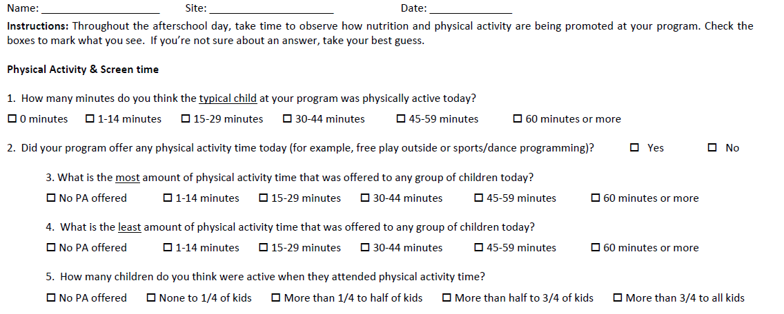
Daily Practice Assessment

Slide 53
Daily Practice Assessment
Completed prior to attending Learning Community 1
Ideally a full week of programming is assessed
One assessment per program, completed by site director (with assistance from other staff)

Slide 54
Practice Assessment
Talk with site directors to explain how to fill out
Address:
  Assistance from other staff
  Different groups
  Maximum/minimum times
  Typical child
  Water served
  Juice serving sizes
  Serve versus consumption
  Outside food

Slide 55
Introducing practice assessment
Break out into pairs and practice explaining the practice assessment to site directors
Switch off OSNAP facilitator and site director role
Note any challenges, miscommunication, strategies used
Report back to group

Slide 56
Policy Assessment
Wait to complete with programs until Learning Community 2
  Will receive skills training on what policies are
Recommend that you try to gather documents/policies from programs around the same time they are completing practice assessment
  Usually at beginning of school year, when they are most likely to have copies

Slide 57
Learning Objective 5: Learn
Learning Communities
Assess
Learn
Identify
Implement
Communicate
Track
Re-Evaluate

Slide 58
Learning Communities
Based on collaborative approach of the Breakthrough Series
Kilo CM. A framework for collaborative improvement: lessons from the Institute for Healthcare Improvement’s Breakthrough Series. Qual Manag Health Care 1998; 6(4):1-13

Slide 59
Facilitating Learning Communities
Guide sites through the session and providing ongoing, individualized feedback that facilitates skill development
Keep the discussion focused on the material so that the learning objectives can be achieved within the time allotted
Emphasize the key learning points for each topic, relating them to the participants’ discussion

Slide 60
Facilitating Learning Communities
Present the material and engage the participants in contributing their experience, thoughts, and ideas in applying the concepts discussed
Emphasize the key learning points for each topic, relating them to the participants’ discussion

Slide 61
Adult Learners
Are autonomous and self-directed.
Have a foundation of life experiences and knowledge.
Are goal-oriented.
Are relevancy-oriented.
Are practical.
Need to be shown respect.
*From: The Food Safe Schools Action Guide, Effective Teaching Strategies; the National Coalition for Food Safe Schools and Centers for Disease Control and Prevention

Slide 62
Facilitating Learning Communities
Include interactive segments that involve participants and respect their knowledge and expertise
  Ask participants to share program practices and solutions to barriers with each other
  Physical Activity / Movement Breaks
  Assessments and action planning
  Ask participants to share documents with each other

Slide 63
Facilitating Learning Communities
Be organized
  Clear objectives that relate to training
  Agendas
  Binders with materials
  Follow up technical assistance
Show relevance of training to working in afterschool programs
  Use examples from real world programs
  Tie in to relevant ECE/QRIS, school guidelines, regulations, activities
Treat the participants as equals

Slide 64
Facilitating Trainings with Adult Learners in Mind
What are other ways to incorporate adult learning theory or facilitation skills into the learning communities?
What did you:
  Like about past trainings you’ve been to?
  Not like about past trainings?

Slide 65
Learning Community Logistics
Three 3-hour sessions offered spaced out over course of the school year
  Additional 1 hour Food & Fun training
Multiple offerings: Consider time of day and day of week
Located at a program site with enough space
Transportation accessibility
Presentation and evaluation materials available

Slide 66
Continuing Education
MassAYEC (Massachusetts Association for the Education of Young Children)
  10 hours = 1 CEU
    3 Learning Communities (=9 hours) + Food & Fun (1 hour)
  5 hours = .5 CEUS
    2 Learning Communities (=6 hours)

Slide 67
MassAEYC Application
Materials found online:
http://www.massaeyc.com/ceu.html#WriteApplic
HPRC can provide examples of previous applications
Reviewed monthly by MassAEYC
Resumes of trainers
3-year approval
Yearly renewal
Specify each offering

Slide 68
What you’ll need to do to offer CEUs
At each LC, have a sign in form and have participants list contact information
Submit evaluations from each LC (templates from OSNAP)
Submit participation plus evaluation summary within one month of completing sessions
Submit any changes in dates to MassAEYC

Slide 69
Learning Community 1

Slide 70
Prior to Learning Community 1
Secure location, space, date and time
Communicate with programs
Distribute self-assessments
Reminders re: assessment completion
Reminders re: Learning Community
Collect ahead of time or send reminders to bring assessments to Learning Community
Tweak PowerPoint slides and run through
Create binders
Gather OSNAP materials and resources

Slide 71
Learning Community 1
Learning Goals
  Overview of the OSNAP Goals and the scientific rationale behind them
  Benefits of incorporating nutrition and physical activity in out of school time programs
  Food & Fun Afterschool curriculum
  Importance of policy to the process of making sustained healthy changes.
Activities
  Score and review daily practice assessment
  Develop action plans with practice, policy, and communication action steps to work towards nutrition and physical activity areas for improvement.

Slide 72
LC 1 Resources/Materials
  OSNAP Goals and the scientific rationale behind them
  Food & Fun Afterschool curriculum
  Daily Practice Assessment
  OSNAP Daily Assessment Areas for Improvement: Practice Report
  Tip Sheets
  Fast Maps
  Action Planning Document

Slide 73
Feedback & Planning
Break out into afterschool teams
Use teams’ completed daily self-assessments to complete the OSNAP Daily Self-Assessment Areas for Improvement: Practice Report
Based on their results, use tip sheets and quick guides to brainstorm priorities
Set 3 goals for improving nutrition, physical activity, or screen time at their programs
Decide on practice action steps for each goal
Complete the OSNAP Action Planning Document (2 copies, one for me, one for you)
Notes:
Now that you’ve got the general idea, the rest of the time is for you all to create your action plans. Here’s the plan for the next hour or so:
You will all split up into small groups with other people from your program. If you’re the only person from your site, it’s OK, one person teams work too!
Using your self-assessments, complete the OSNAP Daily Self-Assessment Areas for Improvement: Practice Report. I’ll give an overview of this momentarily. Then, as a group, review the results from your self assessment. I will be circling through the groups to help you all interpret these results. Think about areas that might be “low hanging fruit” –is there something where a little change could make a big difference? Also, think about changes that might be harder but could have a really big impact in helping your program be a healthy place for the kids you serve. After this, you should have an idea of what you’d like to target to improve physical activity, nutrition, and screen time practices and policies at your program.
Look through the tip sheets and quick guides we’ve provided and think about the specific challenges your program faces and ways that you might address those challenges. Keeping your target areas in mind, what would be some steps/changes you’d like to see?
Once you’ve considered the range of options you have, narrow your focus down to 3 goals that you’re going to focus on before our next learning community. These can be goals that you expect to take the whole school year, or they might be shorter-term goals. The goals should reflect the OSNAP standards, but they can be focused on any area covered by the goals – PA, nutrition, screen time.
[Note to facilitators --– the policy and communication pieces are optional and go above and beyond at this point] Then, once you have your goals in mind, we want you to think not only about how something will change, but what are the related practice (and policy and communication steps that go with that goal? For example, if your goal is to ban outside snacks, then your practice might be “have kids only eat the provided snack, not allow any outside foods to be consumed at the program.” A policy goal might be “To put a policy in our family and staff handbooks that outside food and drinks will not be allowed at the program.” Remember that policies, especially when they’re included in places where people look for rules, can help make your changes last a long time and easier to enforce. Then, think about how you’re going to inform people about this goal – it’s an important step, especially if what you’re doing might seem unpopular at first. This will give you a chance to explain why you made this choice, and how kids and families can benefit. So in my example, I might set communication steps of “Sending a notice home with children that parents should not send snacks in with their child. Explaining to children during snack that food they buy or bring from school or elsewhere cannot be eaten during the program. Ask staff to support this by being good role models and not having outside food and beverages at work. Let families know that we will have a two-week grace period when we will remind children who bring other snacks what our new policy is. After two weeks, we reserve the right to confiscate any outside snacks. Parents can pick these up when they pick up their child…etc.” You want to think through each of these three things – practice, policy, and communication action steps.
Finally, please make two copies of this document – one for you to keep, and one for me to keep. [Note to facilitators – If you have a good scanner back at your office and everyone has reliable email access, then you can just collect the original Action Plans at the end of the LC, scan them in at your office, and then email every site a copy of their action plan. Or, if you have access to a portable scanner or can access a copy machine in the building, then the group only needs to make one copy and you can create a copy for yourself on the spot. Otherwise, if there are multiple people from a given site, have two people fill out identical action plans simultaneously. If all else fails, you can use a camera/smart phone to take a picture of the action plan. You just want a record of the goals the groups are setting, for your own tracking purposes and/or in case the site misplaces their copy]
This should be about 1 hour
20 minutes to review the feedback
20 minutes to brainstorm
20 minutes to fill out

Slide 74
Identify
Assess
Learn
Identify
Implement
Communicate
Track
Re-Evaluate

Slide 75
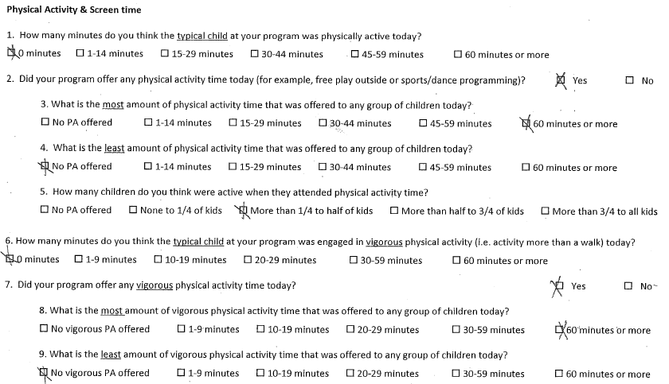
Completed Daily Practice Assessment

Slide 76
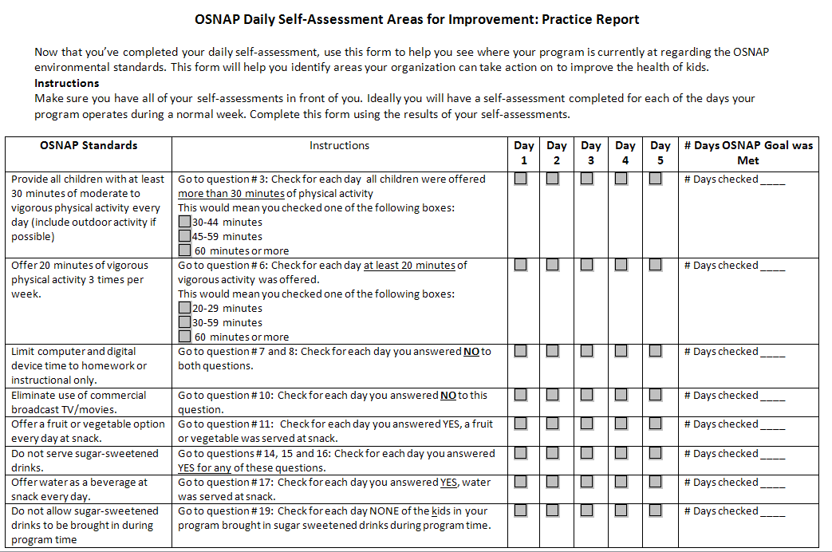
Notes:
This is designed to be straightforward, but I just wanted to briefly talk through this form. Go ahead and take out your 5 days of assessments. The left column states the OSNAP standard, for your reference. Then, there are instructions. In the first row, we see that we need to look at question three. So take your first self-assessment and look for question 3. Which box did you check? If you checked of 30-44 minutes, 45-59 minutes, or 60 minutes or more then what you do is put a check in the grey box under “Day 1” in the 3rd column. Then you do the same thing for the other days. Don’t worry about checking any of the boxes in the “Instructions” column. Then, at the end, you look at each row, count up the number of days that have checks, and write that number in the last column. Then compare that number to the OSNAP goal. How did you do?
Any questions?
[Direct groups to begin completing the Areas for Improvement sheet]
[Note to facilitator: If some groups did not bring their assessments, ask them to complete a blank assessment based on what happened yesterday at their program. Then use that assessment to complete the practice report]

Slide 77
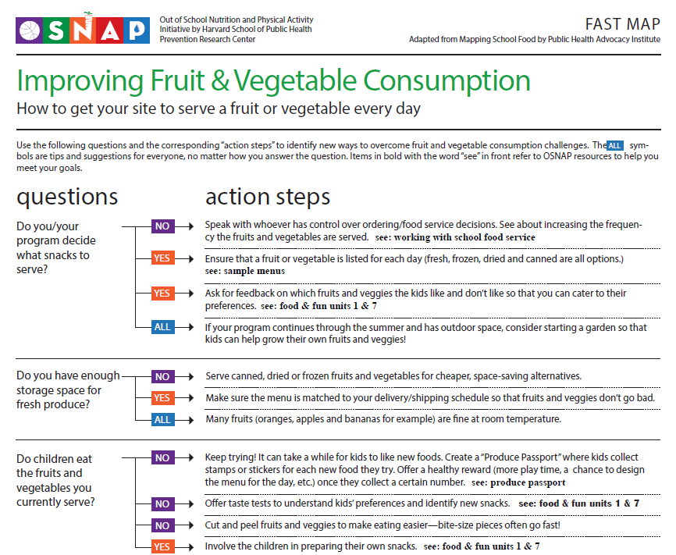
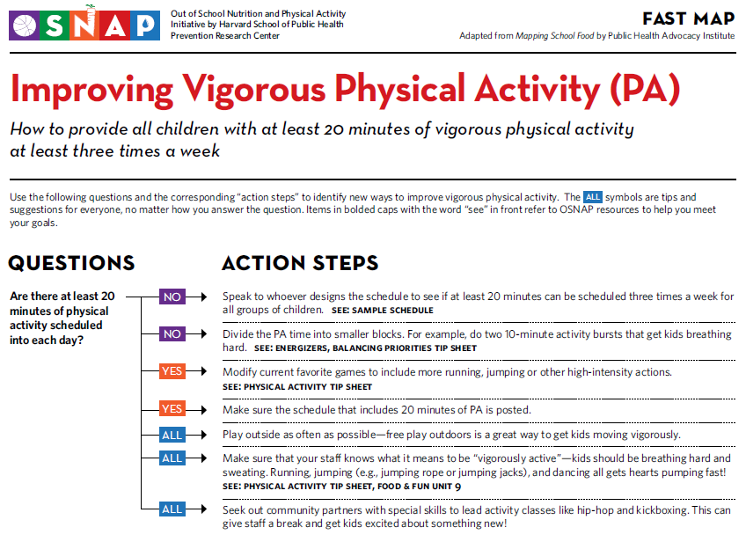
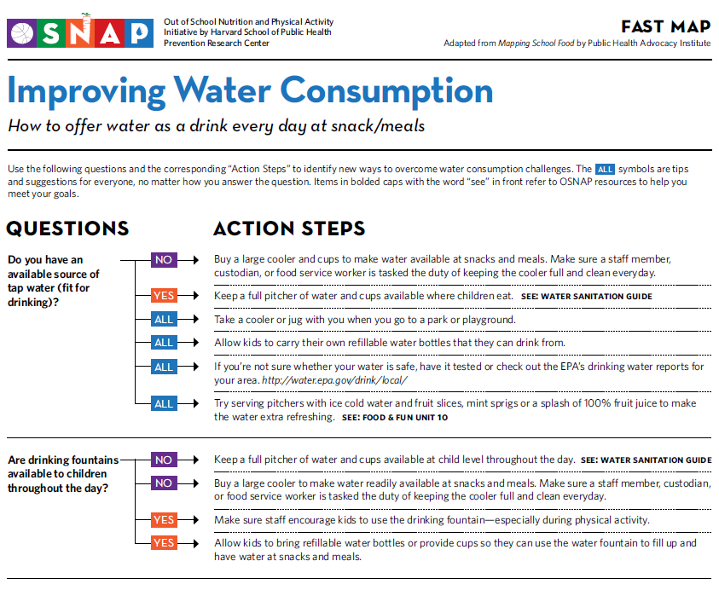
OSNAP Fast Maps
Notes:
Fast maps are a good resources for setting action steps to meet your OSNAP goals, especially at the structural level.

Slide 78



OSNAP Tip Sheets
Notes:
Tip sheets are a good resource to use at the site. They provide information on policies you can implement yourself.

Slide 79
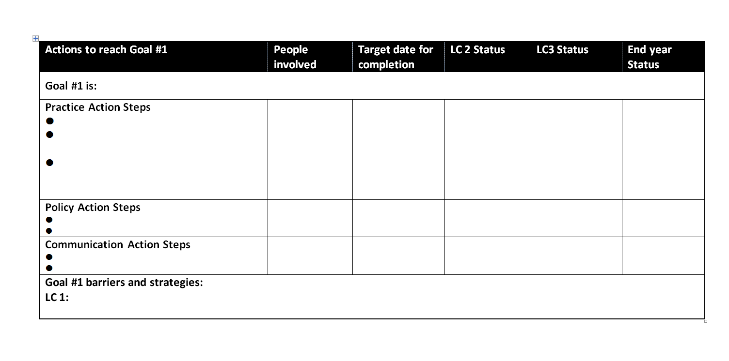
Action Planning Tool

Slide 80
Working with the Daily Practice Self-Assessment
Break into teams to walk through a sample self-assessment, areas for improvement and action plan

Slide 81
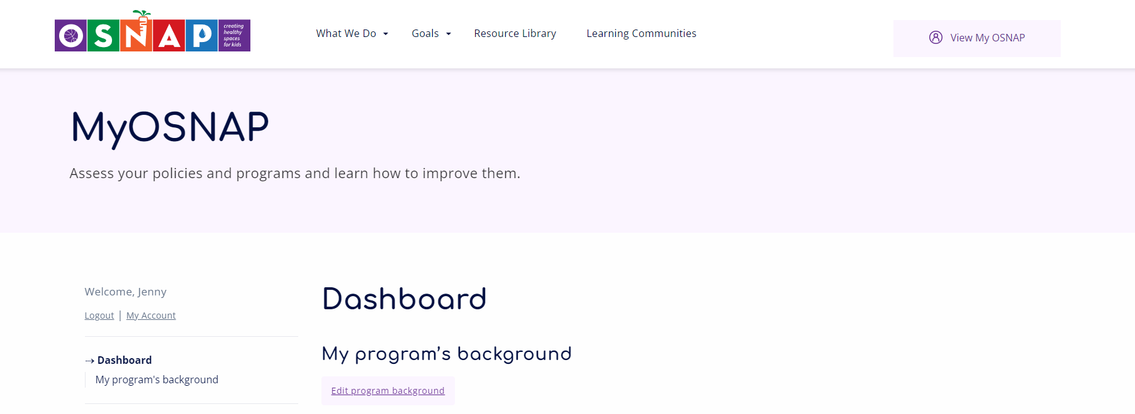
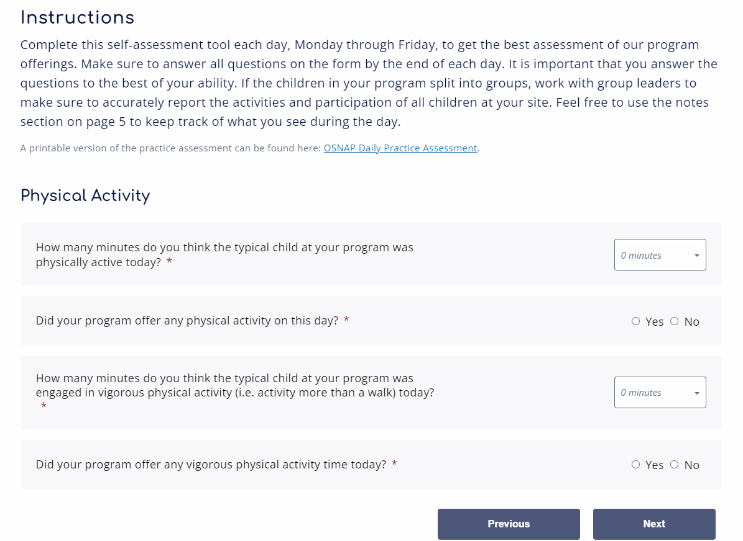
My OSNAP Portal
Participants can also complete assessments online via www.OSNAP.org
My OSNAP portal
  Create an account for your program
  Complete online assessment forms
  Track progress via your dashboard

Slide 82
Recap & questions
Share 1 goal and corresponding action steps with the group
What did you learn today?
Complete Learning Community Evaluation
What do you need from me[/my agency]?
Lingering questions…

Slide 83
Learning Community 1 Follow-Up
Facilitator’s Roles/Responsibilities:
Type Action Plans into electronic format (optional)
File completed Assessments that you collected.
Make copies of documents if you collected the original from the group
Review evaluations
Technical Assistance

Slide 84
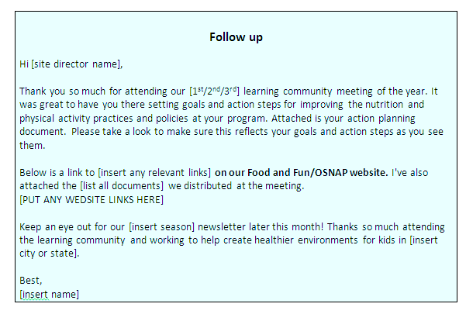
Technical Assistance
Send each site a specific tailored follow up email [See the OSNAP email templates]:
  Attach Action Plan and any supportive materials (and/or links) that relate to the goals the site set during the LC
  In the email, note anything you might have talked about with the programs but didn’t see mentioned on their action plans. Plan to bring up in the next meeting.
Notes:
Examples of technical assistance requests:
Information on the Child and Adult Care Food Program
Where to buy cups, pitchers and/or water jugs
Physical activity equipment ideas
Ideas for how to purchase lower cost fruits/vegetables

Slide 85
Implement & Communicate
Assess
Learn
Identify
Implement
Communicate
Track
Re-Evaluate

Slide 86
Learning Community 2

Slide 87
Prior to Learning Community 2
Reserve/confirm space, location, time/day
Revisit any important comments from LC1 evaluations; consider how they can be addressed in LC2.
Contact potential speakers or additional experts to invite to LC2.
  Ex : Master PE teachers, local organizations that offer physical activity trainings, the local school wellness committee chair or the local school food service director.

Slide 88
Prior to Learning Community 2
Ask sites to let you know how many staff members will be attending to give you an idea of how many people you need to prepare for.
Remind all sites via an email or phone call [see the OSNAP email templates]:
  To bring their binders from LC1 with them;
  To bring action plans with them;
  To bring program documents/policies with them if they haven’t given to you yet; and
  When and where LC2 will be held. Send directions.

Slide 89
Learning Community 2
  Learning Goals
  Strategies and resources for developing nutrition and physical activity policies
    Policy Assessment process begins
  Promote healthy eating and drinking
  Creative ways to get kids moving
  Activities
  Checking in on Action Plans
    Discuss successes and challenges encountered
  Assess policies and documents
  Revise Action Plans

Slide 90
LC2 Resources/Materials
  OSNAP Policy Assessment
  Policy Areas for Improvement
  Policy Writing Guide
  Resources for healthy eating and drinking: Working with Food Service
  Resources for physical activity
  Action Plans

Slide 91

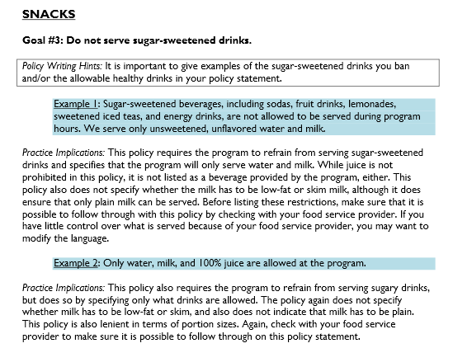
Policy Writing Guide
The next few slides walk through the LC 2 slides on crafting policies

Slide 92
Why Policy?
Lays the groundwork for practice and programs
Ensures that everyone is aware of what is expected from them and what they can expect from the program
Helps hold staff, caregivers, and children accountable for following the program’s rules
Helps ensure that program practices are sustained over time, even as staff changes by providing a written record
Available evidence suggests that policies in school settings can change food service, increase access to physical education, and improve children’s dietary intake.
  OSNAP Evidence: We’ve found that programs participating in OSNAP are more likely to have policy language related to physical activity and nutrition.
Notes:
Now that you’ve got a sense of where your program’s policies are and are not, we’re going to spend some time brainstorming some ways to improve your policy.
Before that, let’s talk for a moment about why policy is important.
[read through slide]

Slide 93
OSNAP Guide for Writing Afterschool Wellness Policies
Provides suggestions for language supporting physical activity at your school. Can be directly inserted in:
  Parent or family handbooks, staff handbooks, general program handbooks
  Letters to families, staff training materials, MOAs/MOUs, or even schedules
Includes explanation of how practices would have to be changed to implement the policy.
Notes:
To support you in writing policies that support the OSNAP standards, we have a policy writing guide.
[Hand out the OSNAP Guide for Writing After-School Wellness Policies.]
Talk through what the goal of this guide is ---
This guide is the primary tool to help you create policy. It has a lot of sample language that you can directly insert into your own documents, or that you can use as ideas to base your own policies off of, if you want to write them yourself.

Slide 94
OSNAP Guide for Writing Afterschool Wellness Policies (cont.)
Similar policy language has already been used in other programs like yours
Language can be adapted and changed to suit your needs
  Think carefully about what your changes might mean for practice.
  For example, a policy that states that teachers should include activity breaks in the daily schedule is weaker than a policy stating that teachers must include them.
Notes:
[read through slide]
Note to facilitator: Take time to walk participants through a section or two of the guide, talking through how the information examples can be used, how to navigate the guide, etc.

Slide 95
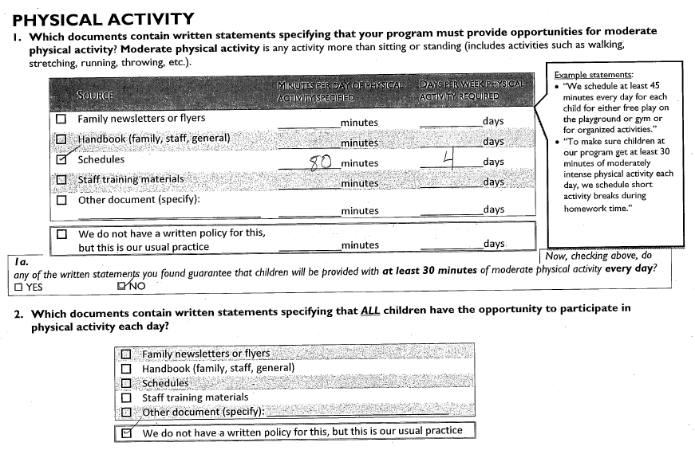
Completed Policy Self-Assessment

Slide 96
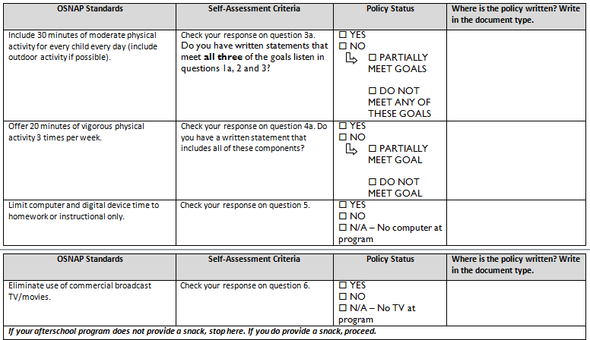
Policy Areas for Improvement

Slide 97
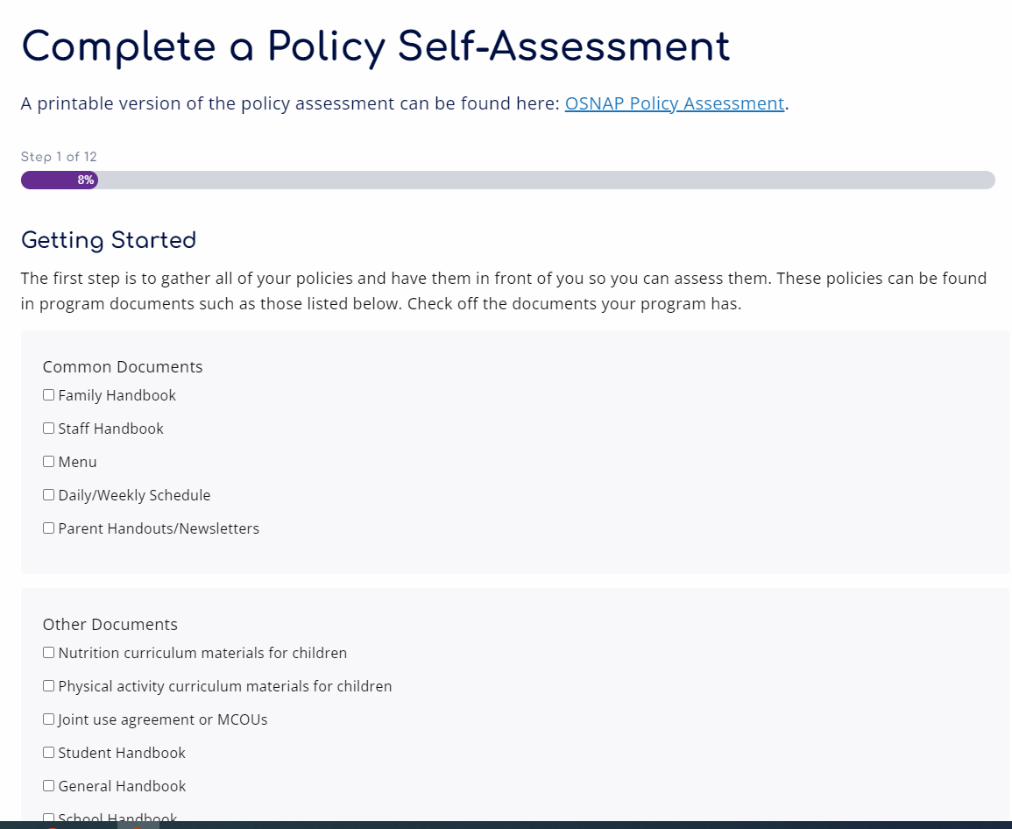
My OSNAP
Can also complete Policy Self-Assessment via www.osnap.org in the My OSNAP portal
Includes assessment report that identifies areas for improvement for policy change

Slide 98

Skill Development #1: Physical Activity Breaks
Notes:
In the OSNAP randomized control trial, we found that inclement weather, small spaces available to programs and limited time led to challenges with providing physical activity.
Even with those challenges there are ways to include more physical activity in your programs, even if it doesn’t seem like you have a lot of space. While we encourage outside free play time when possible, we know that that isn’t always possible. So today we’re going to do a series of activities that are perfect for small spaces, don’t require any or much equipment, and can be done even as a break during homework hour.
[Note to facilitator – choose an activity from each grade range and demonstrate with the group. The idea is to learn by doing – so get the whole group up and moving. Alternatively, if you have other partners who are experts in this – for example, the school district Wellness Coordinator or a master PE teacher – you could invite that person in to be a guest to demo activities.]
30-40 minutes

Slide 99
Resources for Physical Activity
Program Ideas
  What are programs already using?
  Who may be an expert resource in the group?
Curricula and Programs:
  SPARK
  Energizers
  Jammin’ Minutes
Local experts:
  School district staff: Health and Wellness, PE teachers
  Training organizations: Playworks, Playmakers

Slide 100

Skill Development #2: Healthy Eating & Drinking
Notes:
Now we’re going to spend time thinking through how you might best start to address the OSNAP goals around healthy eating and drinking. Just to re-cap, the goals are:
-Do not serve sugary drinks.
-Do not allow sugary drinks to be brought in during program time.
-Offer water as a drink at snack every day.
-Offer a fruit or vegetable option every day at snack.
-When serving grains (like bread, crackers, and cereals), serve whole grains.
-Do not serve foods with trans fat.
Today we’ll give you some tips based on the successes of programs like yours that have set goals and action steps around promoting nutrition in out of school time.

Slide 101
Skill Development #2:
Healthy Eating & Drinking
Water at snack every day
  Coolers or pitchers
  Don’t forget the cups!
No sugary drinks
  That means fruit punch, iced tea, lemonade, soda, sports drinks, energy drinks…
  Serve water at snack instead
  Try to limit the amount of juice served
  Set policies in your handbook & staff manual that ban sugary drinks from being brought to the program
Notes:
Let’s start by discussing healthy beverages.
Promoting water at snack has been a very successful strategy in out of school time settings. Program have approached this goal largely depending on the resources and space available to them. If they worked with school cafeteria staff for snacks, afterschool staff often found that filling a cooler with water was the simplest and most effective way to provide water at snack every day for kids. At programs that didn’t have access to a kitchen, staff often used water pitchers and filled them somewhere in a school building with safe water…a teachers’ room, bathroom, or classroom might have a sink they could use. This strategy might take a bit more time because pitchers are smaller and might need to be refilled, but the afterschool staff had more control and did not have to rely on school staff for help. For both strategies, it’s important to remember to have plenty of cups on hand! Kids won’t be able to drink the water you provide if they don’t have something to drink it from!
While we’ve found that most out of school time programs do not serve sugary drinks at snack, many programs allow staff and kids to bring in foods and drink from home. This can mean that children are drinking sugary drinks during the program even if the program-provided beverage is healthy. One of the most promising approaches to limit the consumption of these sugary drinks is to write a policy banning sugary drinks in your program handbook or staff manual. You could also ban kids from bringing in junk food like chips, candy, and cookies. If you don’t have the authority to change the written policy at your program you could send home a letter to parents instead or put a notice in a program newsletter.
Questions for group discussion:
Can you think if any strategies your program is already using to promote water and limit sugary drinks?
Which of these strategies do you think would work well at your program?
Note to facilitator: If you overheard groups talking about changes related to SSBs and water they’ve made, be sure to give them a shout-out here!
{optional handouts: water pitcher sanitation guide, water and SSB tip sheets, water and SSB quick guides}

Slide 102
Skill Development #2:
Healthy Eating & Drinking
Different resources for programs that purchase their own snacks vs. those that work with school food service
  Snack sense
  Sample menus
  Working with school food service
Replace juice with water & a whole fruit
Notes:
Changing the foods served during the snack period can be a bit more challenging that serving water and banning sugary drinks. That being said, there are a number of key considerations as you begin.
First, programs will choose different strategies depending on whether they buy their own snacks or get foods and drinks through the school food service department. If you buy your own snacks, Snack Sense is an excellent guide for planning low cost healthy snacks during out of school time. There are suggestions for inexpensive fruits & vegetables, whole grain products, and snacks free of trans fats and a sample menu that suggests a month’s worth of snack combinations that meet the OSNAP goals AND are reimbursable by the USDA snack program.
If the school department provides your meals, Snack Sense can also be a great guide for suggestions, but you may also have to look through the options available from the school system’s vendor and change may take a bit longer. Developing a positive relationship with the school food service staff is the most important first step towards making healthy changes in this context.
No matter how you get the foods and drinks you serve at snack, many programs have found that replacing juice with water and a whole fruit like an apple, orange, or banana can be an easy first step for improving nutrition. Whole fruits are contain more fiber and less sugar than juice but cost about the same amount so you can usually improve health and not cost your program any additional money.
Can you think if any strategies your program is already using to promote water and limit sugary drinks?
Which of these strategies do you think would work well at your program?
Note to facilitator: If you overheard groups talking about changes related to snacks they’ve made, be sure to give them a shout-out here!
Hand out snack sense
{Optional: whole grain, fv, trans fat tip sheets & quick guides}

Slide 103
Feedback & Planning
Break out into afterschool teams
Use teams’ completed daily self-assessments to complete the OSNAP Policy Self-Assessment Areas for Improvement
Update Action Plan based on experiences since Learning Community 1, new information presented in Learning Community 2 and policy areas for improvement
Notes:
Now that you’ve got the general idea, the rest of the time is for you all to create your action plans. Here’s the plan for the next hour or so:
You will all split up into small groups with other people from your program. If you’re the only person from your site, it’s OK, one person teams work too!
Using your self-assessments, complete the OSNAP Daily Self-Assessment Areas for Improvement: Practice Report. I’ll give an overview of this momentarily. Then, as a group, review the results from your self assessment. I will be circling through the groups to help you all interpret these results. Think about areas that might be “low hanging fruit” –is there something where a little change could make a big difference? Also, think about changes that might be harder but could have a really big impact in helping your program be a healthy place for the kids you serve. After this, you should have an idea of what you’d like to target to improve physical activity, nutrition, and screen time practices and policies at your program.
Look through the tip sheets and quick guides we’ve provided and think about the specific challenges your program faces and ways that you might address those challenges. Keeping your target areas in mind, what would be some steps/changes you’d like to see?
Once you’ve considered the range of options you have, narrow your focus down to 3 goals that you’re going to focus on before our next learning community. These can be goals that you expect to take the whole school year, or they might be shorter-term goals. The goals should reflect the OSNAP standards, but they can be focused on any area covered by the goals – PA, nutrition, screen time.
[Note to facilitators --– the policy and communication pieces are optional and go above and beyond at this point] Then, once you have your goals in mind, we want you to think not only about how something will change, but what are the related practice (and policy and communication steps that go with that goal? For example, if your goal is to ban outside snacks, then your practice might be “have kids only eat the provided snack, not allow any outside foods to be consumed at the program.” A policy goal might be “To put a policy in our family and staff handbooks that outside food and drinks will not be allowed at the program.” Remember that policies, especially when they’re included in places where people look for rules, can help make your changes last a long time and easier to enforce. Then, think about how you’re going to inform people about this goal – it’s an important step, especially if what you’re doing might seem unpopular at first. This will give you a chance to explain why you made this choice, and how kids and families can benefit. So in my example, I might set communication steps of “Sending a notice home with children that parents should not send snacks in with their child. Explaining to children during snack that food they buy or bring from school or elsewhere cannot be eaten during the program. Ask staff to support this by being good role models and not having outside food and beverages at work. Let families know that we will have a two-week grace period when we will remind children who bring other snacks what our new policy is. After two weeks, we reserve the right to confiscate any outside snacks. Parents can pick these up when they pick up their child…etc.” You want to think through each of these three things – practice, policy, and communication action steps.
Finally, please make two copies of this document – one for you to keep, and one for me to keep. [Note to facilitators – If you have a good scanner back at your office and everyone has reliable email access, then you can just collect the original Action Plans at the end of the LC, scan them in at your office, and then email every site a copy of their action plan. Or, if you have access to a portable scanner or can access a copy machine in the building, then the group only needs to make one copy and you can create a copy for yourself on the spot. Otherwise, if there are multiple people from a given site, have two people fill out identical action plans simultaneously. If all else fails, you can use a camera/smart phone to take a picture of the action plan. You just want a record of the goals the groups are setting, for your own tracking purposes and/or in case the site misplaces their copy]
This should be about 1 hour
20 minutes to review the feedback
20 minutes to brainstorm
20 minutes to fill out

Slide 104
Technical Assistance
Send each site a specific tailored follow up email [see the OSNAP email templates]
  Attach the revised action plan(if you have a scanned/digital copy) and any supportive materials (and/or links) that came out of the Learning Community
  Request copies of any written documents they’ve made since starting the Learning Communities (i.e. letters, policies, flyers, menus) to share with the rest of the Learning Community as a resource
  Ask for permission to share these materials with other sites

Slide 105

Fun ways to keep in touch: Example Newsletter

Slide 106
Learning Community 3

Slide 107
Prior to Learning Community 3
Reserve/confirm space, location, time/day
Revisit any important comments from LC2s evaluations; consider how they can be addressed in LC3.
Ask sites to let you know how many staff members will be attending to give you an idea of how many people you need to prepare for.
Remind all sites via an email or phone call [see ONSAP email templates]:
  To bring their binders with them
  To bring action plans with them
  To bring their completed policy assessments with them
  When and where LC3 will be held. Send directions

Slide 108
Learning Community 3- Overview
Learning Goals
Nutrition and physical activity communication and policy strategies and how staff can be healthy role models for children
Healthy alternatives for celebrations and rewards
Strategies for implementing and sustaining changes (including staff hiring and staff training)
Activities
Share stories of triumphs and challenges
Revise Action Plans

Slide 109
LC 3 Resources/Materials
Tip Sheet on how staff can be healthy role models for children - http://osnap.org/wp-content/themes/osnap.1.0/tip-sheets/healthy.pdf
Activities from Food & Fun Afterschool curriculum - http://foodandfun.org/?p=learn/staff/info&subject=About
Healthy alternatives for celebrations and rewards –
  https://osnap.org/resource-library/?_sf_s=Healthy%20Celebrations
  https://osnap.org/resource-library/?_sf_s=alternatives%20to%20food%20as%20a%20reward
OSNAP Afterschool Job Description Language and Interview questions - https://osnap.org/wp-content/uploads/2013/07/OSNAP-Job-Description-Language-Interview-questions.pdf
OSNAP 5 Step Approach to Implementing and Sustaining Nutrition and Physical Activity Change - http://osnap.org/wp-content/uploads/2013/07/5-Step-approach-to-Implementing-and-Sustaining-Nutrition-and-Physical-Activity-Change.pdf

Slide 110
Skill Development #1: Practices to support healthy eating and beverage consumption
Staff training to model healthy behaviors
Healthy celebrations
Food/PA as reward or punishment
Fundraising
Partnerships in the community (JUAs etc.)
Screen time (marketing, replacement activities)
Notes:
It sounds like you all are working on important changes.
Our first area for skill development today is practices to support healthy eating and beverage consumption [read through bullet list]

Slide 111
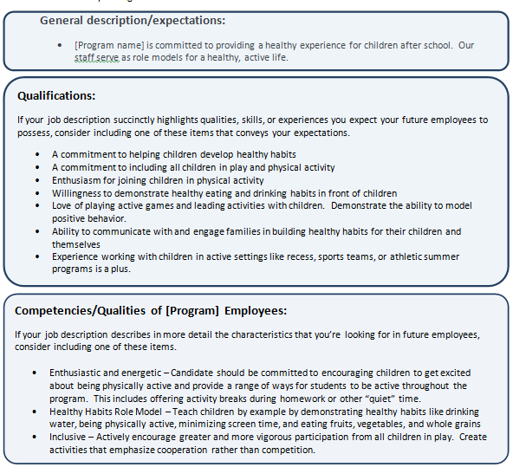
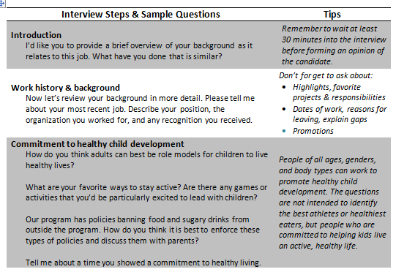
Sustainability
Hiring and interview guides

Slide 112
A 5-Step Approach to
Implementing & Sustaining
Nutrition & Physical Activity Changes
Moving forward
Notes:
[Insert a quick activity break of your choice here!]
In our final section of Learning Communities, I want to share with you all a 5-step approach to implementing & sustaining
the changes you’ve made in nutrition & physical activity.

Slide 113
5-Step Approach
Step 1: Identify your successes
Step 2: Track your progress
Step 3: Staff development
Step 4: Policy change
Step 5: Gain Support of Leaders
Notes:
[read through slide]

Slide 114
Feedback & Planning
Break out into afterschool teams
Update Action Plan based on experiences since Learning Community 2 and new information presented in Learning Community 3
Notes:
Now that you’ve got the general idea, the rest of the time is for you all to create your action plans. Here’s the plan for the next hour or so:
You will all split up into small groups with other people from your program. If you’re the only person from your site, it’s OK, one person teams work too!
Using your self-assessments, complete the OSNAP Daily Self-Assessment Areas for Improvement: Practice Report. I’ll give an overview of this momentarily. Then, as a group, review the results from your self assessment. I will be circling through the groups to help you all interpret these results. Think about areas that might be “low hanging fruit” –is there something where a little change could make a big difference? Also, think about changes that might be harder but could have a really big impact in helping your program be a healthy place for the kids you serve. After this, you should have an idea of what you’d like to target to improve physical activity, nutrition, and screen time practices and policies at your program.
Look through the tip sheets and quick guides we’ve provided and think about the specific challenges your program faces and ways that you might address those challenges. Keeping your target areas in mind, what would be some steps/changes you’d like to see?
Once you’ve considered the range of options you have, narrow your focus down to 3 goals that you’re going to focus on before our next learning community. These can be goals that you expect to take the whole school year, or they might be shorter-term goals. The goals should reflect the OSNAP standards, but they can be focused on any area covered by the goals – PA, nutrition, screen time.
[Note to facilitators --– the policy and communication pieces are optional and go above and beyond at this point] Then, once you have your goals in mind, we want you to think not only about how something will change, but what are the related practice (and policy and communication steps that go with that goal? For example, if your goal is to ban outside snacks, then your practice might be “have kids only eat the provided snack, not allow any outside foods to be consumed at the program.” A policy goal might be “To put a policy in our family and staff handbooks that outside food and drinks will not be allowed at the program.” Remember that policies, especially when they’re included in places where people look for rules, can help make your changes last a long time and easier to enforce. Then, think about how you’re going to inform people about this goal – it’s an important step, especially if what you’re doing might seem unpopular at first. This will give you a chance to explain why you made this choice, and how kids and families can benefit. So in my example, I might set communication steps of “Sending a notice home with children that parents should not send snacks in with their child. Explaining to children during snack that food they buy or bring from school or elsewhere cannot be eaten during the program. Ask staff to support this by being good role models and not having outside food and beverages at work. Let families know that we will have a two-week grace period when we will remind children who bring other snacks what our new policy is. After two weeks, we reserve the right to confiscate any outside snacks. Parents can pick these up when they pick up their child…etc.” You want to think through each of these three things – practice, policy, and communication action steps.
Finally, please make two copies of this document – one for you to keep, and one for me to keep. [Note to facilitators – If you have a good scanner back at your office and everyone has reliable email access, then you can just collect the original Action Plans at the end of the LC, scan them in at your office, and then email every site a copy of their action plan. Or, if you have access to a portable scanner or can access a copy machine in the building, then the group only needs to make one copy and you can create a copy for yourself on the spot. Otherwise, if there are multiple people from a given site, have two people fill out identical action plans simultaneously. If all else fails, you can use a camera/smart phone to take a picture of the action plan. You just want a record of the goals the groups are setting, for your own tracking purposes and/or in case the site misplaces their copy]
This should be about 1 hour
20 minutes to review the feedback
20 minutes to brainstorm
20 minutes to fill out

Slide 115
Technical Assistance
Send each site a specific tailored follow up email
  Attach the revised action plan(if you have a scanned/digital copy) and any supportive materials (and/or links) that came out of the Learning Community
  Request copies of any written documents they’ve made since starting the Learning Communities (i.e. letters, policies, flyers, menus) to share with the rest of the Learning Community as a resource
  Ask for permission to share these materials with other sites
Follow up with and finalize and paperwork that needs to be completed for issuing continuing education credit or college credit.
Plan an end-of-year OSNAP celebration (with healthy treats)
Make certificates for everyone who completed the OSNAP program.

Slide 116
Track &
Re-Evaluate
Assess
Learn
Identify
Implement
Communicate
Track
Re-Evaluate

Slide 117
Program Assessments
Following Learning Community 3, ask programs to complete practice assessments again
Collect or have programs mail in to you along with any revised documents they would like to share communicating their changed practices/policies to parents, staff and children

Slide 118
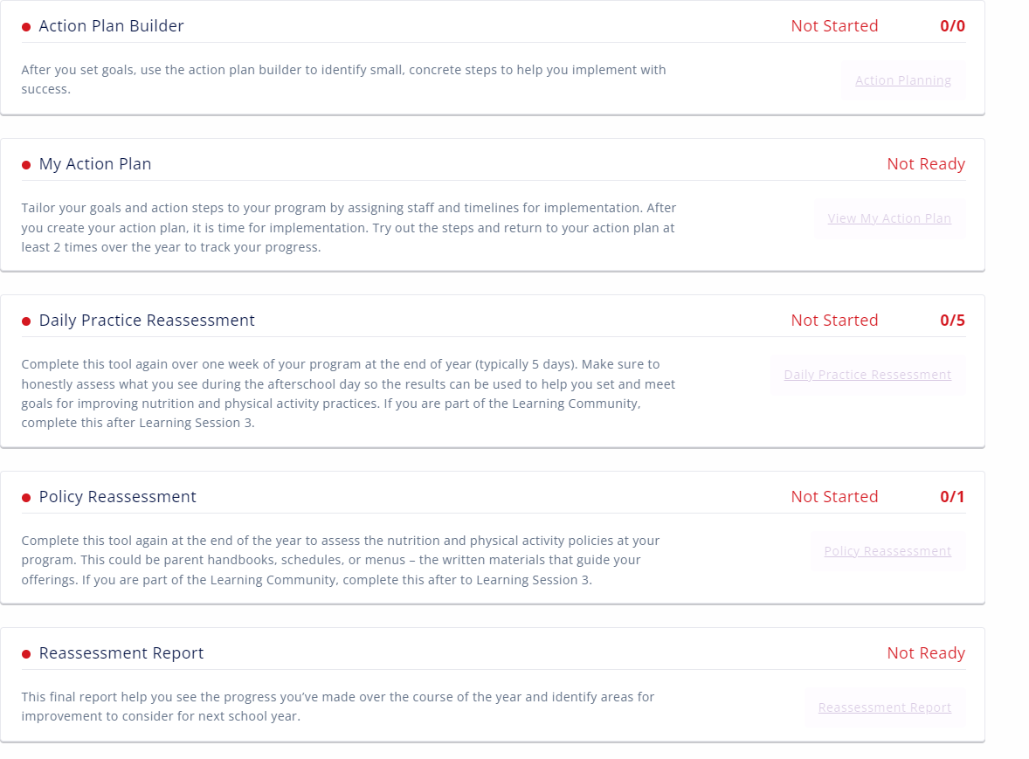
My OSNAP
Can also complete the re-assessment forms via www.osnap.org

Slide 119
Learning Community Challenges
Break into groups and brainstorm, based on your previous experiences, potential challenges facilitators may encounter in Learning Communities
Come up with solutions
Present back to group

Slide 120
Learning Community Challenges
Programs’ Action Plans are not linked directly to OSNAP Goals.
Programs aren’t finishing their Action Plans.
Programs are not completing or bringing their self-assessments.
Participants are not present for the entire Learning Community series.
Participants show up tired at the end of a long day.
Participants are not working well together.
Participants react negatively to a facilitator.
Programs are moving through the material too quickly.
Programs’ Action Plan items are not feasible.
There are significant language barriers

Slide 121
Other Trainings
SPARK
Playworks
Catch
Other?

Slide 122
OSNAP Evaluation
Registration Form
Practice Assessments
Agendas
Attendance sheets
Action Plans
Evaluations

Slide 123
Thank you!
Any outstanding questions?
Who to contact for support:
  Name
  Contact info
Please complete your evaluations and hand in.

