Slide 1


Learning Community 3
Out-of-School Nutrition & Physical Activity Initiative (OSNAP)

Slide 2
Agenda
Time | Task
6:00pm – 6:20pm | Progress “As the wind blows” -- Share improvements with the group
6:20pm – 6:45pm | Skills Development 1 Nutrition strategies
6:45pm – 7:15pm | Skills Development 2 Putting policies into place – handbook revision Institutionalizing and spreading change
7:15pm – 7:35pm | Afterschool team breakout/Dinner Revise Goals & Action Steps as necessary
7:35pm – 8:00pm | Wrap up & next steps Share goals Discuss challenges and next steps Ways the PRC can help Future learning community meetings & visits
Notes:
Note to facilitators: be sure to replace the times with the ones suitable for your meeting, and take out or replace dinner with another meal depending on what you are offering.
You still want to dedicate about 20 minutes to the intro and As-The-Wind-Blows activity, 55 min for skill development, 20 min for review and revision of the action plans, and 25 min wrap-up.

Slide 3
Meeting Objectives
Discuss any changes you have made over the past 2 months
Share successes and challenges around specific nutrition and physical activity goals
Learn to get kids moving with activity breaks in small spaces or when time is limited
Identify ways to improve the nutrition of food and beverages in affordable ways
Obtain resources for developing nutrition and physical activity policies
Revise goals/action plans and write innovation proposals for healthy changes at your program
Notes:
Here are our objectives for the day. By the time you leave today, we should have accomplished all of these things. In particular, we’re going to focus on developing some specific skills related to promoting physical activity, managing snacks, and writing policies.
[talk through objectives]
[Question – timing of the innovation proposals?]

Slide 4
Goals for Nutrition and Physical Activity in Out-of-School Time
Staying Active
Provide all children with at least 30 minutes of moderate to vigorous physical activity every day (include outdoor activity if possible).
Healthy Beverages
Do not serve sugary drinks.
Fruits & Vegetables
Offer a fruit and/or vegetable option every day at every meal and snack.
Limit Inactivity
Focus on Whole Grains
Offer 20 minutes of vigorous physical activity at least 3 days per week.
Do not allow sugary drinks to be brought in during program time.
Serve water every day
When serving grains (like bread, crackers, and cereals), serve whole grains. Whole grains should be listed as the first ingredient.
Eliminate use of commercial broadcast and cable TV and movies.
Limit computer and digital device time to homework or instructional time (instructional is defined as academic, teacher-led programming).
Notes:
Here are the OSNAP standards again, just to refresh your memory.
Note to facilitator: Could do interactively by having sites name as many as they can remember first, then going through the list.

Slide 5
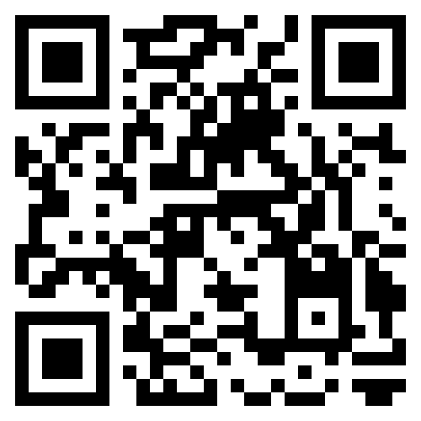
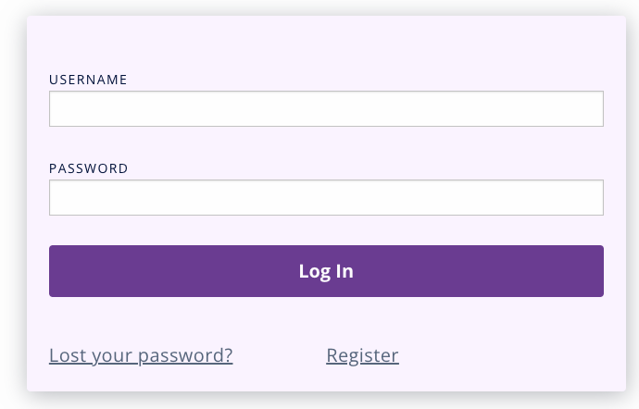

How to Register for My OSNAP
Did you know that you can access OSNAP materials electronically?
To register for My OSNAP:
Go to osnap.org and click “Log in to My OSNAP” or scan this QR code→
Click “Register” to create your account.

Slide 6

Learning Community 3 Progress
Sharing our successes in a physically active way!
“As the wind blows” activity
Notes:
Note to facilitator: Explain to group that today we’re also going to learn an active game as a way of talking about the things we’ve all done since last time. This game is called “As the wind blows;” explain the game as it’s described below. You can also bring a hand-out of the instructions if you think sites would like to remember the instructions/game to take back to their programs.
Instructions for “As the wind blows”
Find an open space – either go outside, into a gym, or push all the desks and chairs against the wall.
Have everyone stand in a big circle; there should be nothing in the middle of the circle. It’s OK if it’s not actually a circle, just as long as everyone is standing next to two people.
One person stands in the middle and is “it”. This person thinks of something his/her program has done or is doing that relates to the OSNAP standards. In general, it’s better to be specific so the game can go on for longer because there are more things that people will have done. However, the statements should still be general enough that there are other people who could have done the same thing.
“It" states this action in a sentence that begins with the words "A cold wind blows." For example:
"A cold wind blows for anyone who puts pitchers of water on the table at snack."
"A cold wind blows for anyone who banned sugary drinks".
"A cold wind blows for anyone who banned outside snacks."
"A cold wind blows for anyone who joined in physical activity at their program this week.“
All of the players for whom the cold wind blows—that is, players that fall into the named category—must leave their spaces and try to find another space (where someone else was standing before – no squeezing in to a made-up space!) At the same time, "it" attempts to find a space in the circle too. When all spaces are occupied, the person who failed to get a space becomes "it" for the next round.
If you have a good chunk of time, the ideal way to play this game would be to go around at the end of every round and have everyone who “had a cold wind blow” talk about their changes. What exactly did they do? Did they face any expected or unexpected challenges? What were the necessary logistics? Have they gotten any positive feedback? The idea is to get everyone talking about their successes in a way that celebrates success and gets other programs thinking about how those changes might be possible at their sites too.
Play the game for 20 minutes, including time for instructions.
[Note to facilitator: if it’s hard to see where the “spaces” are in the circle, or you all can’t quite fit in a circle – if you are in a classroom, just have everyone stand by a chair. Wherever there’s a chair, there’s a “space” – but no sitting allowed during the game!]
[Note to facilitator–If there are very few people in your Learning Community or if there are other reasons that “As the wind blows” doesn’t work -- you can just have groups share out as they’ve done in prior LCs. There’s a prompt slide included at the end of this presentation to help guide that discussion. You could also reach out before the meeting to people/sites people who you know have made great progress to share specifically.

Slide 7
Skills Development #1
Nutrition Strategies

Slide 8
Skill Development #1: Practices to support healthy eating and beverage consumption
Staff training to model healthy behaviors
Healthy celebrations
Food/PA as reward or punishment
Fundraising
Partnerships in the community (JUAs etc.)
Screen time (marketing, replacement activities)
Notes:
It sounds like you all are working on important changes.
Our first area for skill development today is practices to support healthy eating and beverage consumption [read through bullet list]

Slide 9
Making healthy choices easy!
People make 227 food-related decisions every day!
What factors influence how much food and drink we consume?
  Food and eating environment
  Package and plate size
  Amount of food/drink people around us consume
  Availability and effort to obtain food
Some easy strategies:
  Water pitchers on the tables
  Place healthier snack options in front of less healthy items
  Put away leftover foods at the end of snack
  Staff and peer modeling
  Ask kids to talk about the fruits & vegetables they like to eat or how much water they’ve been drinking
Notes:
People make a ton of choices about what they’re going to eat and drink every day – as many as 227!
There are a variety of things that influence our choices. Can anyone name some things that might cause you to eat more or less?
[leave a minute or two here for people to brainstorm. To get things going, you could offer some suggestions like “what I have in my fridge” “if I’m on a date” “when I’m at happy hour” “being at an all-you can eat buffet” “going to a during the Superbowl” to get people thinking about how contexts matter. Once people have offered some ideas, click forward and the bulleted list will fill in. Relate the ideas people suggested to these factors.]
Thinking about these kinds of factors can help us make healthy choices easier! For example, if we want kids to drink water, then it makes sense to have water really easily and obviously available by putting it in the middle of the snack table, along with cups. Similarly, make the healthy options the easiest to reach. Or if we don’t want people to overeat, then we should put away leftovers at the end so people don’t just keep grazing and munching because they see the food. Staff and other kids can set really important examples and shape the food environment by eating and drinking healthy foods. If kids see you eating a piece of fruit every day, it will seem natural.
Source: Wansick, 2004

Slide 10
Encouraging healthy eating & drinking in afterschool
Messages should be short, simple, positive, and motivational!
NOT lectures, negative, guilt producing, or humiliating
Foster an interest in trying new foods, drinks, and activities
Develop healthy behaviors early in life
Emphasize that being healthy can help kids feel strong and fit, improve moods, promote learning. It’s also FUN!
Great resources: Tip Sheets and “Key Information for Program Staff” in each Food & Fun Unit
Notes:
[Note to facilitator: Have staff look over Key information for Staff for fruits and vegetables from Food & Fun
Highlight these positive messages as opposed to talking about dieting, being overweight, etc.]

Slide 11
Staff Modeling
Encourage staff to sit down with kids at snack time
Ban staff from eating unhealthy foods and drinks in front of kids
  Limit to water & foods listed on the Snacking Bridge handout
Make these rules around staff modeling part of your program policy
  Include policies in staff handbooks
  Make them known to parents and children
  Post with other policies at sign in table/in program space
Review the importance of modeling as part of your hiring process and during staff orientation/trainings
Notes:
[Note to facilitators: hand out copies of “Getting Staff On Board” and Healthy Staff/Healthy Kids -Staff Engagement Tip Sheet]
As adults, we set important examples for kids. Even when you don’t think anyone notices what you’re eating or drinking, chances are, you’re making an impression. Sometimes staff can be resistant to changes in what they are allowed to consume while at work. While it’s true that they’re adults and have much more choice about what to eat than the children in your program, getting your staff to be good role models goes a long way in creating a healthy environment at your program.

Slide 12
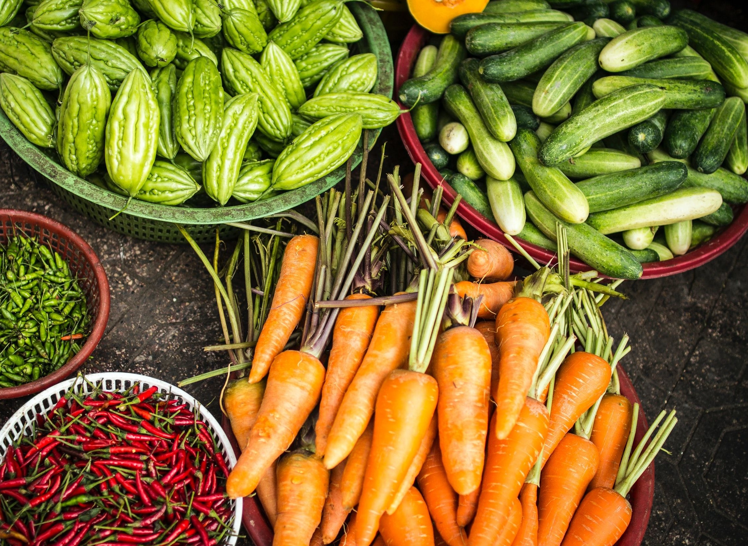
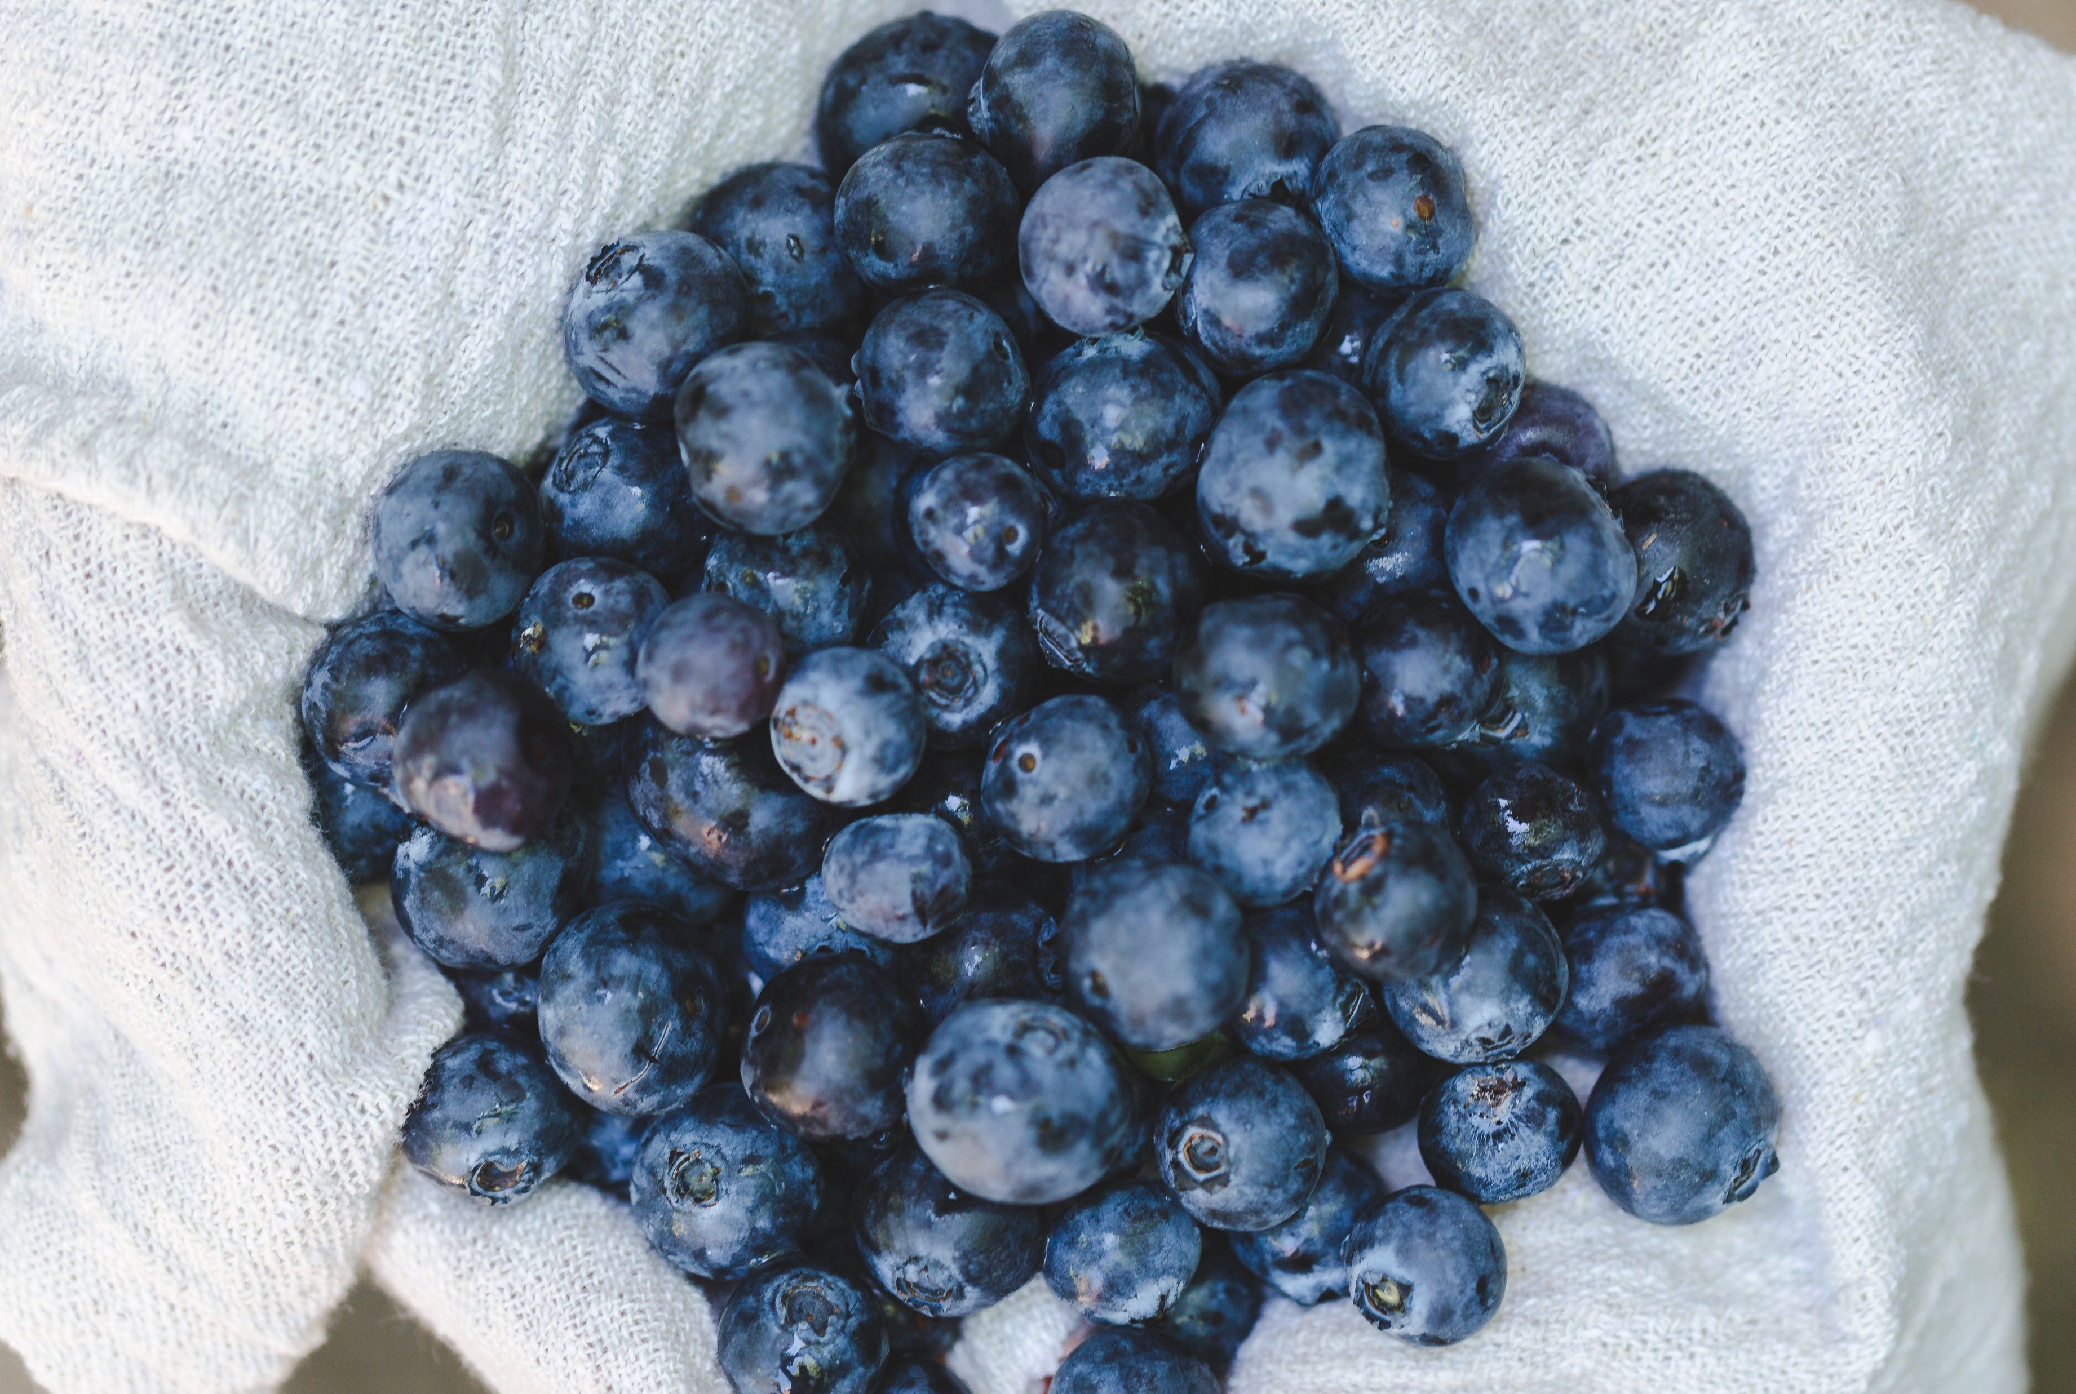
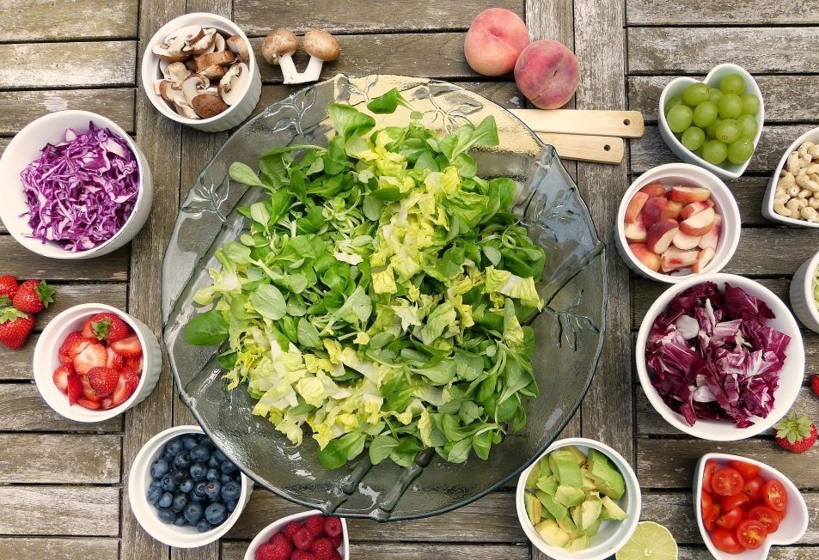

Using food as a reward sends a conflicting message
These are the foods that are healthy and good for you
Notes:
Even when we have really good intentions, sometimes we send mixed messages. For example, here are some foods that are good for you…
[Slides 10-13 10 minutes]

Slide 13
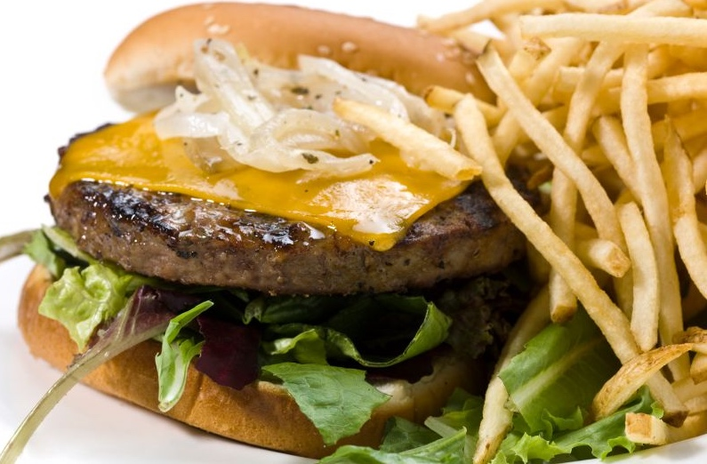



Using food as a reward sends a conflicting message
These are the foods that we give you when you are good
Notes:
…and then here are some foods that people get when they’ve been good!

Slide 14
Alternatives to food as a reward
Social rewards: verbal praise, smiles etc.
Recognition: ribbons, certificates, stickers, daily announcements, photo recognition board, positive letter home to parents
Privileges: going first, helper of the week, choosing an activity or game, sitting by friends during homework, reading to younger kids
Fun group rewards: earning extra time playing outside or in the gym, eating snack or doing homework outside, short dance or physical activity breaks, listening to music during homework
Items for a treasure box: pencils, erasers, stamps, bookmarks, chalk, markers, glitter, water bottles, jump ropes, balls, frisbees, cards, silly bands, temporary tattoos, key chains, magnets
Notes:
Some ideas for doing more healthy celebrations include
[talk through the bullet points; can provide copies of the handouts/resources listed in the Implementation Guide]
Also talk about alternatives to sitting out of PA as punishment

Slide 15












Healthy Celebrations
Notes:
We’ve all been there – it’s someone’s birthday at school or work, so there’s cake! The argument is that everyone only has one birthday a year, so what’s the harm in a sweet treat? But the truth is that there are a lot of celebrations that we like to load up with sugary and other unhealthy snacks for. We have put together several resources that offer alternative ways to honor someone’s special day or celebrate a happy occasion. [Can hand out copies of healthy celebration resources listed in the Implementation Guide]
Snack sense and the Food and Fun recipe packet are great resources for finding health, low cost ideas for celebrations at your program

Slide 16

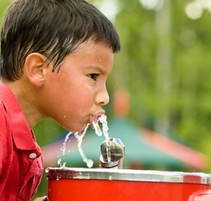
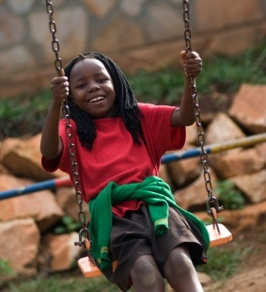
Springtime is here!
Open up the doors and play!
Make use of playgrounds, fields, and courts at or nearby your program
Revisit ideas for offering at least 30 minutes of physical activity for all kids
Can you offer active time for all kids at the beginning of the afterschool day?
Don’t forget activity breaks during homework time
Let kids recharge, de-stress, and run around during end of year testing
Notes:
One more thing before we move on to talking about sustaining change…
Spring is here!!
[read through bullet points]

Slide 17
Skill Development #2:
Putting policies into place

Slide 18
Skill development #2:
Putting policies into place
What changes can be made before the next school year?
Implementation and Dissemination Strategies
Notes:
Since this is our last Learning Collaborative of the year, I want everyone to start thinking ahead to things that you can do between now and the start of the next school year. We’ve heard from a lot of people that their handbooks get revised over the summer – which is a great opportunity to insert policies about the changes you’ve been working on (if you haven’t done so already).
Are there other things that relate to OSNAP that you think will be easier to accomplish over the summer? [For example, will you have the chance to change food service vendors or rework contracts… etc.]

Slide 19

Policy writing & communication
How do you make policy happen?
  Assess your current policies
  Set goals around the creation of new policies
  Use resources to write those policies
  Communicate your new or changed policies to staff and family
Let’s do it!
  Take Action
    Where will the policy go (handbook)?
    What will the policy say?
Celebrate Success
  Who will make sure the policy is implemented?
  How will you tell others about the policy?

Slide 20
A 5-step Approach to
Implementing & Sustaining
Nutrition & Physical Activity Changes
Moving forward!
Notes:
Insert a quick activity break of your choice here!]
In our final section of Learning Communities, I want to share with you all a 5-step approach to implementing & sustaining
the changes you’ve made in nutrition & physical activity.

Slide 21

Step 1: Identify your successes
Use credibility gained from short-term success to press for bigger change in your organization
Ask yourself:
  What are 1 or 2 short-term successes that I want to share with others in your organization?
  What larger changes would I like to make within my organization moving forward?
Resources:
  OSNAP action planning document
Notes:
[read through slide]

Slide 22

Step 2: Track your progress
Keep tracking your progress with the OSNAP practice and policy self-assessments
Ask yourself:
  How will I keep track of my progress moving forward?
  When will I complete the self-assessments?
  How can I build the self-assessments into regular program practice?
Resources:
  OSNAP observational self-assessment
  OSNAP policy coding tool
Notes:
[read through slide]
[If you have a laptop projector and internet access available, you can show everyone where to navigate to on the OSNAP webpage to find the resources listed]

Slide 23

Step 3: Staff development
Get the right people on board
Ask yourself:
  Who will continue to lead nutrition and physical activity efforts at my program?
  Will the site director be in charge or will responsibilities be delegated to other program staff?
  How can I hire staff that are enthusiastic about encouraging healthy eating & physical activity?
  How can I continue to train staff (new & old) on the importance of nutrition and physical activity?
Resources:
  OSNAP PowerPoint templates
  OSNAP interview tips & job description language
Notes:
[read through slide]
[pass out copies of the OSNAP interview tips & job description language, talk through those briefly. Point out that these hiring suggestions don’t mean to find only super healthy, super athletic people, but rather people who are devoted to being healthy role models for children, no matter what size, shape, etc. they might be!]
[If you have a laptop projector and internet access available, you can show everyone where to navigate to on the OSNAP webpage to find the resources listed]

Slide 24

Step 4: Policy Change
Set policies to ensure change is reaching all levels and programs in the organization
Ask yourself:
  What policies could be made to improve the nutrition and physical activity environments across your organization? What would they look like (e.g. changes to staff manuals, family handbooks, required training)?
  What other parts of your organization could learn from the OSNAP health objectives?
  What do you see as barriers to creating policy changes throughout your organization and what supports do you need to overcome these challenges?
Resources:
  OSNAP policy writing guide
Notes:
[read through slide]
[If you have a laptop projector and internet access available, you can show everyone where to navigate to on the OSNAP webpage to find the resources listed]

Slide 25


Step 5: Gain Support of Leaders
Ask yourself:
  Who do you need to involve to sustain and spread the nutrition and physical activity changes you’ve made in OSNAP?
  How will you gain organizational leaders’ support?
Resources:
  OSNAP Action Planning Document
Notes:
[read through slide]

Slide 26
Moving Forward!
Policy change
  Staff & family handbooks
  Schedules
New staff trainings
  Slides and handouts
  Videos
Job descriptions & interview guides
Ideas to spread throughout your organization
  Agency-specific learning communities
  Peer mentoring
OSNAP and Food & Fun Afterschool online
  Web materials
  Apps
Notes:
Here is a list of resources to remember as you plan for moving forward.
[read through slide]
[If you have a laptop projector and internet access available, you can show everyone where to navigate to on the OSNAP webpage to find the resources listed]
[Note to facilitator -- Then, break everyone out by org (Y, Boys and Girls Club, BCYF) to start completing the “A 5 Step approach to Implementing and Sustaining Nutrition and Physical Activity Change“ worksheet (10-15 mins)]

Slide 27
Afterschool team breakout
Break out into afterschool teams
Revise & update OSNAP Action Planning Document
Use observation and policy reports, tip sheets and quick guides to brainstorm priorities
Decide on practice, policy, and communication action steps for each goal
Set action steps for the remainder of the school year & any for summer in preparation for the new school year
Complete 2 copies of the OSNAP Action Planning Document

Slide 28
Recap & Questions
Share your end of year goals
What did you learn today?
How might you apply the new skills you developed?
What do you need from the PRC?
Lingering questions…
Notes:
Set aside 5-15 minutes
If we do an evaluation this would be the time

Slide 29
Next steps
Complete Nutrition and Physical Activity Planning Tool each month
Spring 2012 surveys, interviews, and self-assessments
End of year OSNAP celebration
Notes:
[feel free to add any additional final remarks or notes you want to make]
[provide date/time of OSNAP celebration if already known]

Slide 30
Acknowledgements
The Out-of-School Nutrition and Physical Activity Initiative (OSNAP) was developed as a research project at the Prevention Research Center on Nutrition and Physical Activity at the Harvard T.H. Chan School of Public Health (HPRC) (2009 – 2015).
Funding
This work and the Prevention Research Center on Nutrition and Physical Activity at the Harvard T.H. Chan School of Public Health (HPRC) is supported by the Centers for Disease Control and Prevention (U48DP001946 and U48DP006376), including the Nutrition and Obesity Policy Research and Evaluation Network, as well as support from the Donald and Sue Pritzker Nutrition and Fitness Initiative and the Robert Wood Johnson Foundation (#66284). The findings and conclusions are those of the author(s) and do not necessarily represent the official position of the Centers for Disease Control and Prevention or other funders.
For more information about OSNAP, visit: www.osnap.org
For more information about HPRC, visit: www.hsph.harvard.edu/prc

Slide 31
Where do you stand?
What healthy goal does your strategy aim to support?
What did you do? How did you do it?
  Was it successful?
  What might you do differently if you did it again?
Did you face any challenges?
  Was it difficult to make the changes?
  Were their any barriers that you did not anticipate?
  How can you overcome these challenges?
Can you share any flyers, letters, or policies with others?
Have you used this strategy to encourage other healthy behaviors?
  Could this be a next step?
Notes:
[PROMPT SLIDE IF “”AS THE WIND BLOWS” ISN’T PLAYED]
[Note to facilitator ]– wrap up the presentations by highlighting the successes and achievements that programs talked about. If any noted problems related to today’s skill development topics, also note those and point out that today everyone will gain additional tools to fight those barriers with.
Use tip sheets to give participants permission to name common barriers→ bring binder

