Slide 1


Learning Community 2
Out-of-School Nutrition & Physical Activity Initiative (OSNAP)
Notes:
Note to facilitator: Thank everyone for coming. You may wish to start with an ice breaker and have everyone introduce him/herself. Information you should have people share is their names, which program they come from, and what their role at the program is.
Active icebreaker.
Ice breaker idea: Have each person say something active they did this week or last weekend and make that motion while they say their name. Example: “My name is Anthony and played basketball” *jumps and does shooting motion*→ everyone says “Hi Anthony” and repeats his jump.

Slide 2
Agenda
Time | Task
10:00am – 10:20am | Progress Review Action Planning Documents Small groups by topic Discuss improvements and challenges
10:20am – 11:00am | Skills Development 1 Physical activity breaks
11:00am – 11:30am | Skills Development 2 Healthy eating & drinking
Notes:
Note to facilitators: be sure to replace the times with the ones suitable for your meeting, and take out or replace lunch with another meal depending on what you are offering.
You still want to dedicate about 20 minutes to intro and break out groups, 40 minutes for PA skills training and transition, 30 minutes for nutrition training, 30 minutes for policy training, review and revision of the action plans, and 15 min wrap-up.

Slide 3
Agenda (continued)
Time | Task
11:30am – 12:00pm | Skills Development 3 Introduction to policy writing Policy Assessment
12:00pm – 12:45pm | Afterschool team breakout/Lunch Complete Policy Assessment Revise Goals & Action Steps
12:45pm – 1:00pm | Wrap up & next steps Share goals Future learning communities & trainings
Notes:
Note to facilitators: be sure to replace the times with the ones suitable for your meeting, and take out or replace lunch with another meal depending on what you are offering.
You still want to dedicate about 20 minutes to intro and break out groups, 40 minutes for PA skills training and transition, 30 minutes for nutrition training, 30 minutes for policy training, review and revision of the action plans, and 15 min wrap-up.

Slide 4
Meeting Objectives
Discuss any changes you have made over the past 2 months
Share successes and challenges around specific nutrition and physical activity goals
Learn to get kids moving with activity breaks in small spaces or when time is limited
Identify ways to improve the nutrition of food and beverages in affordable ways
Obtain resources for developing nutrition and physical activity policies
Revise goals/action plans and write innovation proposals for healthy changes at your program
Notes:
Here are our objectives for the day. By the time you leave today, we should have accomplished all of these things. In particular, we’re going to focus on developing some specific skills related to promoting physical activity, managing snacks, and writing policies.
[talk through objectives]

Slide 5
Goals for Nutrition and Physical Activity in Out-of-School Time
Staying Active
Provide all children with at least 30 minutes of moderate to vigorous physical activity every day (include outdoor activity if possible).
Healthy Beverages
Do not serve sugary drinks.
Fruits & Vegetables
Offer a fruit and/or vegetable option every day at every meal and snack.
Limit Inactivity
Focus on Whole Grains
Offer 20 minutes of vigorous physical activity at least 3 days per week.
Do not allow sugary drinks to be brought in during program time
Serve water every day
When serving grains (like bread, crackers, and cereals), serve whole grains. Whole grains should be listed as the first ingredient.
Eliminate use of commercial broadcast and cable TV and movies.
Limit computer and digital device time to homework or instructional time (instructional is defined as academic, teacher-led programming).
Notes:
Here are the OSNAP standards again, just to refresh your memory.
Note to facilitator: Could do interactively by having sites name as many as they can remember first, then going through the list.

Slide 6

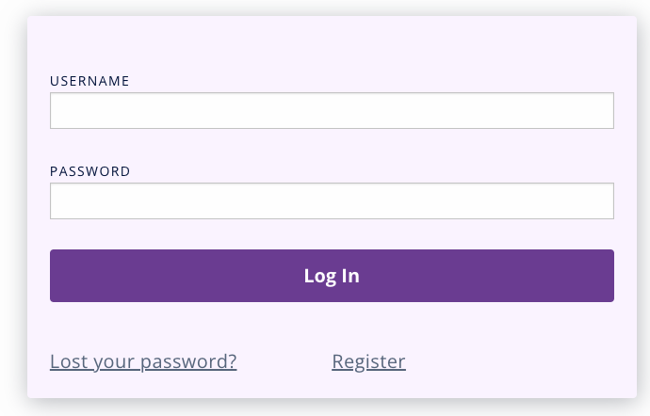

How to Register for My OSNAP
Did you know that you can access OSNAP materials electronically?
To register for My OSNAP:
Go to osnap.org and click “Log in to My OSNAP” or scan this QR code→
Click “Register” to create your account.

Slide 7
Topic Specific Breakout Groups (15 minutes)
Choose breakout group based on the health goals you set on your Action Planning Document at Learning Community 1
Share the practice, policy, and communication improvements your program has worked on over the past 2 months
Discuss any challenges you’ve faced trying to reach these goals
Notes:
For the next 15 minutes, I want us to start by breaking into small groups based on the goals you set at our last meeting.
You may have been working on multiple goals, so choose the goal that you focused on most over the past few months. If more than one person is attending from your program, you can split up and attend different groups so you can hear more about the changes other programs are making. This is an opportunity to discuss and share, so take full advantage!
In your small group, please share the practice, policy, and communication improvements your program has worked on over the past 2 months. We hope that these groups can be a great place for exchanging ideas and tips, so also be sure to discuss challenges you faced and how you managed to work around them or what you’re still struggling with, and then as a group, brainstorm and discuss possible solutions.
I’m going to put a set of questions up on the screen during this time that can guide your discussion. (note: fast forward one slide to preview the questions) I’ll give you a warning when there are 5 minutes left.
[point out where each group should meet.]
Note to facilitator - -you should think about where groups will meet ahead of time, and be prepared to try to spread groups out as much as possible. Given limited space, we suggest having a “water goals,” “sugary drinks goals,” “snack goals,” “physical activity goals,” and “screen time goals” groups (5 total). If necessary, you could combine sugary drinks and water into “beverage goals.”
15 minutes

Slide 8
Where do you stand?
What is one action step you’ve taken towards reaching this healthy goal?
  Do you think you have fully achieved this goal?
  What more do you need to do to achieve this goal?
Did you face any challenges to the action steps you set?
  Was it difficult to make changes?
  Were their any barriers that you did not anticipate?
Do your program policies reinforce this healthy goal?
Have you communicated with children, parents and staff about this healthy goal?
Have you used Food & Fun to reinforce this healthy goal? Which lessons?
Notes:
Note to facilitator: leave these questions on screen during 15 minute breakout. As the groups are meeting, circulate through them and listen for accomplishments, barriers, and strategies to overcome the barriers. Try to note at least a few examples that you can use in the next stage to give positive public recognition to a couple of programs.]
Use tip sheets to give participants permission to name common barriers→ bring binder
Opportunity for positive public recognition when group comes back together

Slide 9

Skill Development #1:
Physical Activity Breaks
Notes:
Now I want to share some very specific ways to include more physical activity in your programs, even if it doesn’t seem like you have a lot of space. While we encourage outside free play time when possible, we know that that isn’t always possible. So today we’re going to do a series of activities that are perfect for small spaces, don’t require any or much equipment, and can be done even as a break during homework hour.
[Note to facilitator – choose an activity from each grade range and demonstrate with the group. The idea is to learn by doing – so get the whole group up and moving. Alternatively, if you have other partners who are experts in this – for example, the school district Wellness Coordinator or a master PE teacher – you could invite that person in to be a guest to demo activities.]
[Pass out physical activity resources handout (e.g., Jammin’ minutes or SPARK)
30-40 minutes

Slide 10

Skill Development #2: Healthy Eating and Drinking
Notes:
Now we’re going to spend time thinking through how you might best start to address the OSNAP goals around healthy eating and drinking. Just to re-cap, the goals are:
-Do not serve sugary drinks.
-Do not allow sugary drinks to be brought in during program time.
-Offer water as a drink at snack every day.
-Offer a fruit or vegetable option every day at snack.
-When serving grains (like bread, crackers, and cereals), serve whole grains.
-Do not serve foods with trans fat.
Today we’ll give you some tips based on the successes of programs like yours that have set goals and action steps around promoting nutrition in out of school time.

Slide 11

Skill Development #2:
Healthy Eating & Drinking
Serve water every day
  Coolers or pitchers
  Don’t forget the cups!
No sugary drinks
  That means fruit punch, iced tea, lemonade, soda, sports drinks, energy drinks…
  Serve water at snack/meals instead
  Try to limit the amount of juice served
  Set policies in your handbook & staff manual that ban sugary drinks from being brought to the program
Notes:
Let’s start by discussing healthy beverages.
Promoting water at snack has been a very successful strategy in out of school time settings. Program have approached this goal largely depending on the resources and space available to them. If they worked with school cafeteria staff for snacks, afterschool staff often found that filling a cooler with water was the simplest and most effective way to provide water at snack every day for kids. At programs that didn’t have access to a kitchen, staff often used water pitchers and filled them somewhere in a school building with safe water…a teachers’ room, bathroom, or classroom might have a sink they could use. This strategy might take a bit more time because pitchers are smaller and might need to be refilled, but the afterschool staff had more control and did not have to rely on school staff for help. For both strategies, it’s important to remember to have plenty of cups on hand! Kids won’t be able to drink the water you provide if they don’t have something to drink it from!
While we’ve found that most out of school time programs do not serve sugary drinks at snack, many programs allow staff and kids to bring in foods and drink from home. This can mean that children are drinking sugary drinks during the program even if the program-provided beverage is healthy. One of the most promising approaches to limit the consumption of these sugary drinks is to write a policy banning sugary drinks in your program handbook or staff manual. You could also ban kids from bringing in junk food like chips, candy, and cookies. If you don’t have the authority to change the written policy at your program you could send home a letter to parents instead or put a notice in a program newsletter.
Questions for group discussion:
Can you think if any strategies your program is already using to promote water and limit sugary drinks?
Which of these strategies do you think would work well at your program?
Note to facilitator: If you overheard groups talking about changes related to SSBs and water they’ve made, be sure to give them a shout-out here!
{optional handouts: water pitcher sanitation guide, water and SSB tip sheets, water and SSB quick guides}

Slide 12

Skill Development #2:
Healthy Eating & Drinking
Different strategies for programs that purchase their own snacks vs. those that work with school food service
  Snack sense
  Sample menus
Replace juice with water & a whole fruit
Notes:
Changing the foods served during the snack period can be a bit more challenging that serving water and banning sugary drinks. That being said, there are a number of key considerations as you begin.
First, programs will choose different strategies depending on whether they buy their own snacks or get foods and drinks through the school food service department. If you buy your own snacks, Snack Sense is an excellent guide for planning low cost healthy snacks during out of school time. There are suggestions for inexpensive fruits & vegetables, whole grain products, and snacks free of trans fats and a sample menu that suggests a month’s worth of snack combinations that meet the OSNAP goals AND are reimbursable by the USDA snack program.
If the school department provides your meals, Snack Sense can also be a great guide for suggestions, but you may also have to look through the options available from the school system’s vendor and change may take a bit longer. Developing a positive relationship with the school food service staff is the most important first step towards making healthy changes in this context.
No matter how you get the foods and drinks you serve at snack, many programs have found that replacing juice with water and a whole fruit like an apple, orange, or banana can be an easy first step for improving nutrition. Whole fruits are contain more fiber and less sugar than juice but cost about the same amount so you can usually improve health and not cost your program any additional money.
Can you think if any strategies your program is already using to promote water and limit sugary drinks?
Which of these strategies do you think would work well at your program?
Note to facilitator: If you overheard groups talking about changes related to snacks they’ve made, be sure to give them a shout-out here!
Hand out snack sense
{Optional: whole grain, fv, trans fat tip sheets & quick guides}

Slide 13
What types of healthy changes can you make at your program?
Child behaviors
  Encouraging kids to eat more fruits and vegetables or participate in physical activity
Program practices
  Changing the day-to-day operations at your site, like serving water at the table during snack time or offering more options for physical activity.
Informal policies
  Changing the informal written plan of action for the program, for instance on schedules or snack menus or in trainings.
Formal policies
  Changing the formal written plan of action for the program, for instance state law and regulations or the rules in written documents like parent handbooks and staff manuals.
Health Communication
  Sharing health information, practices or policies with families, program partners, and children.

Slide 14

Skill Development #3:
Policy writing & communication

Slide 15
Skill Development #3:
Policy writing & communication
Why is policy important?
How do you make policy happen?
Let’s do it!
  Assess current policies
  Create new healthy policies
Notes:
So maybe you’re aware of a lot of policies at your program regarding PA and nutrition, or maybe you’re unsure, or maybe you’re sure that there aren’t any! Either way, our goal today is to help you start the process of creating or improving health-related policies at your program.
I’m going to run through why policy is important and how to make policies. Then, using the materials that you brought, you’ll have the chance to take an inventory of your current policies, and work on identifying and creating any new policies that you think can strengthen the healthy practices at your program.

Slide 16
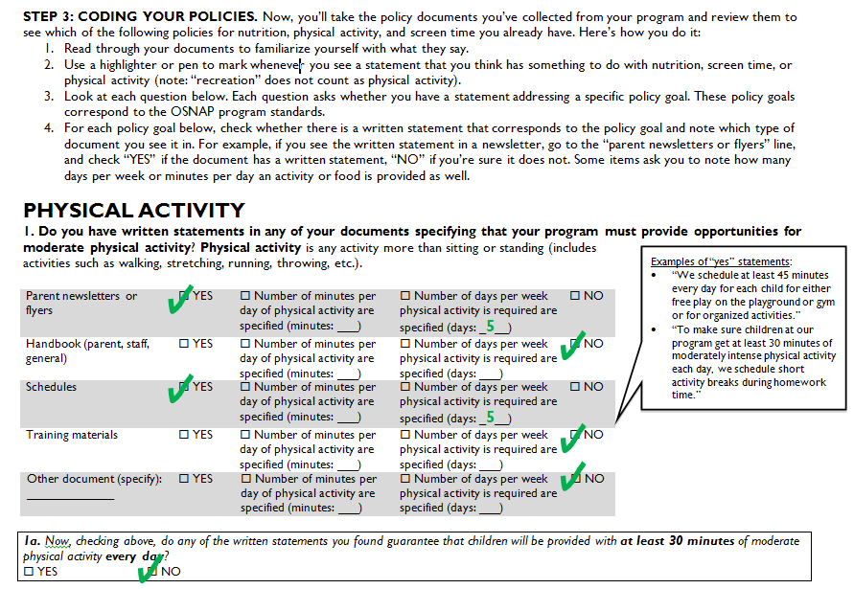
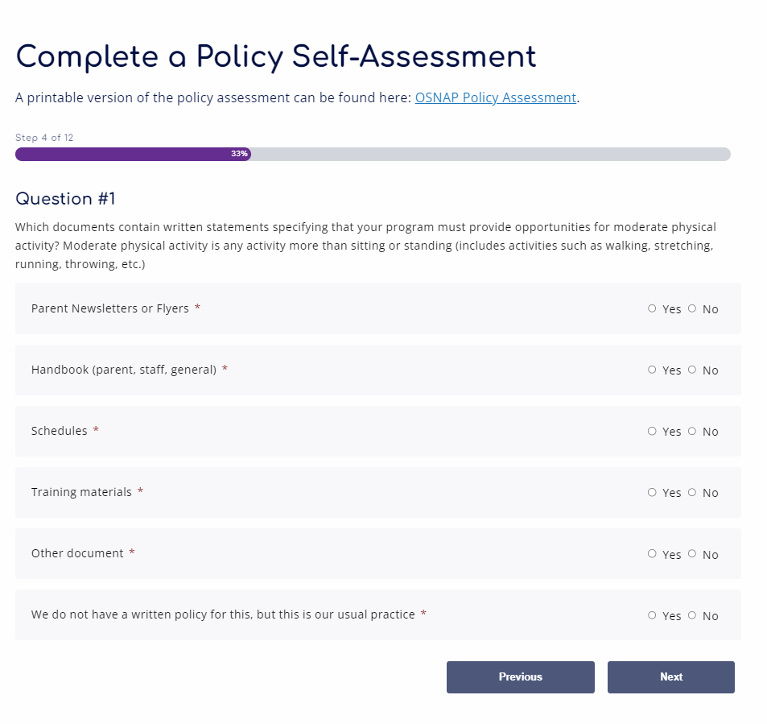
Policy Self-Assessments
Visit our website
to complete your policy assessment online in My OSNAP portal
osnap.org/myosnap
osnap.org/myosnap
Notes:
You were asked to bring copies of your policies and documents with you either for the last Learning Community or with you today; please take those out now.
[Note to facilitator –Ask programs to complete the self-assessments as best they can, with the documents they have, giving about 20 minutes; if a program does not have any of their documents with them, they can try to complete based on memory/ knowledge of existing program documents – stress that they should complete it based on documents that they have, not just what they do in practice.]
We’re going to take about 20 minutes now to assess your program’s policies and documents using the OSNAP policy assessment. Using your written documents, answer the questions on the Policy Assessment related to the OSNAP Standards. We’re looking for written language that applies to the standards; however, if your program usually does something but doesn’t have written language, make a note of that on the assessment. We’ll take about 20 minutes to do this; whatever you don’t finish now you can work on later. I’ll circulate to answer any questions.
The first step is to identify which policy documents your program has. The possible items are listed here [read though list]. They might include some things that you don’t even think of as policies, like menus or schedules. We call these “informal policies.”
Next, you will want to read all of these documents so you have an idea of what each says. As you are reading, you may want to use a highlighter or pen to mark whenever you see a statement that you think has something to do with an OSNAP standard (note: “recreation” does not count as physical activity).
Then, if we look through the assessment, we see familiar headers like “Physical Activity,” “Screen time,” etc. Under each section is a bold question that relates to an OSNAP goal.
For each of these policy questions, check whether there is a written statement that corresponds to the policy goal and note which type of document you see it in. For example, if you see the written statement in a newsletter, go to the “parent newsletters or flyers” line, and check “YES” if the document has a written statement, “NO” if you’re sure it does not. Some items ask you to note how many days per week or minutes per day an activity or food is provided as well. Write these numbers in when appropriate, if you policy has numbers.
[Note to facilitator -- completed example comes in with animation] In this example, it looks like this site had a policy in a parent newsletter or flyer about providing 5 days of physical activity, but that nothing about time was mentioned. It also looks like they had 5 days of physical activity on the schedule. Then, we look at box 1a, which asks “Now, checking above, do any of the written statements you found guarantee that children will be provided with at least 30 minutes of moderate physical activity every day?” What do you all think, should this site have checked “yes” or “no”? [Let the group discuss]. Ultimately, this check is a no, because while they did have policies about offering physical activity every day, the OSNAP goal specifically mentions at least 30 minutes of moderate physical activity. This site might have been giving children an hour every day, but we can’t tell. So for this site, it might be a really simple policy improvement to just specify in their policies that children will get those 30 minutes.
The policy assessment can be completed either with paper & pen, or you can create an account via our OSNAP website, and complete the policy assessment and other assessments/tools in our online portal called My OSNAP.

Slide 17
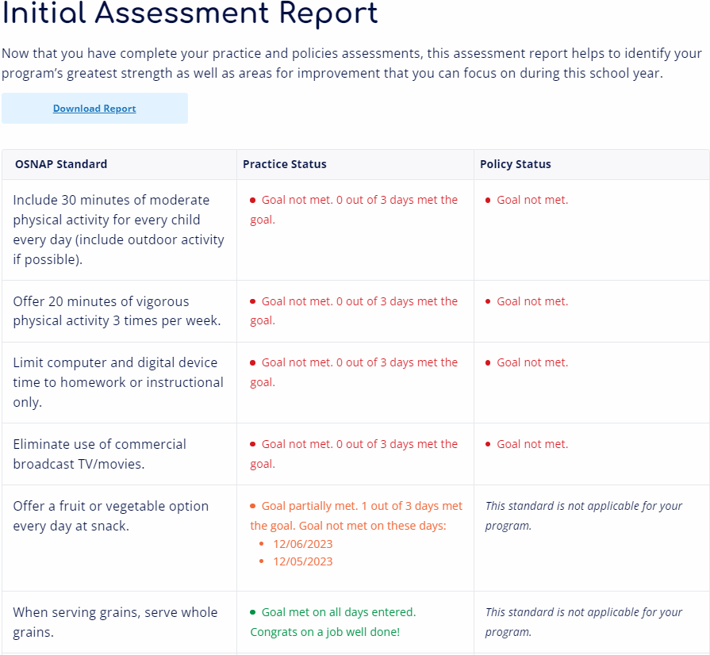
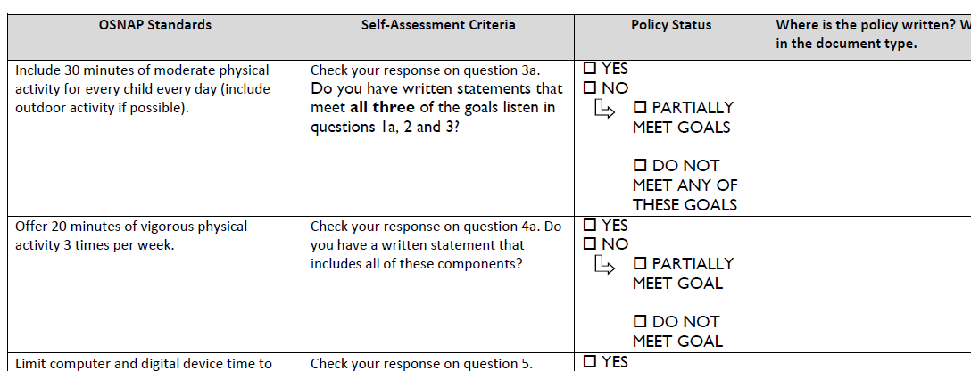
Policy Assessment Areas for Improvement
Assessment reports can also be generated via My OSNAP
osnap.org/myosnap
Notes:
Next we’ll compile the results of your assessment in a way that will help you see clearly which OSNAP Standards you have strong policies around, and which standards might benefit from improved policies.
[Pass out the blank OSNAP Policy Assessment Areas for Improvement Policy Report sheets.]
Using your completed policy self-assessment, each program will complete this OSNAP Policy Assessment Areas for Improvement Policy Report. Column 1 states the related OSNAP Standard. Column 2 tells you where to look on your policy self-assessment to find the relevant information. In column 3, based on what your self-assessment says, you will check off either yes, no, or n/a. In some cases, if you check off no, there is another set of boxes to clarify whether the “no” means that something is completely missing from your policy documents – meaning that none of the items were mentioned – or partially there, which might be the case if you had a statement about providing 30 minutes of moderate to vigorous physical activity to children, but didn’t specifically mention that you would provide it for ALL children or mentioned it for just one group of children. In the final column, make a note of where you found the relevant policy information. Include multiple sources if related policies appear multiple places.
Go ahead and do this now, I’ll give you about 5 minutes and I’ll be coming around to each group in case you have questions.
[Note to facilitator: if you have ample time, could have groups share out their findings. Did anything surprise them? Are there things that they know they do in practice, but couldn’t find anything written down about it?]
If you are using the My OSNAP portal, the website also generates you a report based on your answers in the policy and practice self assessments.

Slide 18
Why policy?
Lays the groundwork for practice and programs
Ensures that everyone is aware of what is expected from them and what they can expect from the program
Helps hold staff, caregivers, and children accountable for following the program’s rules
Helps ensure that program practices are sustained over time, even as staff changes by providing a written record
Available evidence suggests that policies in school settings can change food service, increase access to physical education, and improve children’s dietary intake.
OSNAP Evidence: We’ve found that programs participating in OSNAP are more likely to have policy language related to physical activity and nutrition.
Notes:
Now that you’ve got a sense of where your program’s policies are and are not, we’re going to spend some time brainstorming some ways to improve your policy.
Before that, let’s talk for a moment about why policy is important.
[read through slide]

Slide 19
OSNAP Guide for Writing Afterschool Wellness Policies
Provides suggestions for language supporting physical activity at your school. Can be directly inserted in:
  Parent or family handbooks, staff handbooks, general program handbooks
  Letters to families, staff training materials, MOAs/MOUs, or even schedules
Includes explanation of how practices would have to be changed to implement the policy.
Notes:
To support you in writing policies that support the OSNAP standards, we have a policy writing guide.
[Hand out the OSNAP Guide for Writing After-School Wellness Policies.]
Talk through what the goal of this guide is ---
This guide is the primary tool to help you create policy. It has a lot of sample language that you can directly insert into your own documents, or that you can use as ideas to base your own policies off of, if you want to write them yourself.

Slide 20
OSNAP Guide for Writing Afterschool Wellness Policies, cont’d
Similar policy language has already been used in other programs like yours
Language can be adapted and changed to suit your needs
  Think carefully about what your changes might mean for practice.
  For example, a policy that states that teachers should include activity breaks in the daily schedule is weaker than a policy stating that teachers must include them.
Notes:
[read through slide]
Note to facilitator: Take time to walk participants through a section or two of the guide, talking through how the information examples can be used, how to navigate the guide, etc.

Slide 21
Afterschool team breakout/lunch

Slide 22
Afterschool team breakout
Break out into afterschool teams
Revise & update OSNAP Action Planning Document
Decide on practice, policy, and communication action steps for each goal
  Set at least 1 action step that addresses the steps necessary for implementing policies
Complete 2 copies of the OSNAP Action Planning Document
Notes:
We’re going to take about 45 minutes to allow you all to review and update your Action Plans. I have copies of your plans from the last Learning Collaborative.
Just like last time, for every single goal, come up with practice, policy, and communication action steps. Feel free to go back and look at your tip sheets or policy writing guide for ideas.
[pass out give every group 2 copies of Action Plan from LC 1, along with blank copies if needed, or if you will be able to xerox the updated plan at the end of the LC, supplying 1 copy is sufficient.]
[circulate and help groups update their plans]
Time: 45min

Slide 23
Recap & questions
Share 1 new goal or action step with the group
What did you learn today?
How might you apply the new skills you developed around policy development and/or physical activity?
What do you need from me?
Lingering questions…
Notes:
You all have done some great planning today. I wanted to take a few final moments here to give each program the chance to share out. Let’s go around, and I’d like for every group to share the following items and answer these questions –
Share 1 new goal or action step with the group
What did you learn today?
How might you apply the new skills you developed around policy development and/or physical activity?
What do you need from me?
Lingering questions…
Time: 15 minutes
Evaluation

Slide 24
Next steps
Learning Community 3 is scheduled for the week of [Month Day, Year]
  Collect policy documents
Complete Nutrition and Physical Activity Planning Tool each month
[Insert local training dates & opportunities]
**Please fill out your evaluation**
[insert your contact information here]
Notes:
[note: replace with information that is accurate for your program – are there upcoming additional trainings that you have arranged or would be of interest? For example, SPARK, Playworks, and other organizations offer group training sessions]
To wrap up, I wanted to remind you all that our next Learning Community will be [date]. During that session, we’ll be looking at any existing policy documents that you do have and figuring out how they address the OSNAP standards. So your homework for next session is to collect all of the policy documents that you can think of. When I say “policy document” I mean anything that has a rule, guideline, or policy on it. This could be a handbook, a I will send out a follow-up email reminding you of this, with these sources listed.

Slide 25
Acknowledgements
The Out-of-School Nutrition and Physical Activity Initiative (OSNAP) was developed as a research project at the Prevention Research Center on Nutrition and Physical Activity at the Harvard T.H. Chan School of Public Health (HPRC) (2009 – 2015).
Funding
This work and the Prevention Research Center on Nutrition and Physical Activity at the Harvard T.H. Chan School of Public Health (HPRC) is supported by the Centers for Disease Control and Prevention (U48DP001946 and U48DP006376), including the Nutrition and Obesity Policy Research and Evaluation Network, as well as support from the Donald and Sue Pritzker Nutrition and Fitness Initiative and the Robert Wood Johnson Foundation (#66284). The findings and conclusions are those of the author(s) and do not necessarily represent the official position of the Centers for Disease Control and Prevention or other funders.
For more information about OSNAP, visit: www.osnap.org
For more information about HPRC, visit: www.hsph.harvard.edu/prc

Slide 26
Policy writing & communication
Let’s do it!
  Assess current policies
    What policy documents do you have?
      Policy Self-Assessment
    Do your policies support the OSNAP goals for nutrition and physical activity?
      OSNAP Policy Self-Assessment Areas for Improvement Policy Report
Notes:
Note to facilitator: If you have an abundance of additional time and don’t think that sites will remember to complete the policy assessment ahead of time, you can ask sites to bring their policy documents with them to this session and then walk everyone through the coding process. These next few slides would facilitate that process]

Slide 27
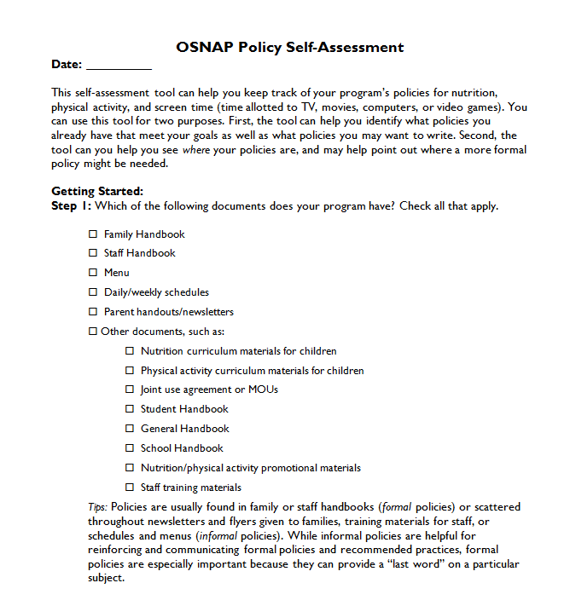
Policy Self-Assessment
Let’s do it!
  Assess current policies
    What policy documents do you have?
    Do you have written statements that address nutrition and physical activity?
    Do your policies support the OSNAP goals for nutrition and physical activity?
Notes:
Today I asked you to bring policy documents with you. Just like you did a practice self-assessment before setting your practice goals, we’re going to start our policy work by figuring out what you already have.
We’re going to begin by completing the policy self-assessment. You can use this tool for two purposes. First, the tool can help you identify what policies you already have that meet your goals as well as what policies you may want to write. Second, the tool can you help you see where your policies are, and may help point out where a more formal policy might be needed.

Slide 28
Coding Your Policies
Read through your documents to familiarize yourself with what they say.
Use a highlighter or pen to mark any statement that has something to do with nutrition, screen time, or physical activity (note: “recreation” does not count as physical activity).
For each policy goal, check whether there is a written statement that corresponds to the policy goal and note which type of document you see it in.
Notes:
Now, you’ll take the policy documents you’ve collected from your program and review them to see which of the following policies for nutrition, physical activity, and screen time you already have. Here’s how you do it:
Read through your documents to familiarize yourself with what they say.
Use a highlighter or pen to mark whenever you see a statement that you think has something to do with nutrition, screen time, or physical activity (note: “recreation” does not count as physical activity).
Look at each question below. Each question asks whether you have a statement addressing a specific policy goal. These policy goals correspond to the OSNAP program standards.
For each policy goal below, check whether there is a written statement that corresponds to the policy goal and note which type of document you see it in. For example, if you see the written statement in a newsletter, go to the “parent newsletters or flyers” line, and check “YES” if the document has a written statement, “NO” if you’re sure it does not. Some items ask you to note how many days per week or minutes per day an activity or food is provided as well.
[note to facilitator: circle around the room and help with any questions that arise]
Time:

