Slide 1


Learning Community 1
Out-of-School Nutrition & Physical Activity Initiative (OSNAP)
Notes:
Note to facilitator: Thank everyone for coming. You may wish to start with an ice breaker and have everyone introduce him/herself. Information you should have people share is their names, their pronouns, which program they come from, and what their role at the program is.
Active icebreaker.
Ice breaker idea (feel free to use your own favorite active ice breaker!): Have each person say something active he/she liked as a kid and make that motion while saying their name. Example: “My name is Jasmine and when I was a kid I liked to figure skate" *twirl* --> then everyone says "hi Jasmine " and twirls.

Slide 2
Agenda
Time | Task
10:00am – 11:30am | Presentation OSNAP support OSNAP Health Goal Nutrition and physical activity discussion Food & Fun Afterschool Curriculum Practice, policy, and communication change Federal and state regulations and OSNAP
11:30am – 12:30pm | Afterschool team breakout/lunch Review practice assessments Identify areas for improvement Brainstorm Goals and action steps
12:30pm – 1:00pm | Wrap up & next steps Share goals Ways [your organization name] can help Future learning community meetings & visits
Notes:
Note to facilitators: be sure to replace the times with the ones suitable for your meeting, and take out or replace lunch with another meal depending on what you are offering.
You still want to dedicate about 1.5 hours to intro and skill development, 1 hour for self-assessment review and creating the action plans, and 30 min wrap-up.
Note: If you have scheduled a longer session, there are additional slides at the end of this presentation that you could include to expand the discussion around certain topics.

Slide 3
Meeting Objectives
Describe the benefits of incorporating nutrition and physical activity in out-of-school-time programs
Discuss why good nutrition and physical activity are important for children & adults
Review the specific health goals of the Out-of-School Time Nutrition and Physical Activity (OSNAP) Initiative
Describe the importance of policy to the process of making sustained healthy changes
Get support and tools to create healthier nutrition and physical activity practices and policies at your site
Set goals and an action plan for healthy changes at your program
Notes:
Here are our objectives for the day. By the time you leave today, we should have accomplished all of these things…
[talk through objectives]

Slide 4

What your program can expect
Support for making policy and practice changes in nutrition and physical activity within your program
  Evidence-based intervention materials like Food and Fun Afterschool
  Trainings
  Feedback on nutrition and physical activity environments, practices, and policies
  Change strategies
  Tailored materials & technical assistance for a diverse range of programs
Notes:
You may be wondering why you’ve all been asked to come here today. I will explain more about the specific OSNAP goals in a moment, but broadly speaking, this Learning Community today is part of a bigger initiative to improve nutrition and physical activity practices and policies in afterschool settings in {your city/district/area}.
By participating in the OSNAP Initiative, you can expect Support for making policy and program practice changes in nutrition and physical activity within your program.
We will provide you with materials you can use to teach children about the importance of nutrition and physical activity like Food & Fun Afterschool curriculum. [Note to facilitator: We suggest that you provide the Food & Fun flyers and the CD today, you can also choose to provide the Nutrition and Physical Activity Planning Tool for sites to use; there are a few additional slides at the end you can insert here if you have additional time and would like to tell people a little more about Food & Fun].
We will offer trainings on ways to get kids moving, short physical activity breaks, inclusive games, and how to write policies to help make lasting changes.
Additionally, I/we will give you feedback on your current nutrition and physical activity environments, practices, and policies as well as help you make plans for targeted improvements.
We will give you ways to make healthy changes in how your afterschool program runs so that kids will be even healthier.
And finally, I will work with each program to give you tailored materials & technical assistance for a diverse range of programs

Slide 5

Why out-of-school time programs to promote nutrition and physical activity?
Afterschool programs serve 7.8 million children.
Another 24.6 million children would participate if a program were available.
Afterschool and other out-of-school time programs are ideal settings for promoting healthy nutrition and physical activity environments.
America After 3pm, 2020 report.
Notes:
When we thought about places that have an impact in kids’ lives, we realized how important
afterschool programming is.
For example, afterschool programs, serve 7.8 million children annually. And Another 24.6 million children would participate if a program were available.
Thus, your programs are ideal settings for promoting healthy nutrition and physical activity environments.
[Note to facilitators: replace with information specific to your city/school district/town if you have it – For example, here’s information about Boston:
About half of Boston school-age children & youth ages 5-18 participate in out-of-school program (nearly 40,000 kids!)
600+ organizations with 1,400+ program opportunities across the city (afterschool & summer)]
Source: https://afterschoolalliance.org/documents/AA3PM-2020/National-AA3PM-2020-Fact-Sheet.pdf

Slide 6
Goals for Nutrition and Physical Activity in Out-of- School Time
Notes:
Before we start in on this, I want to take 10-15 minutes to start a discussion about the topics related to physical activity/nutrition folks think are important to focus on in out of school time. Does anyone want to start us off? What do you think are the big issues that your program should be focused on?
[Guide a discussion until everyone has had a chance to voice their thoughts, or until 15 minutes has passed]

Slide 7
Goals for Nutrition and Physical Activity in Out-of-School Time
Staying Active
Provide all children with at least 30 minutes of moderate to vigorous physical activity every day (include outdoor activity if possible).
Healthy Beverages
Do not serve sugary drinks.
Fruits & Vegetables
Offer a fruit and/or vegetable option every day at every meal and snack.
Limit Inactivity
Focus on Whole Grains
Offer 20 minutes of vigorous physical activity at least 3 days per week.
Do not allow sugary drinks to be brought in during program time
Serve water every day
When serving grains (like bread, crackers, and cereals), serve whole grains. Whole grains should be listed as the first ingredient.
Eliminate use of any screen time intended for entertainment purposes only.
Limit instructional computer and digital device use to homework or instructional time (instructional is defined as academic, teacher-led programming).
Notes:
Here are the OSNAP standards again, just to refresh your memory.
Note to facilitator: Could do interactively by having sites name as many as they can remember first, then going through the list.

Slide 8
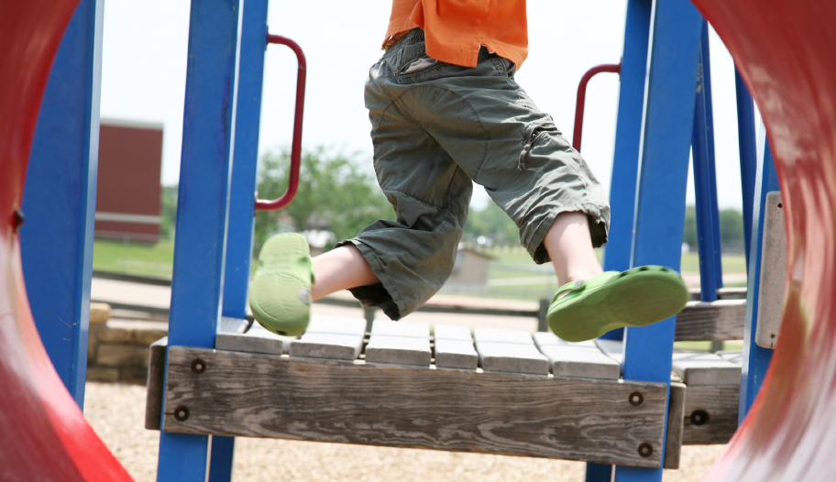
Staying Active
Goals
Provide all children with at least 30 minutes of moderate to vigorous physical activity every day (include outdoor activity if possible).
Offer 20 minutes of vigorous physical activity at least 3 days per week.
Why is it important?
Kids need at least 60 minutes of physical activity every day.
Regular physical activity is important for preventing chronic diseases like heart disease, diabetes, high blood pressure, and osteoporosis.
Suggested strategies
Schedule at least 30 minutes of physical activity every day.
Have kids vote on their favorite active games to improve participation.
Key messages
Moving your body is fun and helps your body be healthy and strong.
All types of activities like playing, dancing, and sports are good for you.
Doing activities that make you sweat and breathe hard will make you strong and keep your bones and heart healthy.
Notes:
So here are our two physical activity related goals. [read goals]. You notice that we make a point to note outdoor activity. In general, outdoor spaces are more open and it is often easier for kids to be more physically active. We encourage taking kids outside to play in all kinds of weather, and I have a specific chart that shows what temperatures and conditions are safe to take kids outside in, if you’re interested.
Physical activity is really important for kids, and national guidelines say that kids need at least 60 minutes of physical activity every day. We know that you don’t spend all day with kids, but we’re suggesting that kids can get half of that time during the afterschool hours.
Regular physical activity is important for preventing chronic diseases like heart disease, diabetes, high blood pressure and osteoporosis
A couple things that we have found that help with this goal are…[read suggested strategies].
A final, but really important thing to emphasize here is how we talk about being healthy with kids. The messages that you all give are an important part of getting kids excited about physical activity an nutrition. We know that weight can be a sensitive topic, so we try to avoid say things like “we do this so we can be skinny.” Instead, we frame the messages around health and fitness. So here are some examples of things that you can say to kids that underscore how good it is to be active without bringing up weight or body image. [read Food & Fun key messages]

Slide 9
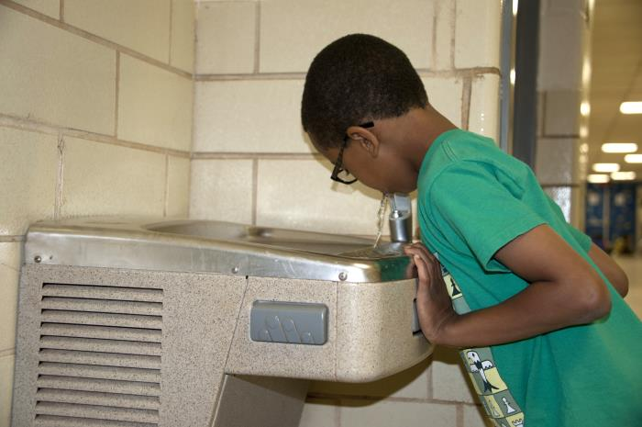
Healthy Beverages
Goals
Do not serve sugary drinks.
Do not allow sugary drinks to be brought in during program time.
Why is it important?
Sugar-sweetened drinks (including soda, sweetened teas, fruit drinks, energy drinks, and sports drinks) are the top source of added sugar in children’s diets.
Drinking sugary beverages is associated with obesity and type 2 diabetes in kids.
They provide a lot of calories with little to no nutritional benefit.
Suggested strategies
Create a policy that restricts sugary drinks brought from home.
Turn off the vending machine during the afterschool program time.
Key messages
Eating and drinking too much sugar is not healthy for your body and it can cause cavities.
Juice is not as healthy as it seems. It can have as much sugar as soda. Limit juice to 4 ounce or less
Notes:
Sugary drinks are drinks with sugar added to them or any 100% juice greater than 4 ounces (a half a cup) in size. They include soda, sweetened iced teas, fruit punches, fruit drinks (such as lemonade), sports drinks, and sweetened water (e.g., Vitamin water).
Our goal is to keep these out of the afterschool environment. This means not serving big juices or other sugary beverages, as well as not letting kids bring them in from outside to be consumed during program time. This might be things like a Capri-Sun they packed from home, a soda or juice drink they bought at the corner store before the program, or a program partner having a pizza and soda party.
[read goals and “why is it important”]
So, two things you could think about doing would be [read suggested strategies].
And here again are our healthy messages around beverages.
Eating and drinking too much sugar is not healthy for your body and it can cause cavities.
Juice is not as healthy as it seems. It can have as much sugar as soda. For example, Minute Maid Orange Juice and Coca-Cola Classic both have 41g of sugar in 12 ounces.
[Note to facilitator: see “How Sweet is it?” bonus slide for even more information]
Source: https://www.hsph.harvard.edu/wp-content/uploads/sites/30/2012/10/how-sweet-is-it-color.pdf

Slide 10

Healthy Beverages
Goal
Serve water every day.
Why is it important?
Water is the best way to keep kids hydrated.
It is calorie-free and almost cost free from the tap!
Suggested strategies
Build water breaks into your program schedule.
Serve water in a pitcher with cups in the snack area every day; drinking from water fountains often doesn’t provide children with enough water.
Key messages
Water is the best thirst quencher.
Water and low-fat milk are the best drinks to have at snacks and meals.
Drink water when you are thirsty.
Notes:
The previous slide was all about sugary drinks – but then you might wonder what to serve the kids to keep them hydrated. The answer is -- water!! Our goal is to have water offered as a drink every day during snack time. And by “offering” it, we mean that children should be able to take a serving of water back to their seats with them. So having a water fountain around doesn’t quite count --- unless you have cups or water bottles that the kids can fill up!
[read goals and “why is it important”]
So, two things you could think about doing would be [read suggested strategies].
And here are some things to say about around drinking water.

Slide 11
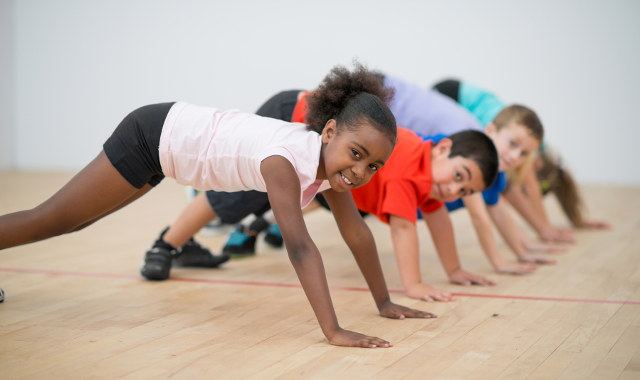
Limit Inactivity
Goal
Eliminate use of commercial broadcast and cable TV and movies.
Limit computer and digital device time to homework or instructional time (instructional is defined as academic, teacher-led programming).
Why is it important?
TV watching may influence kids to make unhealthy food choices because they see a lot of ads for foods that are high in sugars and calories.
Time in front of the screen can lead to overeating, less physical activity, and overweight.
Suggested strategies
Set a program policy banning televisions and movies.
Try new indoor active games from Food & Fun if weather limits outdoor play time or as a special treat on Fridays.
Key messages
Moving your body keeps you fit.
Do something active instead of watching TV, playing video games, or spending time on the computer.
Notes:
Our next set of goals is around screen time. When we say screen time, we mean electronic devices that have a screen – that could be a TV, computer, video game, handheld PSP, and even a smartphone.
Our goals are to [read goals].
Reducing screen time is important for two reasons. One, kids are exposed to a ton of advertisements in media. This could be commercials, product placement in TV shows and movies, online pop-up ads, or even internet games designed by food companies. All of these things are designed to get people to eat or drink a certain product, and that product usually isn’t a healthy one! So, we want to limit screen time so that we limit kids’ exposure to these ads.
Secondly, time spent in front of screens is time that kids aren’t running around and being active. We know that computers are a useful educational tool, and that some of you may work at programs where teaching kids to use computers or having kids do homework on the computer is a big part of why parents send their kids to you. So, we’re asking that you focus on cutting out any of that non-instructional time. We can also give you some tips on ways to get kids active even during homework time in a computer lab.
Some ideas for strategies are …. [read suggested strategies].
And here are a couple healthy messages… [read key messages].

Slide 12

Fruits and Vegetables
Goal
Offer a fruit and/or vegetable option every day at every meal and snack.
Why is it important?
Fruits and vegetables contain vitamins, minerals, and fiber that keep kids and adults healthy.
Fruits and vegetables protect against heart disease, stroke, high blood pressure, and some cancers.
Suggested strategies
Talk with food service managers to make sure the fruits and vegetables served at your program match the planned menus.
Use taste tests to learn kids’ fruit and vegetable preferences.
Key messages
Eat 5 or more fruits and vegetables (combined) each day.
Just take a bite! Don’t be afraid to try a new fruit or vegetable – chances are you’ll like it.
Fruits and vegetables come in lots of colors. Try to eat as many different colors as you can.
OSNAP doesn’t consider juice a fruit or vegetable
Notes:
The next set of goals focuses on fruits and vegetables. Here, we ask that you offer a fruit or vegetable option every day. Fresh fruits and veggies are great, but you can also serve frozen fruit and veggies, fruit cups, dried fruit, and canned fruit and veggies.
Eating fruits and vegetables is important because fruits and vegetables contain vitamins, minerals, and fiber that keep kids and adults healthy. These things protect against heart disease, stroke, high blood pressure, and even some cancers.
Changing the food that you serve can seem like a big challenge. We suggest that you check with food service managers to make sure the fruits and vegetables served at your program match the planned menus. If you’re adding more fruits and veggies to the menu, consider using taste tests to learn what the favorite ones are – that means less waste, and more kids eating nutritious foods!
The messages here are [read key messages].

Slide 13
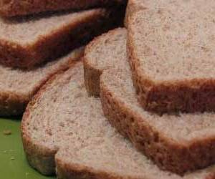
Focus on Whole Grains
Goal
When serving grains (like bread, crackers, and cereals), serve whole grains. Whole grains should be listed as the first ingredient.
Why is it important?
Whole grains contain fiber, vitamins, and healthy fats that can lower your risk for heart disease and diabetes.
They can also help you feel full longer.
Suggested strategies
Select breads, crackers, and, cereals that list a whole grain as the first ingredient on the label. Examples are whole wheat, barley, oats, and rye.
Select foods containing at least 3 grams of fiber and 5 grams of sugar or less per serving.
Key messages
Whole grains and products made with whole grains are healthy for your heart and whole body.
Whole grain products offer more fiber and vitamins than refined grains.
Notes:
A lot of the snacks that you serve are probably grain-based. Things like cereal, chips, popcorn, crackers, granola bars, and pretzels are all grain products. One of the OSNAP goals is to serve whole grains instead of refined grains. When something is made with whole grains, it means the grain, which could be wheat, oats, rye, corn, or others, is less processed and it has more of the healthy stuff like fiber, which is reduced in processed grains. Fiber-rich foods make good snacks because they help you feel full for a longer time than their refined counterparts. Whole grains also have vitamins and healthy fats. It can be tricky to tell which foods count as “whole grain” foods. For OSNAP, we say a food is a whole grain food if whole grains are listed as the first ingredient. For wheat, whole wheat should be listed as the first ingredient. Things like “enriched wheat flour” are NOT whole grains. Oats and corn can be little trickier because they don’t always say whole, but usually if these grains are the first ingredient, it’s a whole grain product. [can fast forward here to next slide, talk about nutrition labels, then return]
Sometimes companies add more sugar to whole grain products, so we recommend selecting foods that have at least 3 grams of fiber per serving and less than 5 grams of sugar. Products meeting these goals might not be readily available through your food vendor, but we have lists of products that are whole grain, common snack products that kids still enjoy.
Here are some healthy messages that help point out other fats that are better for you. [read key messages]

Slide 14
How can your OSNAP program support other state initiatives?
Child Care Regulations could cover….
  Adequate space for physical activity
  Encouraging outdoor play
  Requiring physical activity
  Encouraging a variety of foods be served at snack
  Requiring child participation in food preparation
  Making water freely available
  Requiring physical activity and nutrition curricula
  Provision of nutrition training to staff
  Staff making positive statements about healthy eating
  Prohibiting withholding food or outdoor time as punishment
  Parents must be informed of changes to the menu
Notes:
OSNAP may also be able to make you meet state regulations. For example, your state may have regulations for out-of-school providers or there may be other state regulations for healthy afterschool.

Slide 15
OSNAP goals support federal and district objectives
Water regulations within schools
  Healthy, Hunger-Free Kids Act of 2010 states programs participating in the National School Lunch Program and CACFP should make safe drinking water available to children, throughout the day, including at meal times, in the location where meals are served.
School Wellness Committees
Notes:
In addition to state regulations, the goals of OSNAP also align with national requirements and possibly objectives in your school district as well. Afterschool providers and child care programs receiving CACFP funds, are required to have clean, safe, drinking water available for the children throughout the day.
Additionally, many local wellness committees are working on similar goals.
More detailed info, FYI:
School meal programs -- Sec. 203.Water (NSLP/SBP)
Requires schools to make free potable water available where meals are served.
The Healthy, Hunger-Free Kids Act of 2010 (the Act), Public Law 111-296, establishes a requirement to make potable water available to children in the Child and Adult Care Food Program (CACFP). The purpose of this memorandum is to provide guidance on the implementation of this provision.
Section 221 of the Act added a new provision to the Richard B. Russell National School Lunch Act (42 U.S.C. 1766(u)). This new provision requires child care centers, family day care homes, at-risk afterschool programs, and shelters participating in CACFP to make drinking water available to children, as nutritionally appropriate. Throughout the day, including at meal times, water should be made available to children to drink upon their request, but does not have to be available for children to self-serve. While drinking water must be made available to children during meal times, it is not part of the reimbursable meal and may not be served in lieu of fluid milk.
Sources:
https://obamawhitehouse.archives.gov/sites/default/files/Child_Nutrition_Fact_Sheet_12_10_10.pdf
https://fns-prod.azureedge.us/sites/default/files/cacfp/CACFP20_2016os.pdf

Slide 16
What types of healthy changes can you make at your program?
Child behaviors
Encouraging kids to eat more fruits and vegetables or participate in physical activity
Program practices
Changing the day-to-day operations at your site, like serving water at the table during snack time or offering more options for physical activity
Informal policies
Changing the informal written plan of action for the program, for instance on schedules or snack menus or in trainings
Formal policies
Changing the formal written plan of action for the program, for instance state law and regulations or the rules in written documents like parent handbooks and staff manuals
Health communication
Sharing health information, practices or policies with families, program partners, and children
Notes:
Now that you’re familiar with the different content areas that OSNAP talks about, let’s talk about what kinds of changes you can do around these ideas to make your program an even healthier place for kids to be.
These are all ways of promoting healthy changes, and they can all be very useful.
[read through list and the example/description]
Keep these in mind as we look at some examples…. [next slide]

Slide 17
Examples
The staff handbook says that staff are prohibited from keeping students out of play time/gym as punishment.
The site director decides that every day before snack, she’s going to play music and everyone is supposed to jog or dance in place for 5 minutes.
Ms. Lunn takes her students outside every day from 4:30-5:00 to play active games.
A newsletter went home suggesting easy, healthy snack items that parents could send with kids.
5th graders are scheduled to have basketball every day from 3:45-4:45.
Notes:
So here are some examples of things that might be going on at a program. Thinking about the previous slide (behavior, school practices, informal polices, formal policies, health communication), which do you think the first is best described as?....
Formal Policy
School Practice (could also be informal policy, except that it might not happen if the principal is out for a day)
Behavior change/practice (just one teacher does it though, so not school-wide)
Health Communication
Informal Policy

Slide 18
Feedback & Planning
Break out into afterschool teams
Use your completed daily self-assessments to complete the OSNAP Daily Practice Assessment Areas for Improvement: Practice Report
Based on your results, use tip sheets and fast maps to brainstorm priorities
Set 3 goals for improving nutrition, physical activity, or screen time at your program
Decide on practice action steps for each goal
Complete the OSNAP Action Planning Document (2 copies, one for me, one for you)
Notes:
Now that you’ve got the general idea, the rest of the time is for you all to create your action plans. Here’s the plan for the next hour or so:
You will all split up into small groups with other people from your program. If you’re the only person from your site, it’s OK, one-person teams work too!
Using your self-assessments, complete the OSNAP Daily Practice Assessment Areas for Improvement: Practice Report. I’ll give an overview of this momentarily. Then, as a group, review the results from your self assessment. I will be circling through the groups to help you all interpret these results. Think about areas that might be “low hanging fruit” –is there something where a little change could make a big difference? Also, think about changes that might be harder but could have a really big impact in helping your program be a healthy place for the kids you serve. After this, you should have an idea of what you’d like to target to improve physical activity, nutrition, and screen time practices and policies at your program.
Look through the tip sheets and quick guides we’ve provided and think about the specific challenges your program faces and ways that you might address those challenges. Keeping your target areas in mind, what would be some steps/changes you’d like to see?
Once you’ve considered the range of options you have, narrow your focus down to 3 goals that you’re going to focus on before our next learning community. These can be goals that you expect to take the whole school year, or they might be shorter-term goals. The goals should reflect the OSNAP standards, but they can be focused on any area covered by the goals – PA, nutrition, screen time.
[Note to facilitators --– the policy and communication pieces are optional and go above and beyond at this point] Then, once you have your goals in mind, we want you to think not only about how something will change, but what are the related practice (and policy and communication steps that go with that goal? For example, if your goal is to ban outside snacks, then your practice might be “have kids only eat the provided snack, not allow any outside foods to be consumed at the program.” A policy goal might be “To put a policy in our family and staff handbooks that outside food and drinks will not be allowed at the program.” Remember that policies, especially when they’re included in places where people look for rules, can help make your changes last a long time and easier to enforce. Then, think about how you’re going to inform people about this goal – it’s an important step, especially if what you’re doing might seem unpopular at first. This will give you a chance to explain why you made this choice, and how kids and families can benefit. So, in my example, I might set communication steps of “Sending a notice home with children that parents should not send snacks in with their child. Explaining to children during snack that food they buy or bring from school or elsewhere cannot be eaten during the program. Ask staff to support this by being good role models and not having outside food and beverages at work. Let families know that we will have a two-week grace period when we will remind children who bring other snacks what our new policy is. After two weeks, we reserve the right to confiscate any outside snacks. Parents can pick these up when they pick up their child…etc.” You want to think through each of these three things – practice, policy, and communication action steps.
Finally, please make two copies of this document – one for you to keep, and one for me to keep. [Note to facilitators – If you have a good scanner back at your office and everyone has reliable email access, then you can just collect the original Action Plans at the end of the LC, scan them in at your office, and then email every site a copy of their action plan. Or, if you have access to a portable scanner or can access a copy machine in the building, then the group only needs to make one copy and you can create a copy for yourself on the spot. Otherwise, if there are multiple people from a given site, have two people fill out identical action plans simultaneously. If all else fails, you can use a camera/smart phone to take a picture of the action plan. You just want a record of the goals the groups are setting, for your own tracking purposes and/or in case the site misplaces their copy]
This should be about 1 hour
20 minutes to review the feedback
20 minutes to brainstorm
20 minutes to fill out

Slide 19

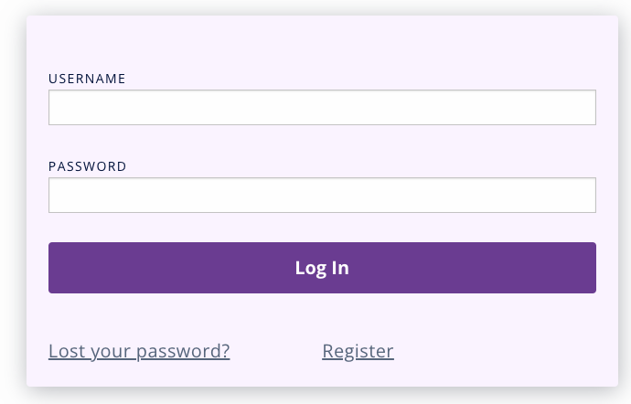
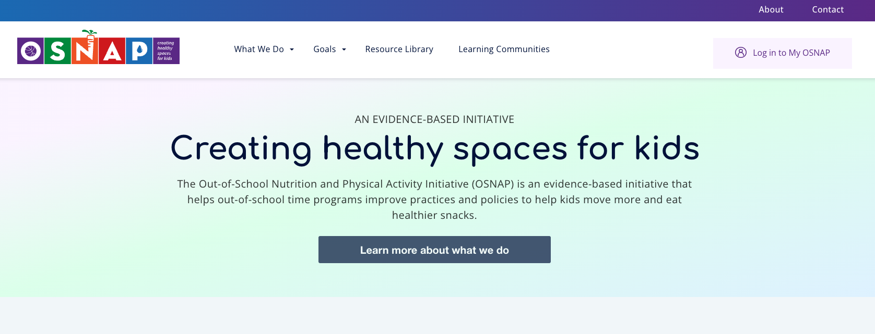
How to Register for My OSNAP
Did you know that you can access OSNAP materials electronically?
To register for My OSNAP:
Go to osnap.org and click “Log in to My OSNAP” or scan this QR code→
Click “Register” to create your account.

Slide 20
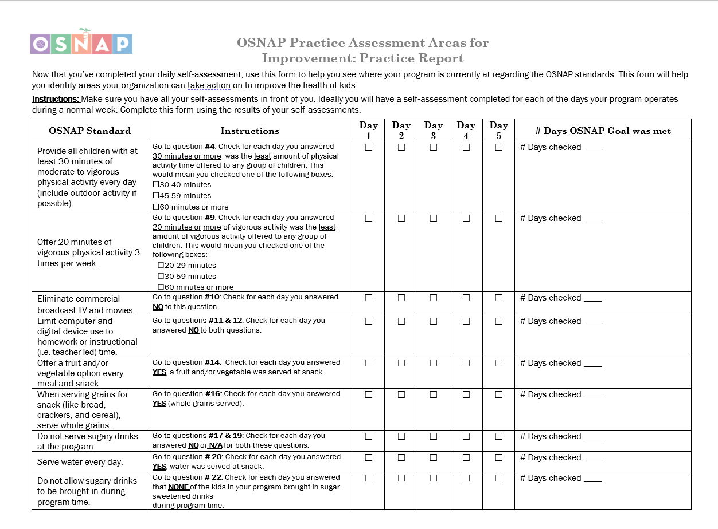
Notes:
This is designed to be straightforward, but I just wanted to briefly talk through this form. Go ahead and take out your 5 days of assessments. The left column states the OSNAP standard, for your reference. Then, there are instructions. In the first row, we see that we need to look at question three. So, take your first assessment and look for question 3. Which box did you check? If you checked of 30-44 minutes, 45-59 minutes, or 60 minutes or more then what you do is put a check in the grey box under “Day 1” in the 3rd column. Then you do the same thing for the other days. Don’t worry about checking any of the boxes in the “Instructions” column. Then, at the end, you look at each row, count up the number of days that have checks, and write that number in the last column. Then compare that number to the OSNAP goal. How did you do?
Any questions?
[Direct groups to begin completing the Areas for Improvement sheet]
[Note to facilitator: If some groups did not bring their assessments, ask them to complete a blank assessment based on what happened yesterday at their program. Then use that assessment to complete the practice report]

Slide 21
Recap & Questions
Share 1 goal and corresponding action step with the group
What did you learn today?
What do you need from me/[my agency]?
Lingering questions…

Slide 22
Wellness Innovation Funds
[insert details of funds here—
Maximum amount of award
Whether process will be competitive (will every group that applies get innovation funds? Just the best ones? Just the ones meeting certain standards?)
Process for applying (will you take applications over email, via fax, in the mail, or at the next Learning Community?)
Your guidelines]
Notes:
delete this slide if not offering Innovation Funds]
Before we finish up, I’m excited to announce that we also have some funding to support your programs in making these changes. We are offering “Innovation Funds” which are mini-grants that you can use to help you achieve your goals. [Explain the specifics of what you can offer and how programs apply]
[insert details of funds here—
Maximum amount of award
Whether process will be competitive (will every group that applies get innovation funds? Just the best ones? Just the ones meeting certain standards?)
Process for applying (will you take applications over email, via fax, in the mail, or at the next Learning Community? )
Your guidelines
Distribute hard copies of the Innovation Fund Application if available, explain the different sections.

Slide 23
Homework: Written Documents
Collect your program’s written documents:
  Menus
  Schedules
  Parent/Staff handbooks
  Staff training materials
  Newsletters
Documents that communicate the policies, rules, practices and expectations of your program
Either sent to me or bring to next Learning Community
Notes:
Now that you all have some practice doing your self-assessments, next Learning Community we will turn our attention to the policy assessment. The first step for this assessment is to collect your program’s policies and documents (items like schedules, menus, handbooks, training materials for staff, newsletters home to parents). If you haven’t given me these documents yet, please collect copies of them to either send/fax/email to me or to bring to the next Learning Community. At that learning community, we will use these documents to fill out the policy assessment. Unlike the 5-day practice assessment, this is an assessment that you just do once, because you probably don’t have different policies every day!
Any questions?

Slide 24

Why policy?
Lays the groundwork for practice and programs
Ensures that everyone is aware of what is expected from them and what they can expect from the program
Helps hold staff, caregivers, and children accountable for following the program’s rules
Helps ensure that program practices are sustained over time, even as staff changes by providing a written record

Slide 25
Next Steps
Homework!
  Collect your policy documents and bring with you to the next Learning Community.
Learning Community 2 will be during the week of [insert date]
Learning Community 3 will be during the week of [insert date]
[any additional scheduled dates or plans, like SPARK, Food & Fun, Playworks trainings, etc.]
Nutrition and Physical Activity Planning Tool in your folder
Submit your Innovation Proposal [take out if not doing]
Policy checklist for next meeting
[Any information about continuing education hours or other messages]
Notes:
[Note to facilitator -- Nutrition and Physical Activity Planning Tool -- if you want to offer this tracking tool to sites, you can include it in their folders. It can be useful if they want to record which lessons and activities they’ve tried.
Do they want to keep in touch any other way between now and then?
Online, email list serve, conference call?
Also, if you are able to offer stipends to those who attend, you would want to provide those details here – how much, the process for getting the stipend, etc.]

Slide 26

Thank you!
Contact information
  [Put your contact info here]

Slide 27
Acknowledgements
The Out-of-School Nutrition and Physical Activity Initiative (OSNAP) was developed as a research project at the Prevention Research Center on Nutrition and Physical Activity at the Harvard T.H. Chan School of Public Health (HPRC) (2009 – 2015).
Funding
This work and the Prevention Research Center on Nutrition and Physical Activity at the Harvard T.H. Chan School of Public Health (HPRC) is supported by the Centers for Disease Control and Prevention (U48DP001946 and U48DP006376), including the Nutrition and Obesity Policy Research and Evaluation Network, as well as support from the Donald and Sue Pritzker Nutrition and Fitness Initiative and the Robert Wood Johnson Foundation (#66284). The findings and conclusions are those of the author(s) and do not necessarily represent the official position of the Centers for Disease Control and Prevention or other funders.
For more information about OSNAP, visit: www.osnap.org
For more information about HPRC, visit: www.hsph.harvard.edu/prc

Slide 28
Bonus slides
The following slides are optional extra content that you can insert into the presentation. Just copy and paste the slide into the presentation where you want it.

Slide 29
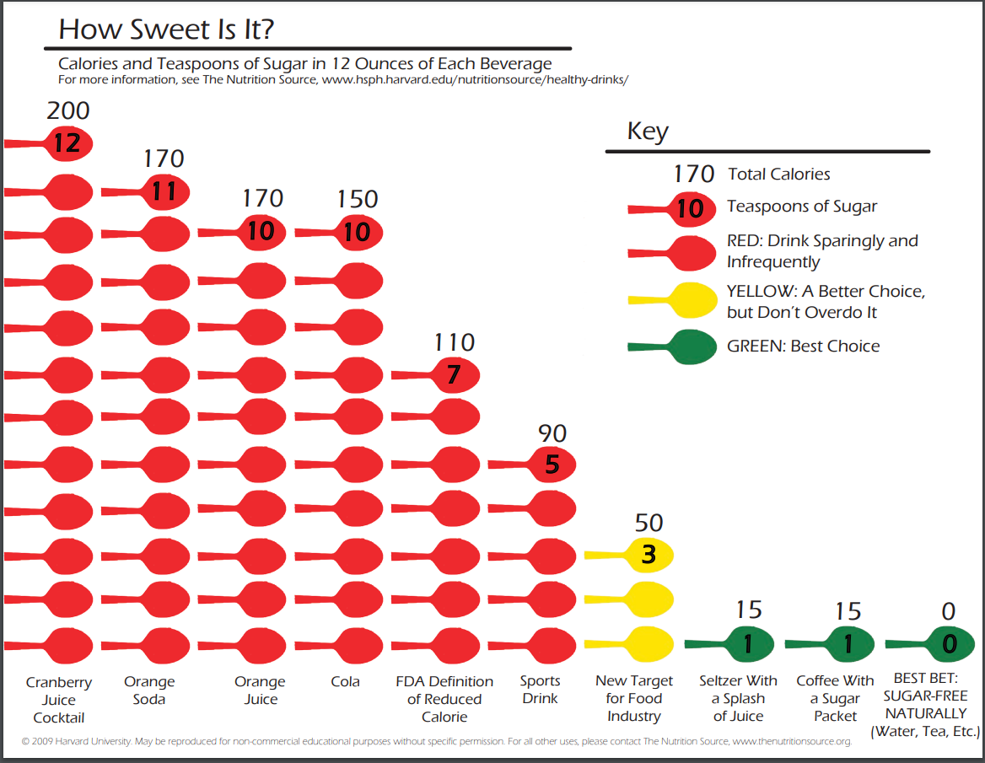
Notes:
Note that Cranberry Juice Cocktail has more sugar than orange soda!
https://www.hsph.harvard.edu/wp-content/uploads/sites/30/2012/10/how-sweet-is-it-color.pdf

Slide 30
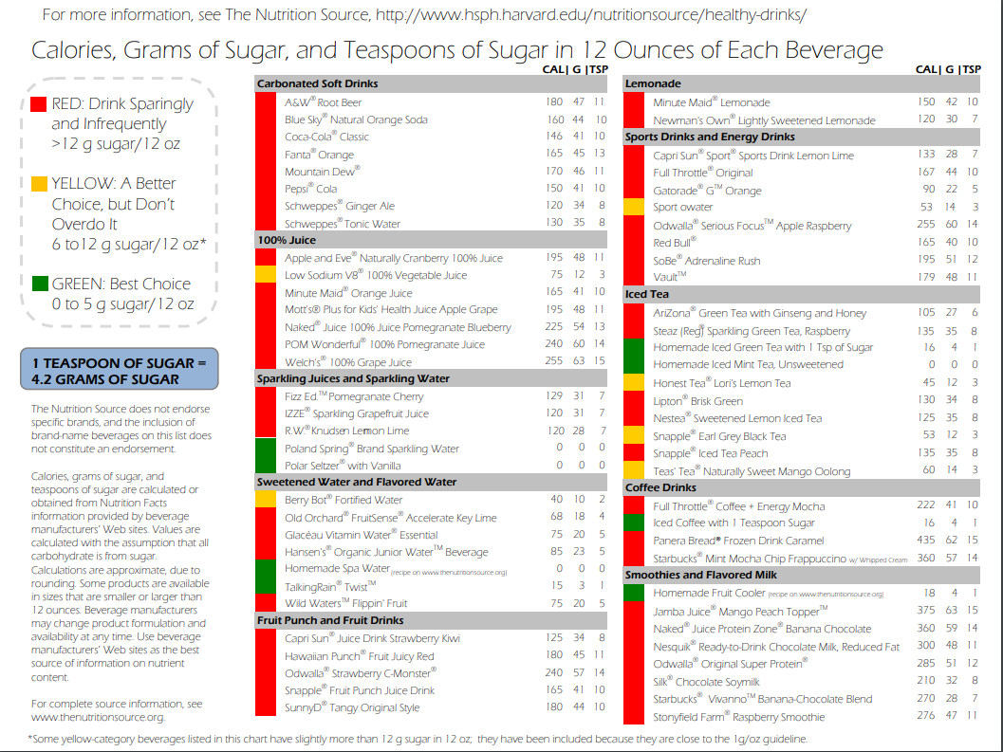
Notes:
Source: https://www.hsph.harvard.edu/wp-content/uploads/sites/30/2012/10/how-sweet-is-it-color.pdf

Slide 31



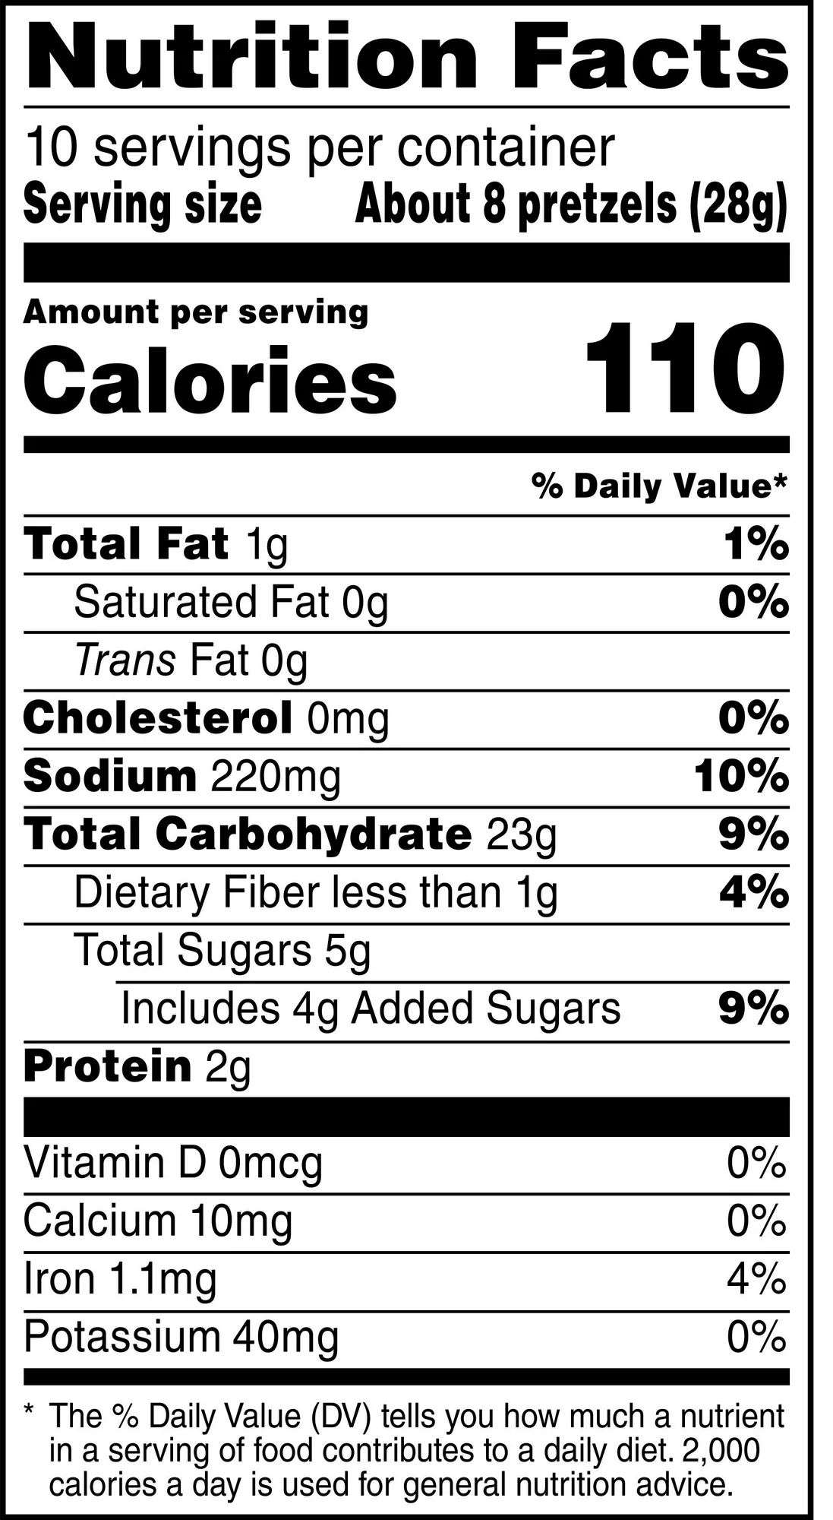




Notes:
Our first label here is for pretzels. Click animations. Flour is listed as the first ingredient. Do you think these pretzels count as a whole grain snack?
[Correct answer: No – it is enriched flour, but NOT whole wheat flour. This means it is not made from the whole grain]
Let’s look at another favorite. How about Cheerios?
[Yes, first ingredient is whole grain oats. It also meets our recommended suggestion of less than 5g sugar per serving and 3g fiber.]
Ok, one more – this one is a little tricky!
So, the first ingredient is actually peanuts. Nuts have healthy fats, so we like that [though you’d want to be careful about peanut allergies!] Then we see two other ingredients – high maltose corn syrup and sugar. Both of those are sugary products. Then we see rolled oats. Rolled oats are a whole grain, but they’re 4th on the label, which means that these bars are made up of more peanuts and sugar by weight than whole grains. If we look at the label, we see that one bar has 11g of sugar and 2g of fiber. So, even though we often think of granola bars as “healthy” snacks, we see that sometimes they are very sugary.
Rold Gold pretzel pics: https://www.walmart.com/ip/Rold-Gold-Braided-Honey-Wheat-Pretzel-Twists-10-Oz/10900057
Cheerios pics: https://www.walmart.com/ip/Original-Cheerios-Heart-Healthy-Cereal-8-9-OZ-Cereal-Box/10311408?athbdg=L1600&from=/search
Nature valley pics: https://www.walmart.com/ip/Nature-Valley-Granola-Bars-Sweet-and-Salty-Nut-Peanut-15-Bars-18-OZ/216139497?adsRedirect=true

Slide 32
Food and Fun Afterschool Curriculum
Curriculum Components
  Afterschool activities for kids
  Parent communications
  Nutrition and physical activity planning and tracking tools
    Monthly nutrition and physical activity planning tool
    Family engagement planning tool
    Observe what’s going on at your program and others!

Slide 33
Food and Fun Afterschool Curriculum
The Basics
Designed for children in grades K-5
Focused on 7 simple science-based healthy eating and physical activity environmental standards
11 units with over 70 activities to pick and choose from
Encourages healthy behaviors through active play, literacy and math skills development, creative learning, and hands-on snack time activities
User-friendly, flexible format and instructions
Lesson extensions make activities easily adaptable across program settings and diverse populations

Slide 34
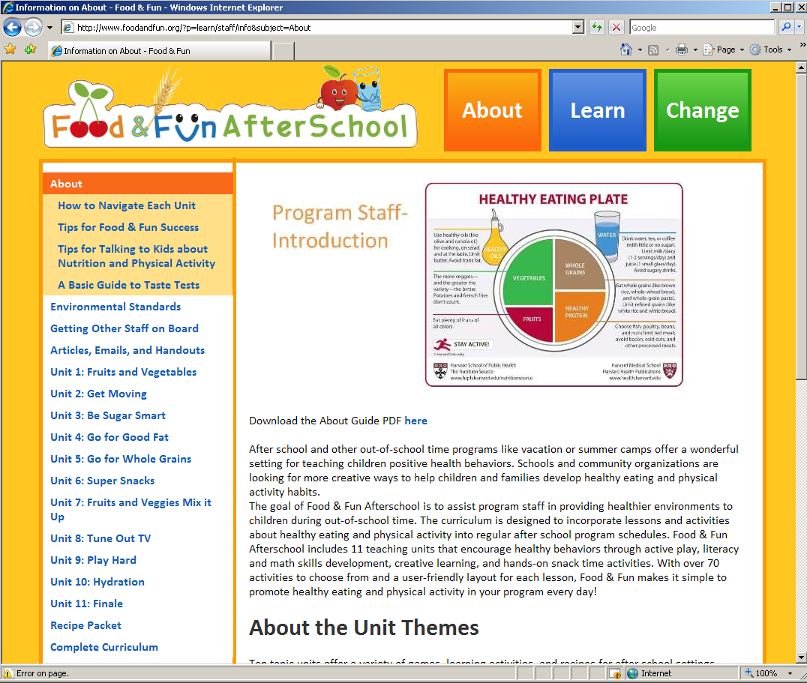
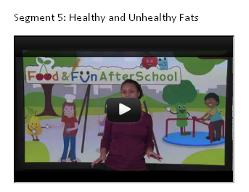

Food and Fun Afterschool
http://foodandfun.org

Slide 35
How many fruits & vegetables should kids have each day?
2 servings
3.5 servings
5 servings
A
B
C

Slide 36
How many fruits & vegetables should kids have each day?
2 servings
3.5 servings
5 servings
A
B
C
Notes:
Should be getting 5 servings each day
Discussion Questions:
Why do you think healthy eating is important?
What types of things do you consider healthy?
What should afterschool programs do to promote healthy eating?
Source: https://www.myplate.gov/eat-healthy/vegetables and https://www.dietaryguidelines.gov/sites/default/files/2021-03/Dietary_Guidelines_for_Americans-2020-2025.pdf

Slide 37
Who is most physically active?
1st grade students
7th grade students
A
B

Slide 38
Who is most physically active?
1st grade students
7th grade students
A
B
Notes:
Kids PA declines with age. 26.2% of 6-11 year olds meet the physical activity guidelines compared to 15.2% of 12.7 year olds.
Discussion Questions:
Why do you think physical activity is important?
What types of things do you consider good physical activity for kids?
What should afterschool programs do to promote physical activity?
Bonus question: Are there any differences in PA levels across genders? We also see differences by gender 18% of girls versus 23.1% of boys meet the PA guidelines of 60 minutes of PA per day.,
Source: https://paamovewithus.org/wp-content/uploads/2022/10/2022-US-Report-Card-on-Physical-Activity-for-Children-and-Youth.pdf

Slide 39
How many gallons of soda are made each year?
20 million
3 billion
12.3 billion
A
B
C

Slide 40
How many gallons of soda are made each year?
20 million
3 billion
12.3 billion
A
B
C
Notes:
Source:
Beverage Marketing Corporation. (February 5, 2018). Volume of the carbonated soft drink market in the United States between 2011 and 2017* (in billion gallons) [Graph]. In Statista. Retrieved January 19, 2024, from https://www.statista.com/statistics/829724/volume-of-carbonated-soft-drinks-in-us/

Slide 41
Where do you stand?
What is one goal that you feel confident you are addressing in your program?
  How do you work to meet that goal at your site?
Have you noticed any nutrition, physical activity, or screen time areas you would like to improve at your program?
  Practices you’d like to change?
  Policies you’d like to implement?
How do you currently communicate with families?
  How could you communicate about these health goals?
How could you use Food & Fun to support healthy changes at your program?
Notes:
Now that you are familiar with the goals and types of changes, I want you to start thinking about how these things are relevant to your program. Take 5 minutes to think through these questions with the staff from your program. [Read through the slide] You may want to have someone take notes, because we’ll use the next 10 minutes to go around and hear everyone’s ideas.
[5 minutes for groups to discuss, Facilitator circles around groups, listening and answering any questions that may arise]
Hopefully this was a useful brainstorming session. I’m going to ask each group to share their answers [note to facilitators, if you are running short on time, you can have them share just a few of their answers, as opposed to all]. As each group shares, think about whether that’s something that you’ve dealt with or would like to address at your program too. The reason we bring you together for these learning communities is to share your expertise and experiences, and we hope that you guys will be able to share those skills with one another.
[10 minutes of sharing out]

Slide 42
Health Messages
Short, simple, positive, and motivational!
NOT lectures, negative, guilt producing, or humiliating
Encourage kids to feel good about healthy eating, drinking and physical activity
Foster an interest in trying new foods, drinks, and activities
Develop healthy behaviors early in life
Emphasize that being healthy can help kids feel strong and fit, improve moods, promote learning. It’s also FUN!
Notes:
First, a primer on what the messages ARE and what they are NOT.
Food and Fun messages ARE short, simple, positive, and motivational.
Example: “I’m glad to see you’re enjoying that fruit. It’s giving you healthy fiber and vitamins to grow and stay healthy.”
Food and Fun messages are NOT lectures, negative, guilt producing, or humiliating.
Example of a positive message: “It’s great to eat fruit every day because studies show that fiber can lower blood cholesterol and lower your risk of heart disease. Plus it’s low in calories so it can help you keep a healthy weight.”
The goal is to encourage kids to feel good about eating healthy and foster an interest in trying new foods. It is important to start developing healthy behaviors early in life to establish good healthy and physical activity habits for the future.

Slide 43
Continuing Education Units
If relevant, insert relevant information here about the CEUs you are offering
  How do people earn the credits?
  How many credits?
  Attendance policy for getting credit?
  Necessary paperwork, etc.]

Slide 44
Web Resources
Prevention Research Center on Nutrition and Physical Activity at the Harvard T.H. Chan School of Public Health: https://www.hsph.harvard.edu/prc/
  Center works with community partners to design, implement and evaluate programs that improve nutrition and physical activity, and reduce overweight and chronic disease risk among children and youth
The Nutrition Source: www.hsph.harvard.edu/nutritionsource
  An online nutrition news and resource center
Alliance for a Healthier Generation: http://www.healthiergeneration.org
  A joint venture between the American Heart Association and the Clinton Foundation with a mission to reduce childhood obesity to empower kids nationwide to make healthy lifestyle choices

