Slide 1
Firearm Suicide Prevention
A brief module for Utah concealed carry classes.

Slide 2
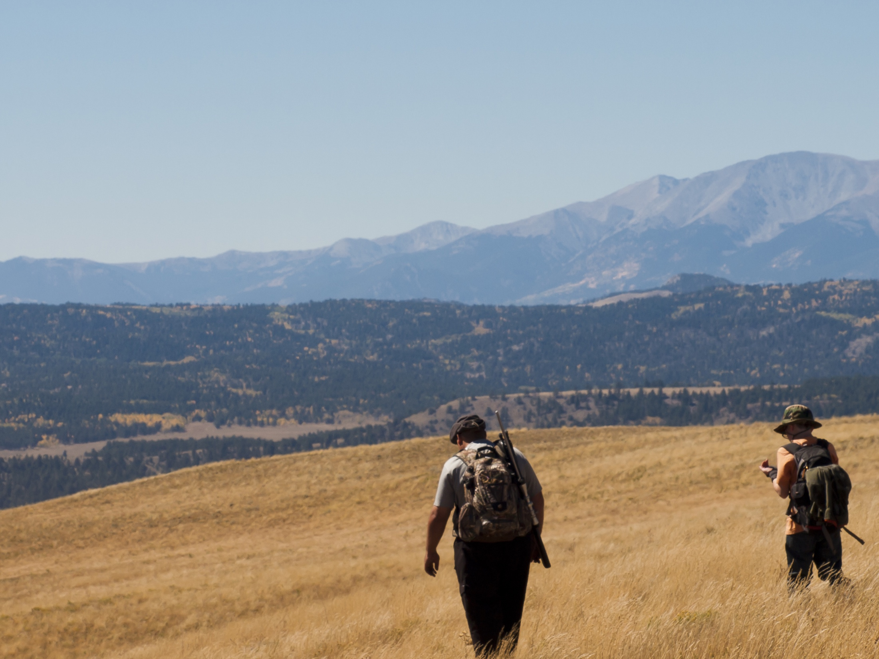
Protecting your family involves more than keeping them safe from accident or attack.

Slide 3
Utah Suicide & Homicide Rates
Suicide
Homicide
Rates are the number of deaths for every 100,000 people in Utah. The graph includes suicides and homicides by all methods. In 2014, 50% of suicides and 59% of homicides in UT were by firearms.

Slide 4
Utah Firearm Deaths, 2010-2014
86% of firearm deaths in Utah are suicides.
Source: CDC WONDER website (official mortality data)

Slide 5
Time & Distance
Putting time & distance between a suicidal person and a gun may save a life.
But won’t they just substitute another method?
Some may, but nearly anything else is less likely to kill.
Others may delay their attempt.
Either way, the odds of survival go up, for three reasons…

Slide 6
Why means matter
Suicidal crises are often brief.
The deadliness of an attempt depends in part on the method used.
90% of those who attempt suicide and survive don’t go on to kill themselves.

Slide 7
Suicidal Crises
People admitted to a hospital after an attempt were asked how long they’d been thinking about suicide before the attempt.
48% said 10 min or less.
Most people who become suicidal have struggled with ongoing, underlying problems. But the movement from suicidal idea to action is sometimes rapid.
% of Attempts

Slide 8
Why means matter
Suicidal crises are often brief.
The deadliness of an attempt depends in part on the method used.
90% of those who attempt suicide and survive don’t go on to kill themselves.

Slide 9
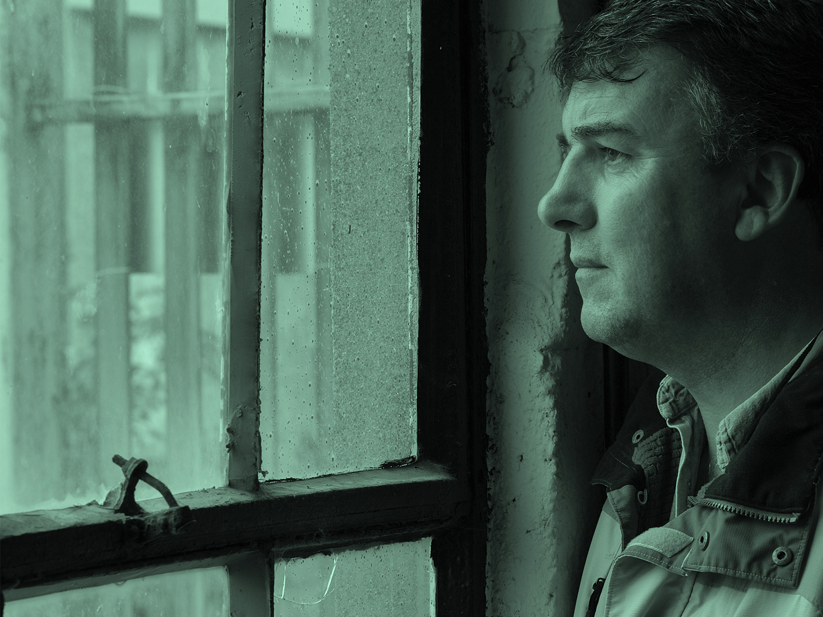
Protecting One Another
Having access to a firearm during a suicidal crisis increases the odds that an attempter will die.
We can protect one another. Be alert to signs of suicide in friends and family.
If someone is at risk, help keep guns from them until they recover.
It’s like holding on to a friend’s keys when they’re drunk.

Slide 10
Who’s at Risk of Suicide?
People who struggle with depression, substance abuse, or other mental health problems, especially if they’re also facing a painful crisis like a relationship break-up, arrest, trouble at work, or financial crises – problems that make you feel hopeless and trapped.
Teens at Home? Teens who die by suicide may show few or not warning signs. A wise precaution: store all guns locked if you have children at home- especially teenagers.

Slide 11
Storage Options
If a household member is at risk of suicide, you could store guns away from home until they’ve recovered (e.g., with a relative you trust, at a self-storage unit)
Or change the locks and make sure they can’t find the keys/combination.
Another option: don’t keep ammunition at home until they’ve recovered.
Hiding guns isn’t recommended. Family members often know one another’s hiding places.
If it’s a friend at risk, offer to hold onto their guns.***
* This is allowable under Utah law but may not be under other state laws.

Slide 12
What if it’s You at Risk?
If you feel yourself spiraling down, take precautions before things get to a crisis point.
Any strategy that builds some time between you and a gun in a suicidal crisis will keep you safer.
Store your guns off-site temporarily, or ask someone you trust to hold onto the keys, or store keys somewhere they’re not available in a crisis like a bank safe deposit box, or disassemble guns.
These are temporary measures until you’ve recovered.

Slide 13
Under Utah’s Safe Harbor law (53-5c-201), a gun owner or spouse can store their firearms free of charge with law enforcement if they believe someone at home is a danger to self or others.

Slide 14
Getting Help
Utah Statewide Crisis Line: 1-801-587-3000
National Suicide Lifeline: 1-800-273-TALK (8255)
In an emergency, call 911 and ask for a CIT (Crisis Intervention Team) officer
To learn more about suicide prevention, visit utahsuicideprevention.org

Slide 15
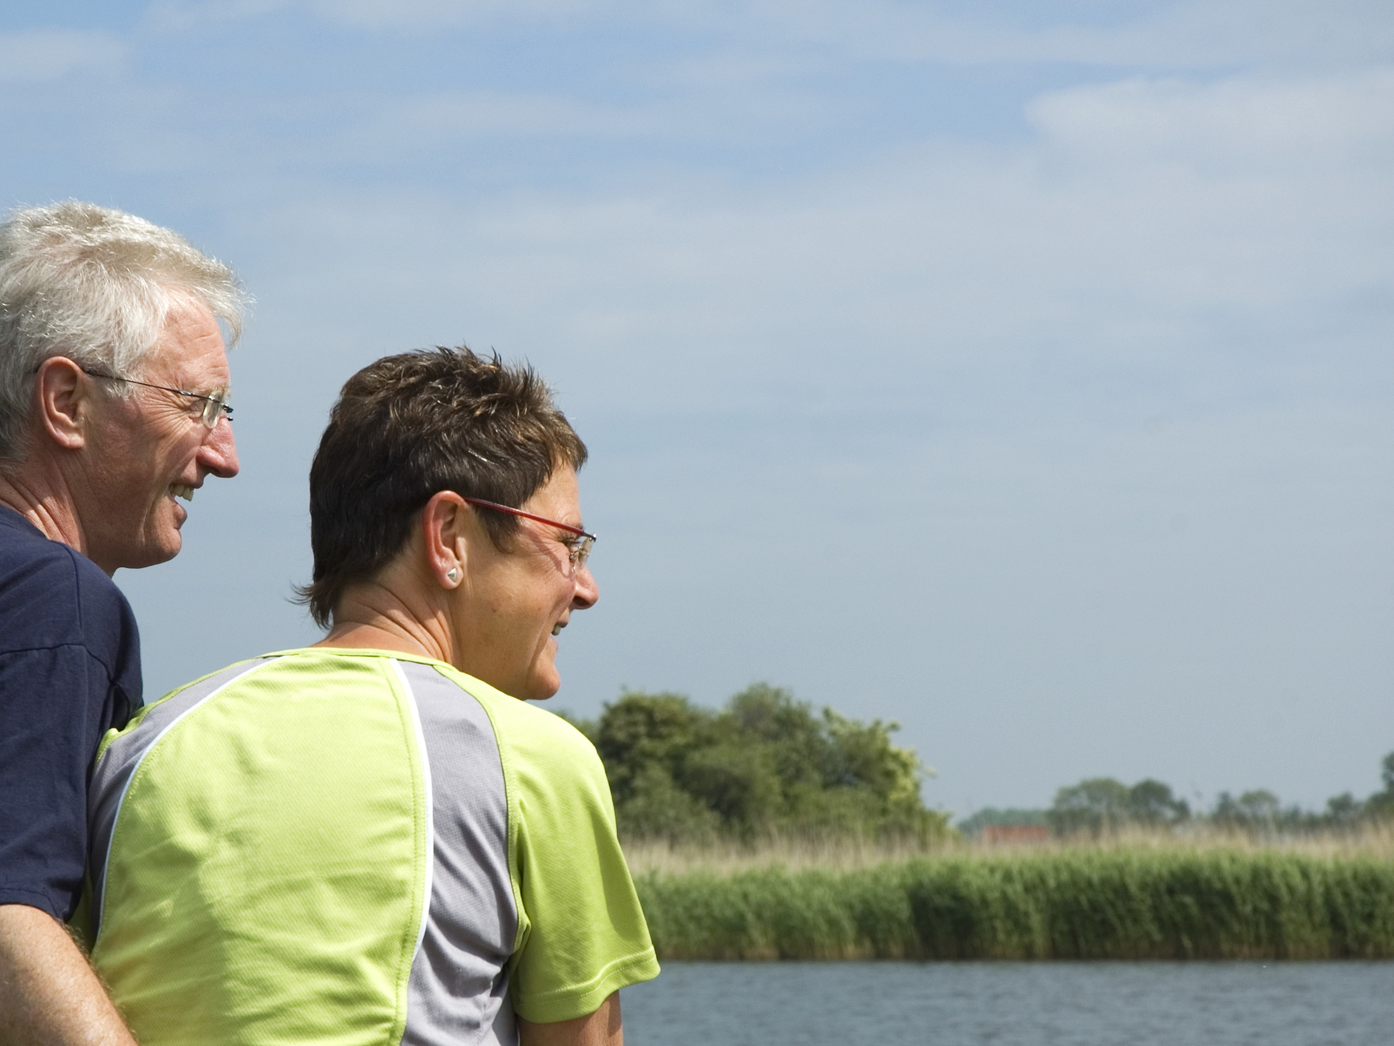
Protecting our Freedom
Gun-owning families can bring down the number of firearm suicides.
We can do it without government mandates.
Together, we can protect our family, our friends, and our freedom.

