Slide 1


Coloring the Narrative:
How to Use Storytelling to Create Social Change in
Skin Tone Ideals
Teacher’s Aid
[Insert Instructor Name, Title]
[Insert Date]
[Insert Institution and/or Course Title]

Slide 2
Key Terms
Teacher’s Aid
What is a story?
  A descriptor of all types of narratives, from mundane anecdotes to deep-seated cultural frameworks
What is a narrative?
  A story or account of events, sequenced over time and space; a process for the human mind to make meaning and relate with the world; can be dominant or passive.
What is a narrative frame?
  The larger story that shapes our understanding of information, experiences, and messages; the structure and boundaries of a narrative that defines point of view and power. Frames are lenses through which we view narratives.
What is discourse?
  The stories, narratives, and cultural systems that we bring to any interaction
SOURCE: Reinsborough P and Canning D (2010). Re: Imagining Change: How to use story-based strategy to win campaigns, build movements, and change the world. Canada: PM Press.

Slide 3
Key Terms
Teacher’s Aid
What is a story-based strategy?
  A framework that links a social movement with an analysis of narrative by placing storytelling at the center of social change strategy. The framework provides tools to craft more effective social change stories, challenge assumptions, intervene in prevailing cultural narratives, and change the story around an issue.
What is colorism?
  Prejudicial or preferential treatment of same-race people based solely on their skin color.
What are skin tone ideals?
  Beauty standards about shades of skin that are perpetuated by media and societal influences
SOURCE: Reinsborough P and Canning D (2010). Re: Imagining Change: How to use story-based strategy to win campaigns, build movements, and change the world; Walker A (1983). In Search of Our Mothers’ Gardens.; Craddock N (2016), Colour Me Beautiful

Slide 4
Why should we use story-based strategies for social change?
Teacher’s Aid
Research shows that stories are more effective at changing attitudes than are rational arguments or persuasive writing
Storytelling is a fundamental aspect of human life: they are how we think, feel, remember, imagine, make meaning of our experiences, and relate to others
The explicit use of storytelling strategies in pop culture, marketing, advocacy and nonprofit agencies has grown in the past 30 years.
Funders and nonprofits use storytelling to conduct needs/strength assessments, community organizing, public education, and program evaluation
SOURCE: VanDeCarr P (2013). Storytelling and Social Change

Slide 5
What are the functions of story?
Teacher’s Aid
SOURCE: VanDeCarr P (2013). Storytelling and Social Change

Slide 6
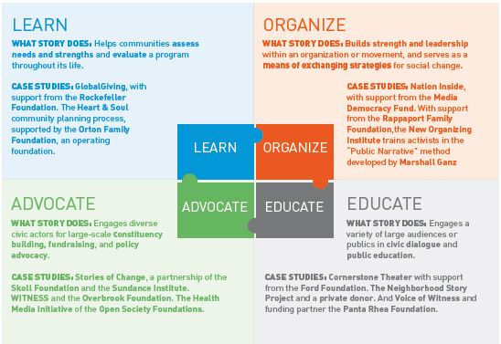

Teacher’s Aid
SOURCE: VanDeCarr P (2013). Storytelling and Social Change

Slide 7
Examples of Real-World
Skin-Lightening Campaigns
Teacher’s Aid
SOURCE: VanDeCarr P (2013). Storytelling and Social Change

Slide 8

L’Oreal Paris Billboard, 2016
Teacher’s Aid
Tagline: Melanin-Vanish: Because we definitely deserve; 50x More White Perfect

Slide 9
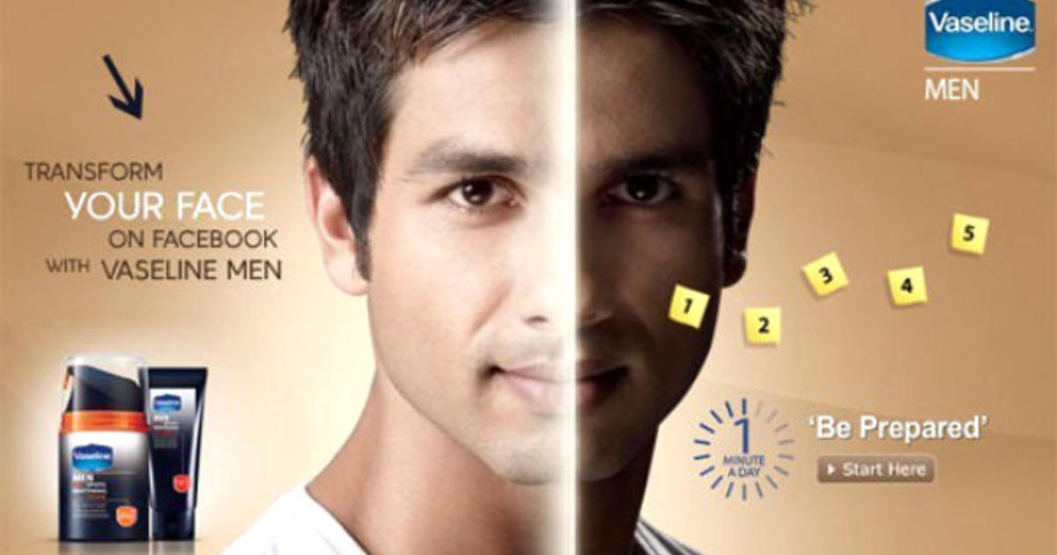
Unilever (Vaseline for Men), 2010
Teacher’s Aid
Tagline: Transform Your Face on Facebook with Vaseline for Men (Indian ad starring Bollywood star Shahid Kapur)

Slide 10


Whitenicious by Dencia
Teacher’s Aid
Tagline: Luxury high-end skincare products (Ad campaign starring Cameroonian pop star Dencia. Picture on right is from Maxim magazine photo spread in 2010. Picture on left is from 2016).

Slide 11
Anti-Skin-Lightening Campaigns
Teacher’s Aid
SOURCE: VanDeCarr P (2013). Storytelling and Social Change

Slide 12
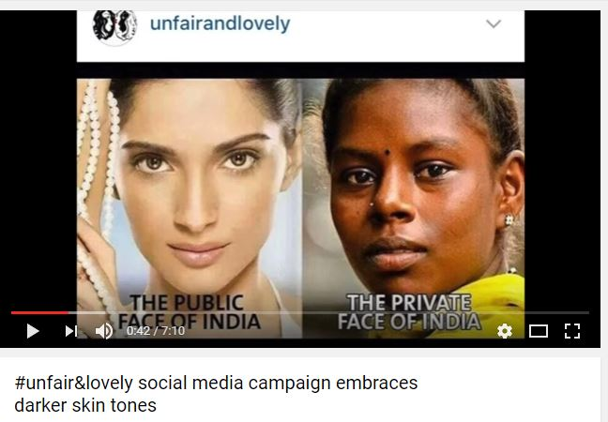
Unfair & Lovely Social Media Campaign
Teacher’s Aid
Notes:
https://www.youtube.com/watch?v=JSdaZMWuRik

Slide 13

Dark Is Beautiful Campaign
Teacher’s Aid

Slide 14
Group Activity
Teacher’s Aid
SOURCE: VanDeCarr P (2013). Storytelling and Social Change

Slide 15
Homework Assignment: Choose a POV
Teacher’s Aid
Rebecca Obafemi: Nigerian mother who moved to Hamilton without skin-lightening cream
Piti Bunyasarn: Thai au pair who moved to Hamilton with skin-lightening cream
Muñoz: Immigrant bodega owner who refuses to stock skin-lightening products
Kwame Michael Boateng: Pastor of church for many Anglophone African Hamilton residents
Sukhon Pradtana: Master’s student in health communications who meets with Piti Bunyasarn
Sally Kreisberg: Sukhon’s mentor who studies body image and risky cosmetic products and procedures

Slide 16
In-Class Assignment
Teacher’s Aid
Step 1 (5 minutes): Discuss homework ideas & common themes
Step 2 (5 minutes): Vision & Campaign Goal-Setting
Step 3 (5 minutes): Identify Targets & Audiences
Step 4 (5 minutes): Construct & Deconstruct the Narratives
Step 5 (5 minutes): Define Use of Your Story
Step 6 (5 minutes): Design Primary Campaign Narrative
Step 7 (10 minutes): Define Your Intervention
Step 8 (5 minutes): Propose an Evaluation Strategy
Recall the range of examples described in the VanDeCarr text – collecting and distributing micro-narratives, video advocacy, theater for social change, books created by communities, etc. Think creatively and practically!

