Slide 1
TeamBirth: Process Innovation for Clinical Safety, Effective Communication, and Dignity in Childbirth

Slide 2
We are a joint center for health systems innovation at Brigham & Women’s Hospital and the Harvard T.H. Chan School of Public Health.

Slide 3
Our vision is a world in which every person can choose to grow their family with dignity.

Slide 4
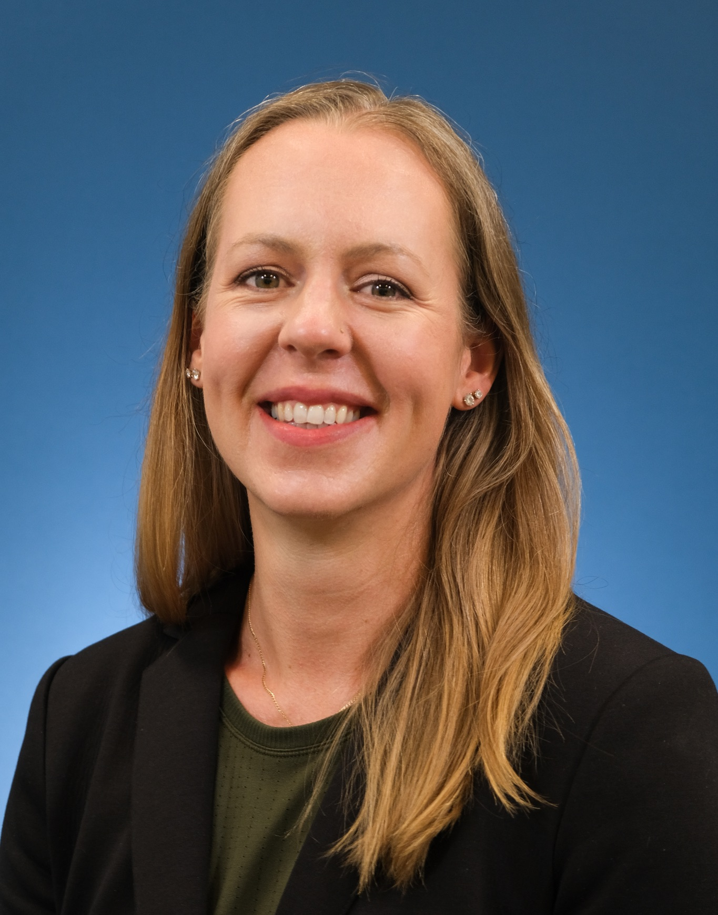
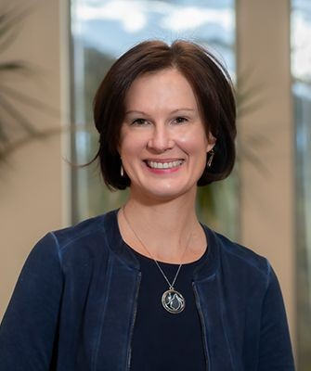
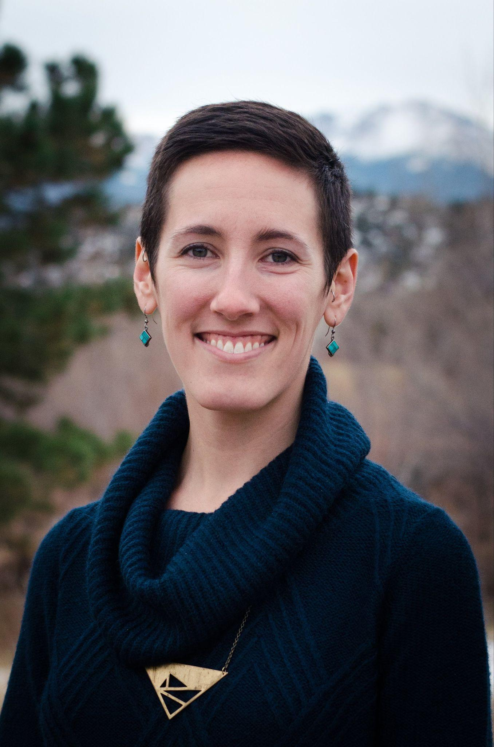
Meet the DDI Team
Amber Weiseth DNP, MSN, RNC-OB Director
Jonathan Wolinsky MPP
Associate Director
Joyce Edmonds
PhD MPH, RN
Sr. Research
Scientist
Trisha Short
BSN, RN
Sr. Implementation Specialist
Misha Severson
MN, RN
Implementation Specialist
Abby Slattery MPH, MSN, RN Implementation Specialist
Whitney Miller
MSN, CNM, FNP-BC
Implementation Specialist
Indigo Miller
MPH, RN
Sr. Implementation Specialist
Angela Chien MD
TeamBirth Faculty
Yara Altaher MPH
Sr. Research Coordinator
Lynn El Chaer
MPH
Research Assistant
Kaya Duguay
MPH
Project Coordinator
Tyler Fox
MPH
Strategy & Project
Coordinator
Isabel Griffith
MPH
Research Specialist
Kelsey McLernon
Implementation
Assistant
Interns
Elizabeth Curtis, Neema Leema, Kerry Lindquist, Christie Louis, Kathryn Ault, Jen Trebbin, Fiona Unsworth, Harini Somanchi

Slide 5
TeamBirth Core Components
Critical to successful delivery of TeamBirth across the maternal health continuum
1.
STRUCTURED TEAM HUDDLES
2.
SHARED PLANNING TOOL
Structured conversations that includes the birthing person and their support people
Visual tool that structures communication and provides space to document discussions during huddles

Slide 6
TeamBirth Huddles:
WHO
WHEN
The entire direct care team, including the person in labor and their support
At admission and at major decision points or changes in care plans throughout labor and postpartum
WHAT
WHY
Discuss preferences; care plans for mom and baby; labor progress*; and expectations for the next huddle
Give all team members the opportunity to participate in shared decision-making
* ‘Labor progress’ refers to the laboring uterus and cervix. Plans for progress should also be discussed in postpartum and newborn huddles.

Slide 7
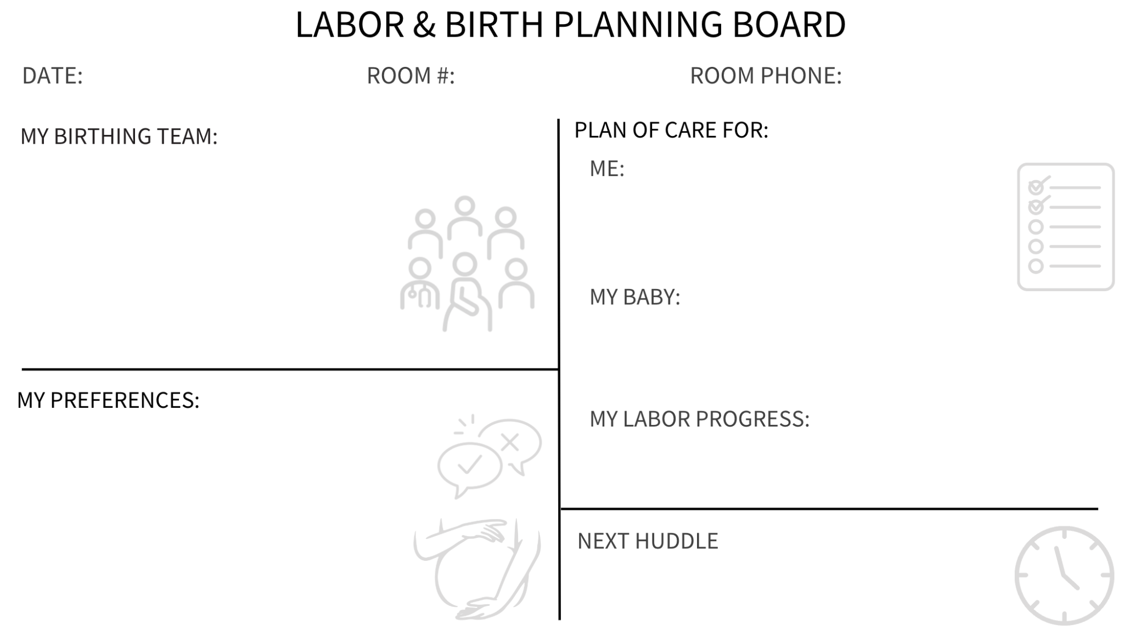

Slide 8
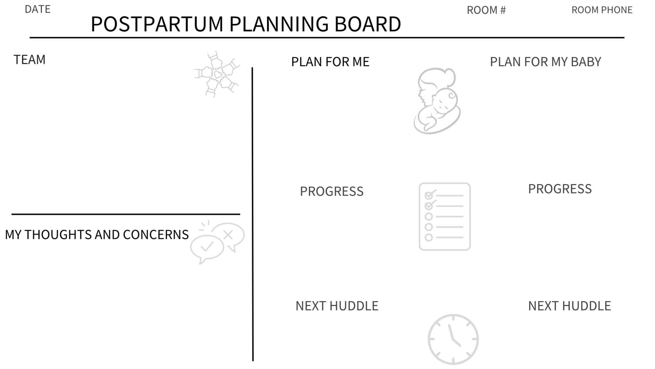

Slide 9
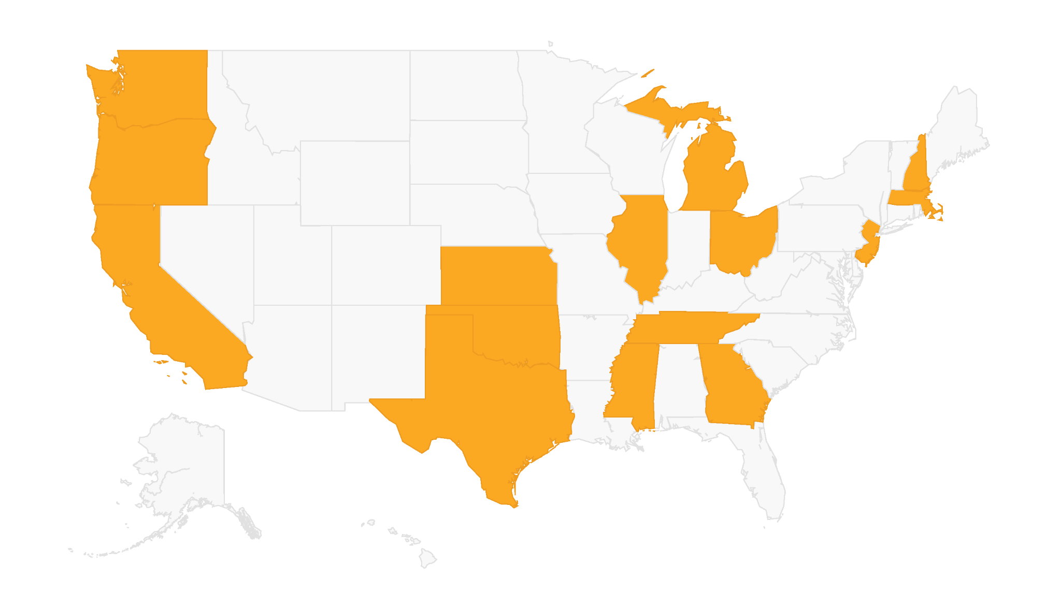
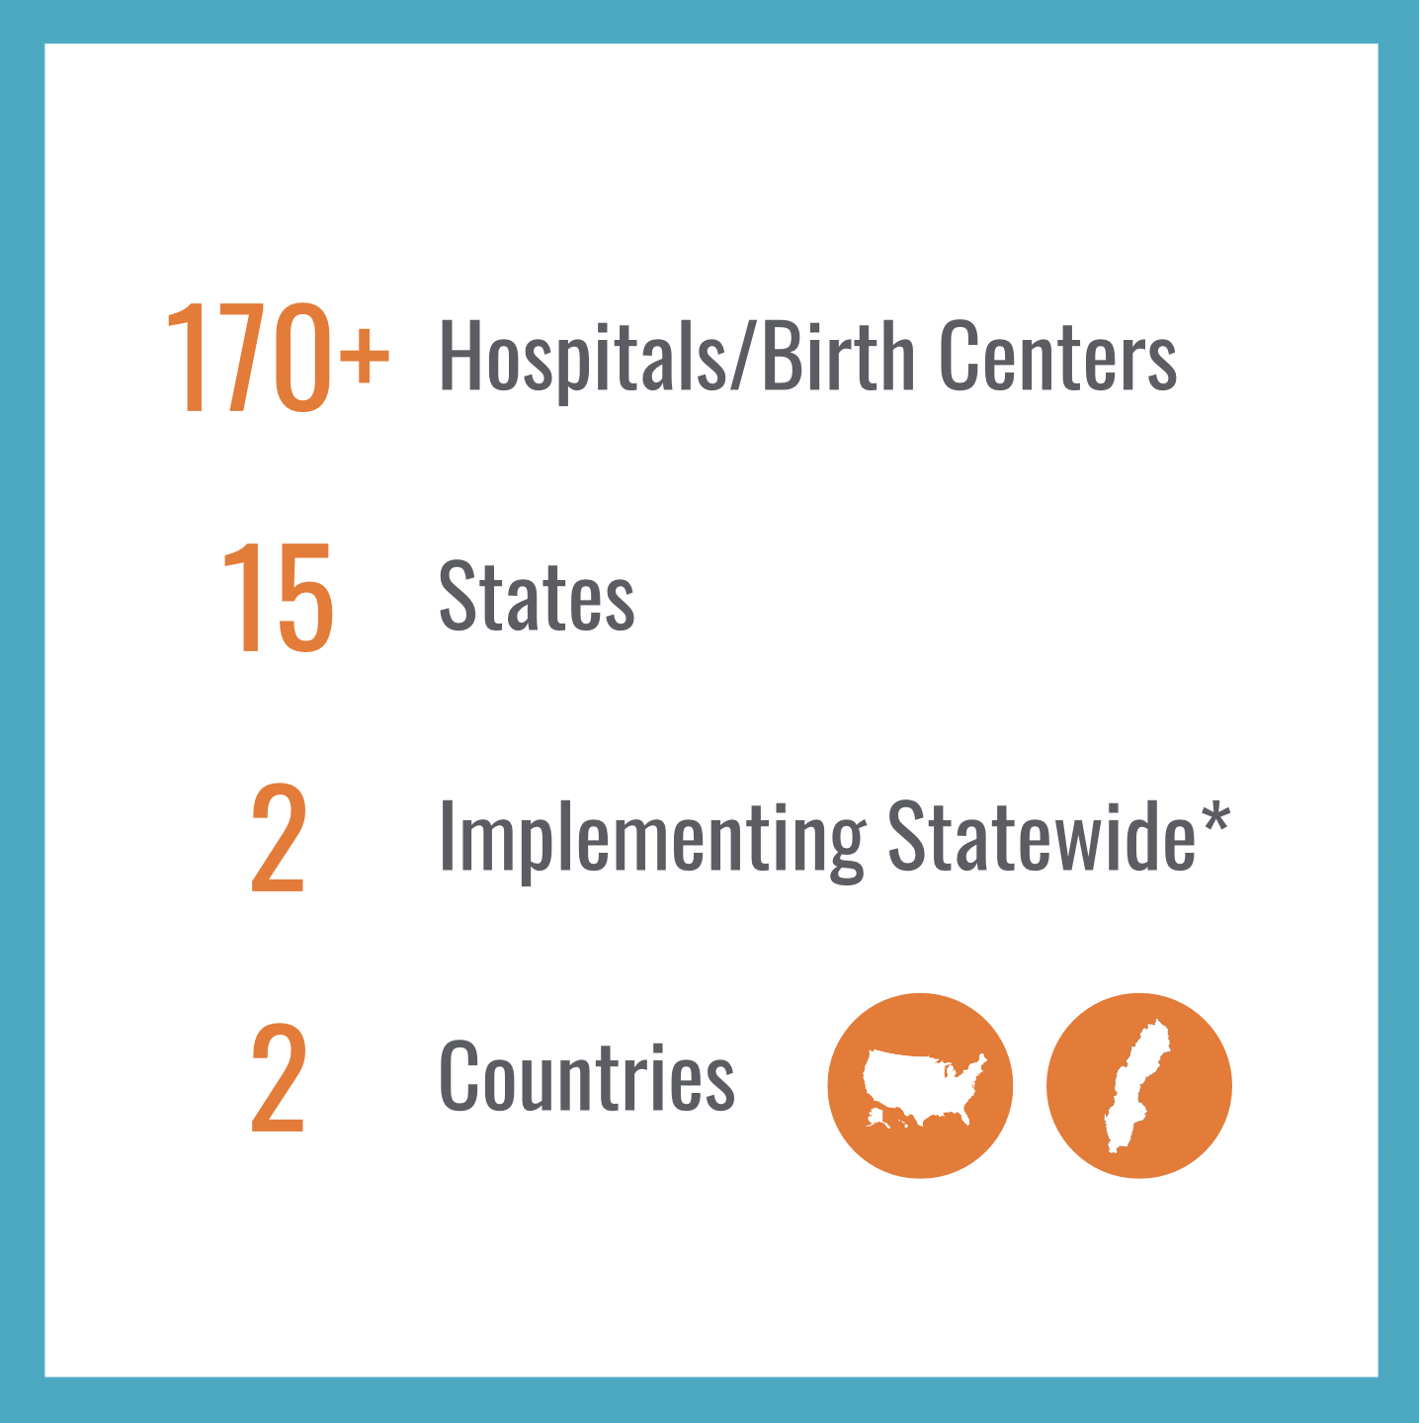
TeamBirth is spreading nationally and globally
*
*
*
Notes:
Map Legend Canva Link: https://www.canva.com/design/DAFt5u8mPoc/DheqQYPngJBcbl0NoMHXYA/edit

Slide 10
Contact Us:
tfox@ariadnelabs.org

