Slide 1
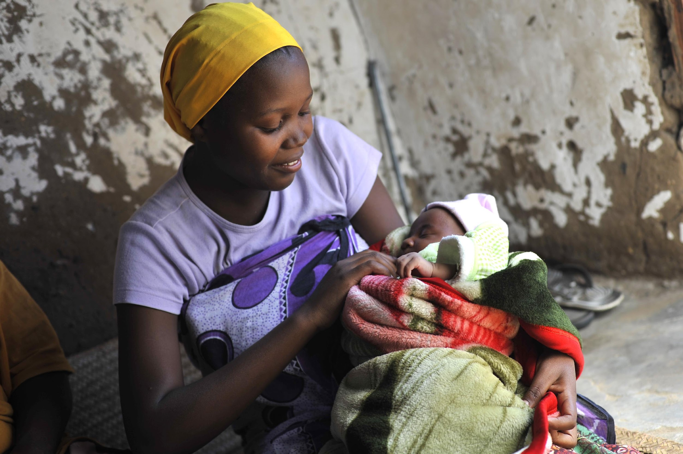
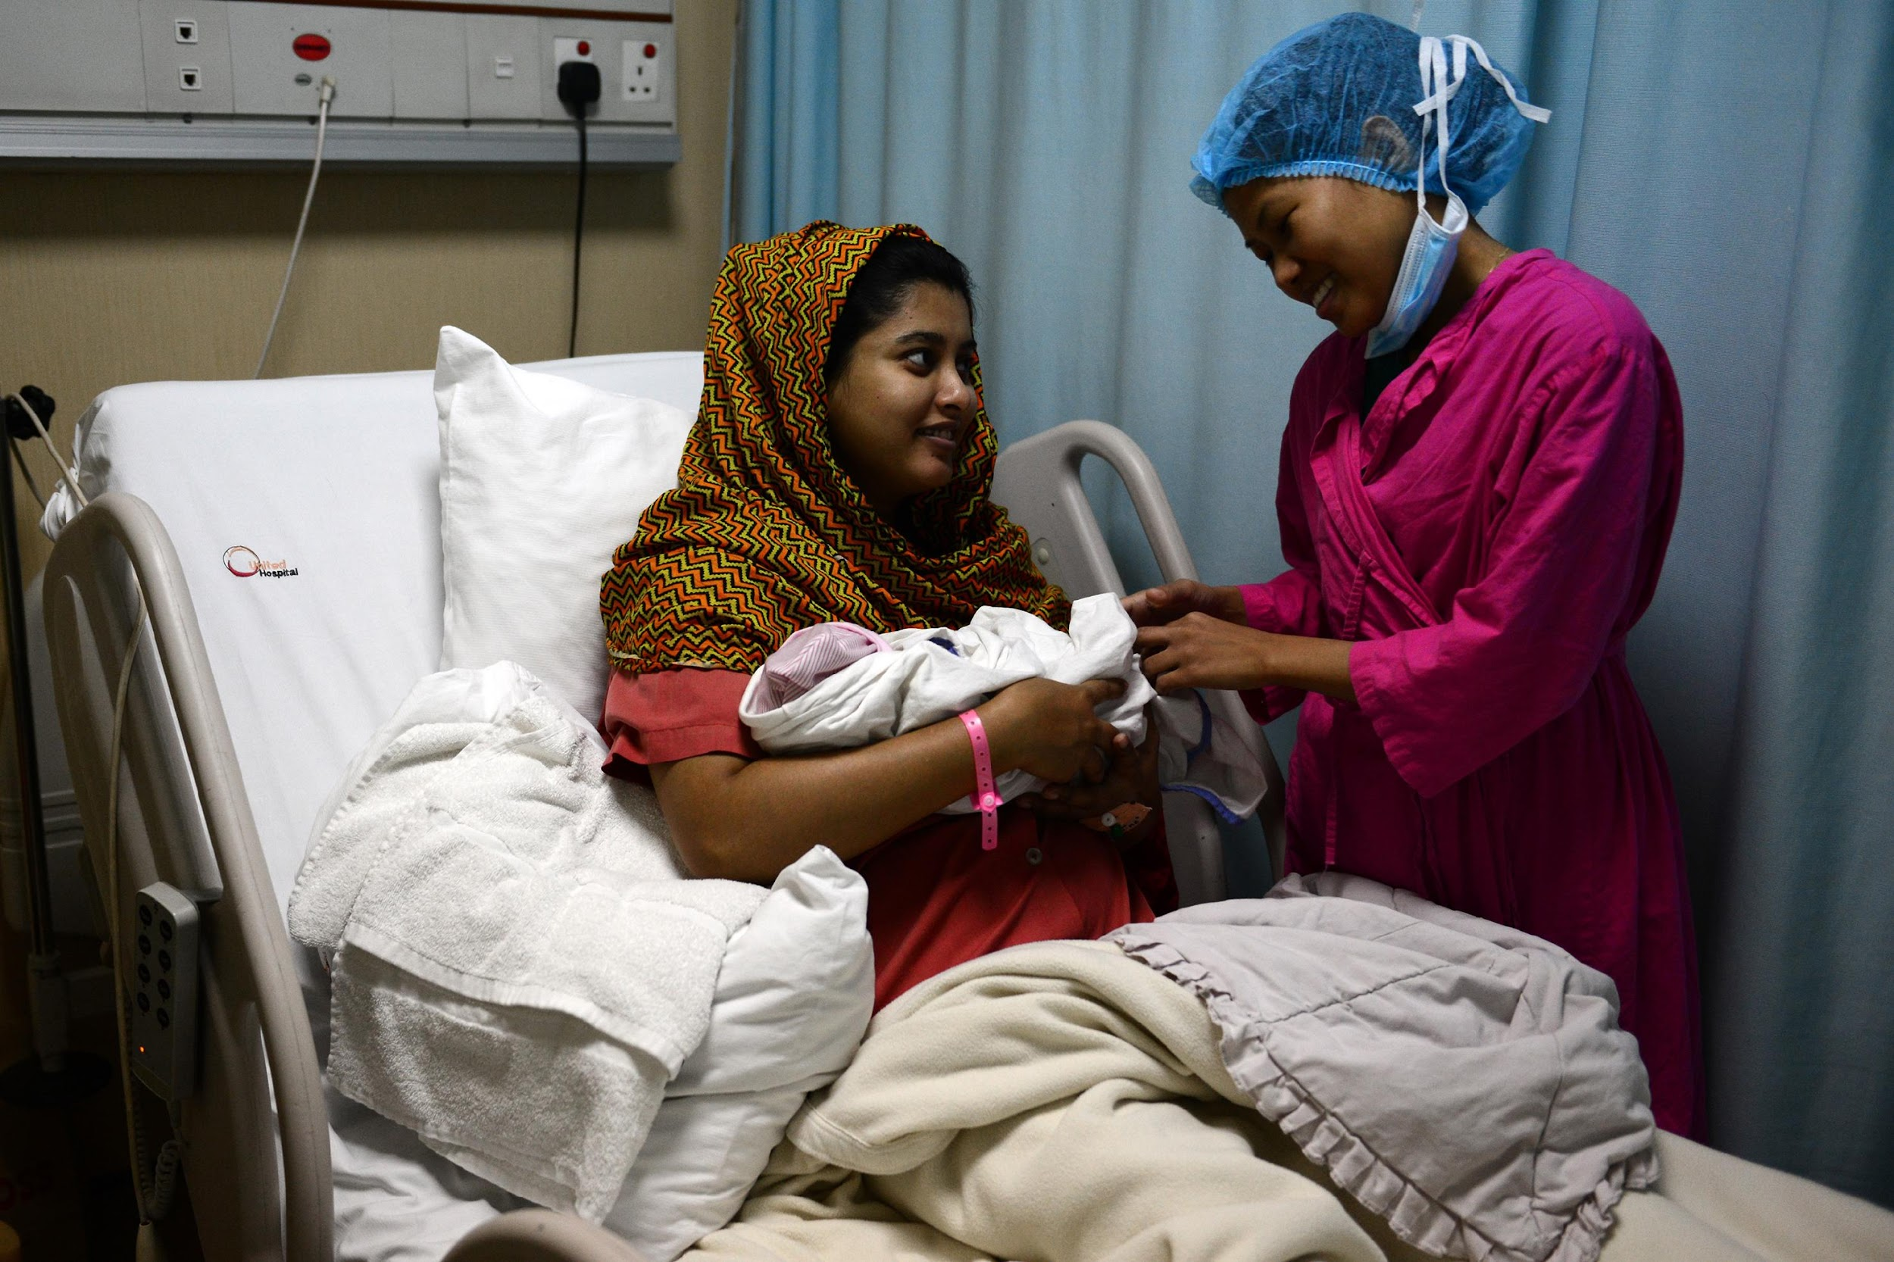
Confidential - Not for distribution
Low Birthweight and Preterm Infant Feeding Trial and Supportive Care Package Study (LIFT-UP)
MCH Internship Opportunity

Slide 2
Who we are?
Notes:
Time permitting

Slide 3
LIFT-UP Project Team
Katherine Semrau, PhD, MPH
Ilana Dzuba, MHS
Director of BetterBirth Program (Senior PI);
Associate Professor, Harvard Medical School
Assistant Director, Program Management,
Vulnerable Infant Portfolio
Danielle Tuller, MHS
Rana Mokhtar, PhD, MPH, MA
Associate Director Program Management & Strategy, BetterBirth Program
Research Associate
Volha Belavusava, MD
Linda Vesel, PhD, MPH
Neonatology Fellow
Senior Research Scientist & Scientific
Lead, Vulnerable Infant Portfolio (Co-PI)
Tricia Vallabhaneni, MBA, MEd
Project Manager

Slide 4
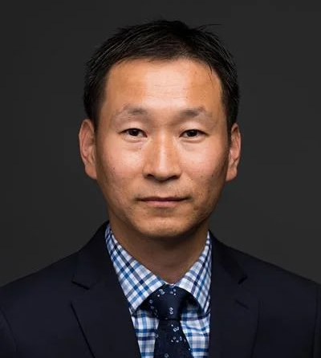
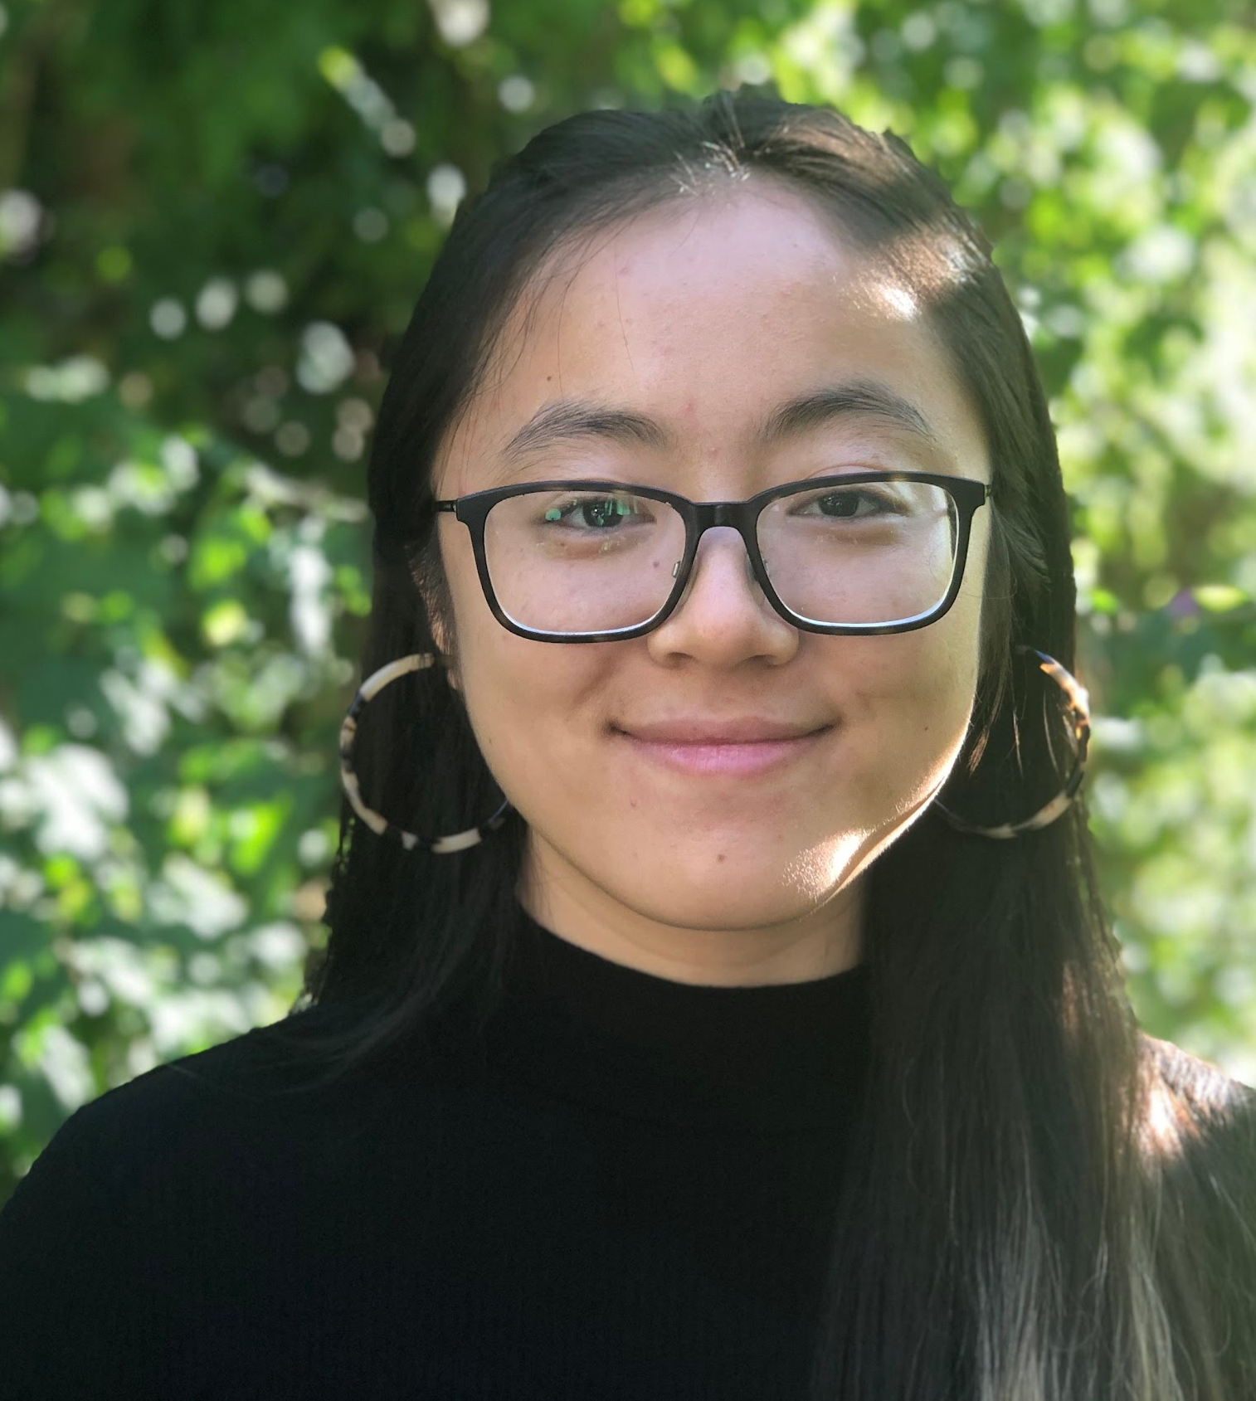
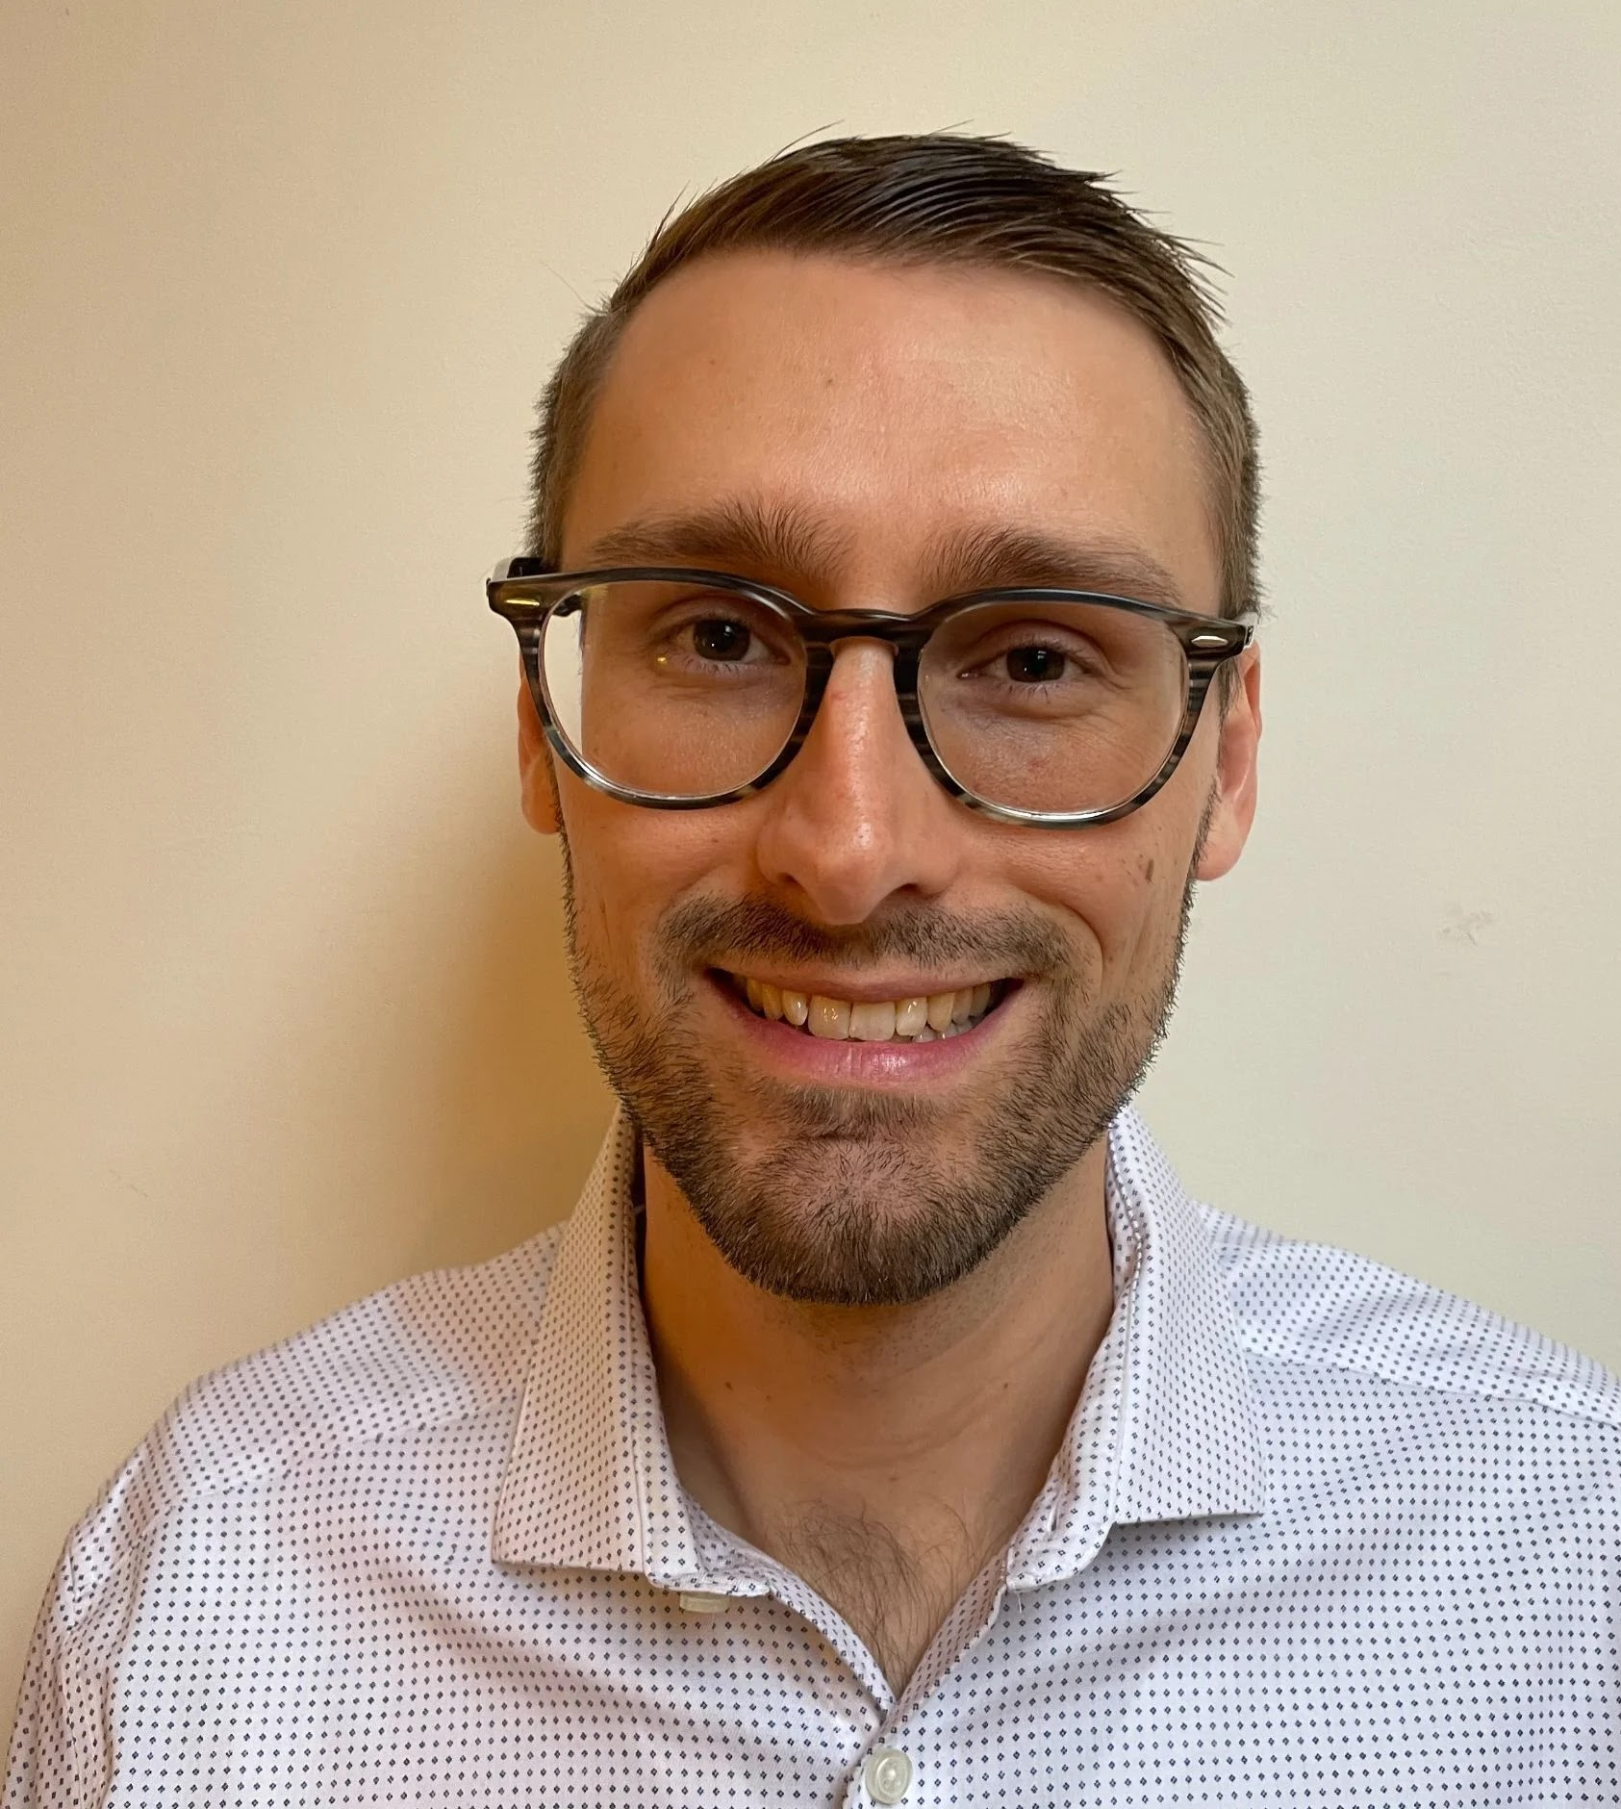
LIFT-UP Project Team
Ki-Do Eum, PhD, MPH
Abby Ow
Data Science
Computer Science
…And consulting with others
Sam Woodbury
Steven Halstead
Computer Science
Computer Science
Shreyas Srinath, MSc
Mary Robertson
Computer Science
Finance

Slide 5
LIFE & LIFT-UP Study Consortium Partners
Ariadne Labs | Boston, USA (Senior PI, Katherine Semrau; Co-PI, Linda Vesel)
Community Empowerment Lab | Uttar Pradesh, India (Co-PI, Aarti Kumar)
Jawaharlal Nehru Medical College | Karnataka, India (Co-PI, Roopa Bellad)
Muhimbili University of Health and Allied Sciences | Dar es Salaam, Tanzania (Co-PI, Karim Manji)
UNC Project Malawi | Lilongwe, Malawi (Co-PI, Tisungane Mvalo)
PATH & PATH Living Labs | Seattle, USA; Nairobi, Kenya & Delhi, India (Co-PI, Kimberly Mansen)
Brigham & Women’s Hospital | Boston, USA (Co-PIs, Krysten North, Mandy Brown Belfort)
Emory University | Atlanta, USA (Co-PI, Bethany Caruso)
Harvard T.H. Chan School of Public Health | Boston, USA (Co-I, Chris Sudfeld)
Boston Children’s Hospital | Boston, USA (Co-I, Chris Duggan)
Brown University, Warren Alpert Medical School | Providence, USA (Co-PI, Anne CC Lee)

Slide 6
Background; Current Challenges & Opportunities for Low Birthweight and Preterm Infant Feeding

Slide 7
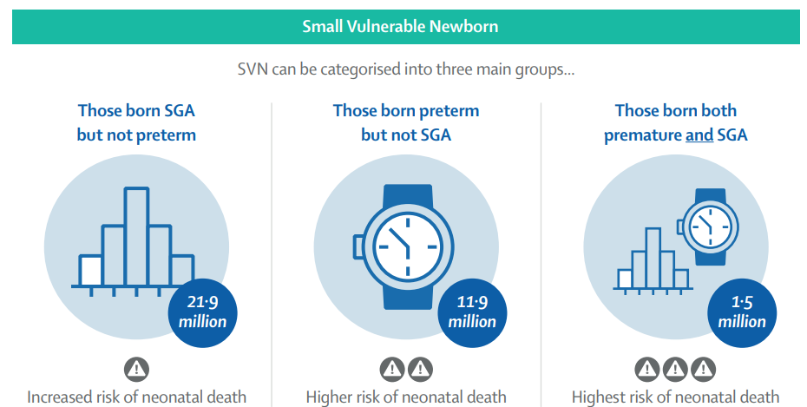
Background | Challenge - 55.3% of global neonatal deaths are among small and vulnerable newborns (SVNs)
Together, these 3 groups account for 99.5% of the 19.8 million babies born LBW
Lancet SVN Series 2023 Infographics
Notes:
Despite major progress in improving child survival, the burden of neonatal mortality has remained high due mainly to babies who are born preterm (or born too soon), small for gestational age (SGA) (or born too small), or with low birthweight (LBW). These infants are often referred to as SVNs
Current estimates indicate that more than half of deaths in the first month of life occur among these small vulnerable newborns.
This is why we are prioritizing this population in the LIFT-UP study

Slide 8
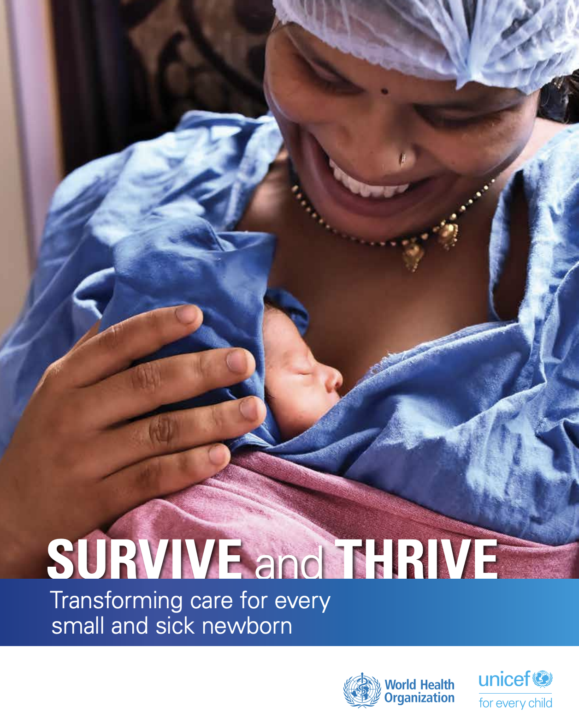
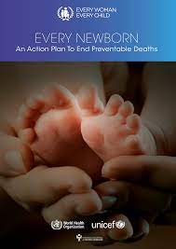
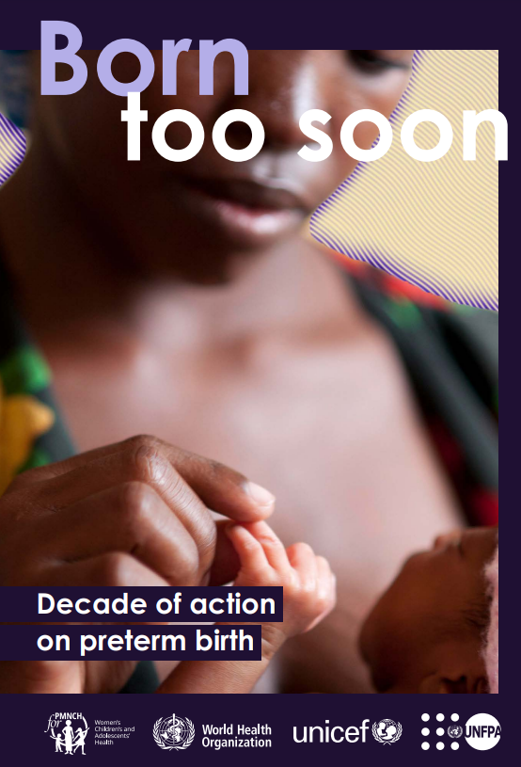
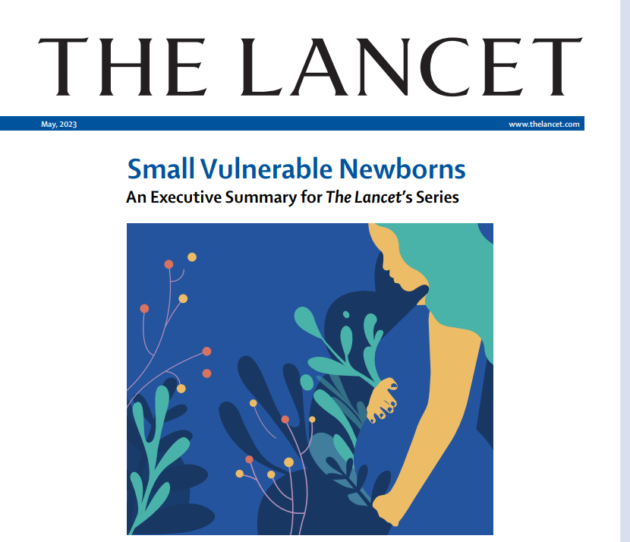
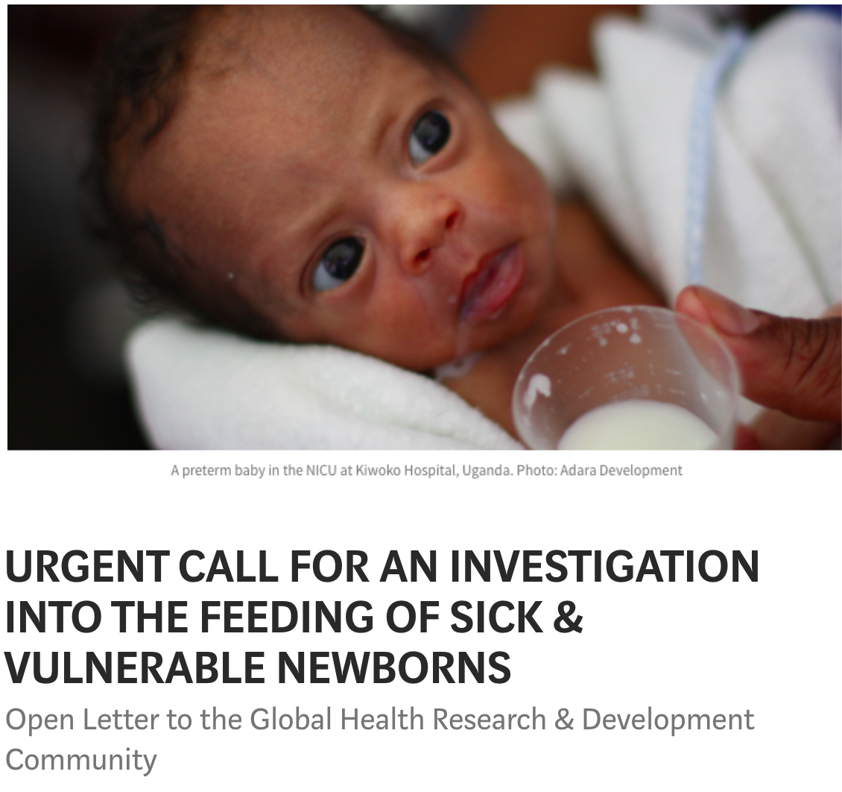
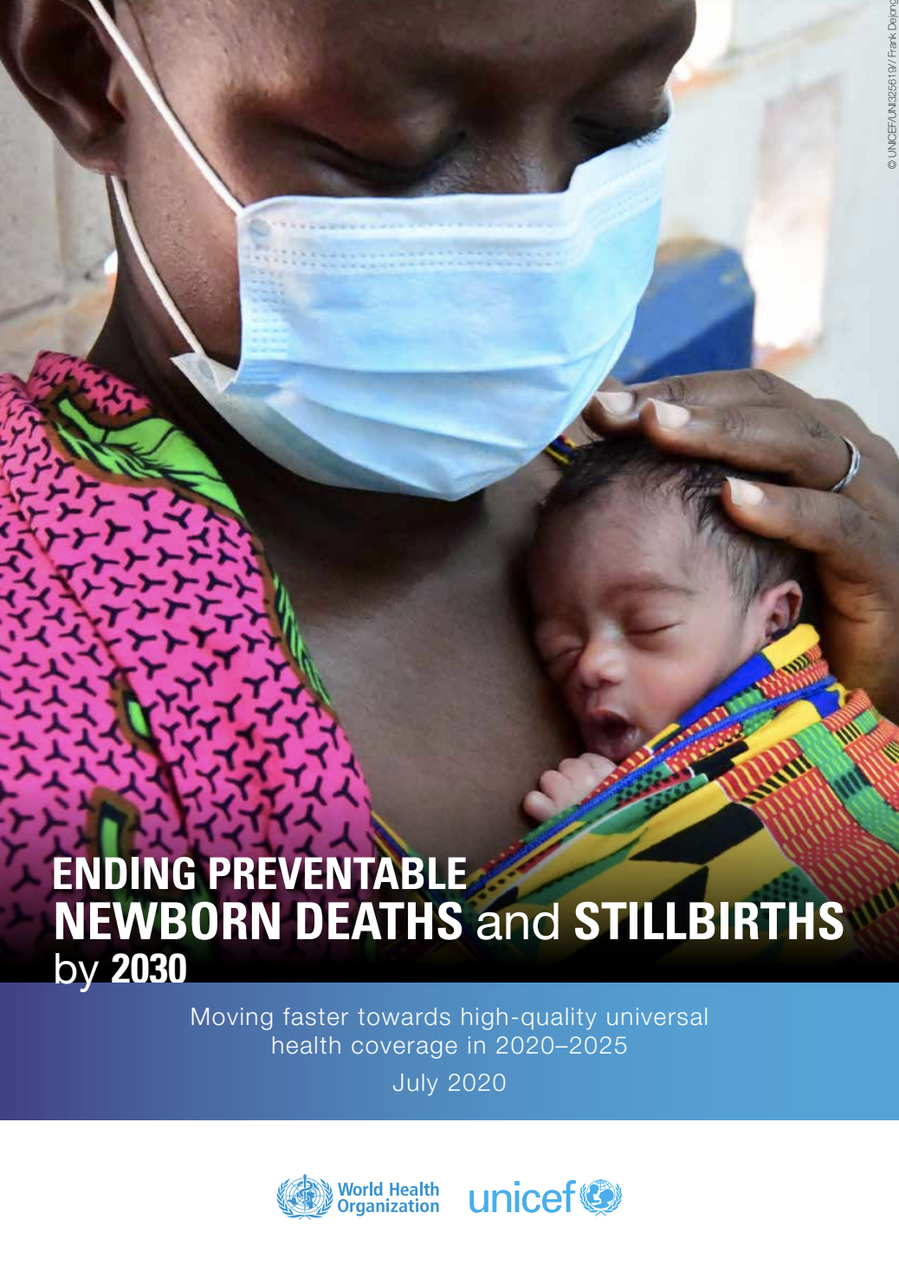
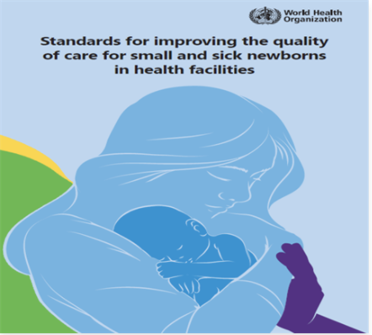
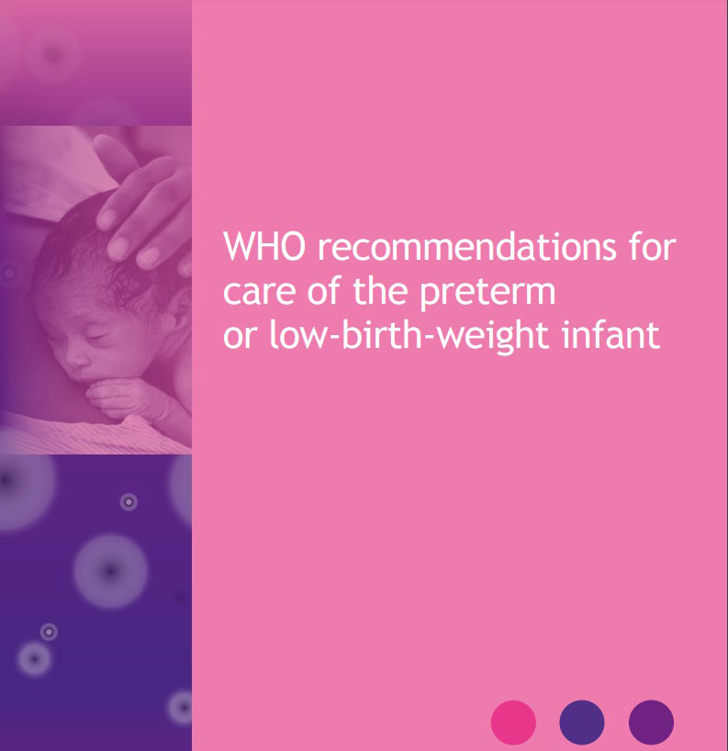
Background | Opportunity - now is the right moment to prioritize small vulnerable newborns
Notes:
A number of opportunities in recent years have propelled interest and investment in the care of preterm and LBW infants in order to attain global mortality reduction targets.
This started about a decade ago with the launch of Every Newborn Action Plan to finally prioritize newborn health and survival and elevate the newborn within the global health agenda. ENAP created a roadmap for ending preventable newborn deaths
In 2017, 40 global health organizations issued an urgent call to action for more evidence to address the current state of feeding of sick and vulnerable infants. This was the driver behind the LIFE study.
Over the past 5 years, the WHO, UNICEF, USAID among other organizations have released reports, guidelines and new research findings focusing on the care of the small vulnerable newborns.
With interest and investment galvanized, research is needed to develop evidence-based approaches and translate findings into action to ensure the most vulnerable infants can survive and thrive.

Slide 9
Background | Opportunity - supporting new WHO recommendations for care of preterm and LBW infants
Notes:
Published in Nov 2022
Previous recommendations were much older:
Guidelines on optimal feeding of low-birth-weight infants in low- and middle-income countries, 2011
Recommendations for management of common childhood conditions, 2012
WHO recommendations on interventions to improve preterm birth outcomes, 2015
The Grading of Recommendations Assessment, Development and Evaluation (GRADE) approach was used to appraise the quality and certainty of the quantitative evidence for each priority question
This guideline includes 25 recommendations and 1 good practice statement for care of the preterm and LBW infant.
11 are new and 14 are updated, and the good practice statement is new.
There are 11 strong recommendations and 14 conditional recommendations
Research over the past decade has led to a revision of the WHO recommendations for care of the preterm or low birthweight infant, released at the end of 2022 – first revision for a decade.
These updated recommendations present a further opportunity to advocate for optimal feeding and care of small vulnerable infants, translating evidence to practice, sharing lessons learned and strengthening the evidence-based behind some of the newer recommendations.
Optimal feeding
Early initiation of breastfeeding within 1 hour of birth
Exclusive breastfeeding for the first 6 months of life
Introduction of nutritionally adequate and safe complementary foods at 6 months together with continued breastfeeding up to 2 years of age or beyond
The LIFT-UP study directly addresses a number of WHO recommendations shown on this slide - namely, (1) provision of kangaroo mother care (KMC) for all preterm or LBW infants as early as possible and for a prolonged period of time; (2) provision of mother’s own milk for preterm or LBW infants; and (3) extra support for families caring for preterm or LBW infants in the facility through education, counseling and discharge preparation and in the home through peer support.
All of the evidence that we gather through this study will inform the implementation of these interventions.

Slide 10
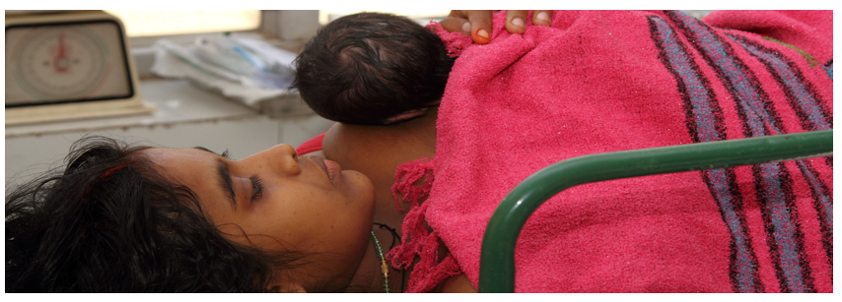
Background | LIFT-UP study - Goal
To improve feeding and growth outcomes among low birthweight and/or preterm infants in low resource setting by
promoting the initiation and maintenance of breastfeeding through an integrated approach comprising lactation support, feeding counseling, KMC and WASH in the facility and during the transition home,
fortifying human milk for very LBW or very preterm infants, and
exploring the acceptability and feasibility of introducing probiotics in India, Malawi, and Tanzania

Slide 11
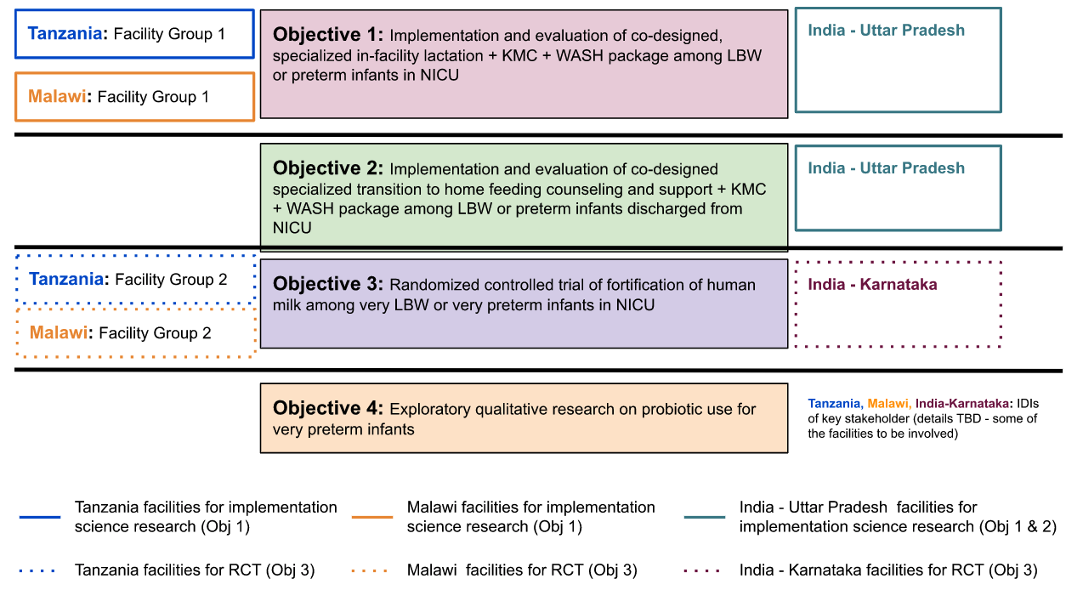
Background | LIFT-UP study overview - Objectives, settings & populations
Adaptive implementation science research
Individual RCT
Exploratory qualitative research
Notes:
Focus on high risk infants driving high mortality rates
Mixed methods and strategies
Large multi-country consortium
Capacity building and professional development
Co-design with users
Global goods
Focus on moving from research to policy/practice and addressing global guidelines
RCT
Assess the impact of fortifying human milk on growth outcomes in VLBW or very preterm infants in NICU [Different facilities from the implementation science research]
Qual research to get an initial understanding of the feasibility and acceptability of probiotic use in hospitalized very preterm infants
IDIs among clinicians, hospital leadership, supply chain experts, policymakers, Ministry of Health (MoH) officials, etc.

Slide 12
What is the internship opportunity?

Slide 13
Intern roles and responsibilities
Assist with quantitative tool development for adaptive implementation science research (‘objective 2’)
Data visualization/presentation to summarize key findings
REDCap:
Testing data collection tools in REDCap prior to study launch (for objective 2 and RCT)
Create a user guide/ recording for REDCap data collection for RCT
Finalize documentation of tool guides to share with site partners
Create training materials for site partners
Participate in weekly site calls with partners (optional depending on schedule)
Monitor DQA for RCT and objective 1 to ensure sites are checking data consistently and flag if there are any issues
Conduct literature review and assist with one publication

Slide 14
What will the intern gain from this internship?
Interns will be able to gain very valuable, hands-on research experience on a very complex global research project. They will be engaged with study partners across multiple countries, participating in a critical effort to translate evidence into practice

