Slide 1
Parents have the power to shape their children's futures and make their communities stronger.

Slide 2
Agenda
1
Introductions
3
Western MA Expansion
2
Who is Families First
4
Project Summary/Goals
3
6

Slide 3
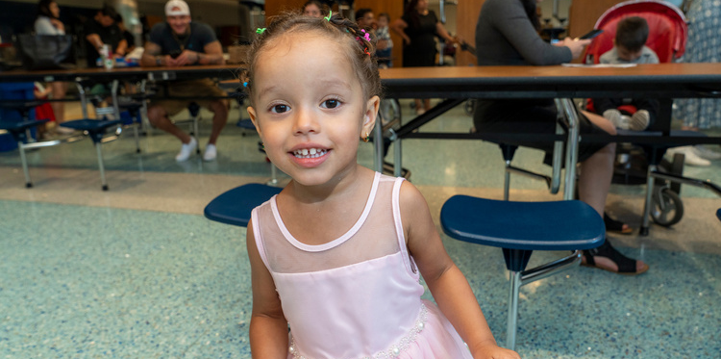
OUR VISION AND MISSION
Every parent is strong and supported.
Every community benefits from the power of parents.
Families First partners with parents to amplify their power so they can positively impact the lives of children and communities through our groundbreaking programs.
.
Every child is thriving and resilient.

Slide 4
OUR HISTORY
Since 1988, Families First has worked with families so they can strengthen their knowledge, skills, and support systems.
Notes:
Explain BRIEFLY about POP, specific focus on early childhood for the last 7 years, Ripple launched in 2020, and commitment to DEIB.

Slide 5
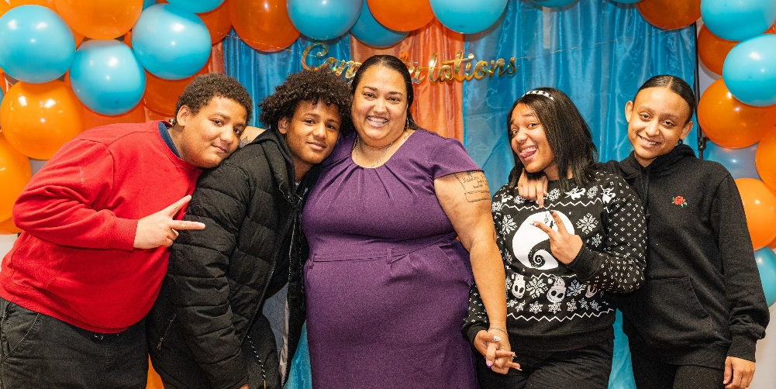
Parent’s
Voice
“Since I’ve been in the program, I’ve noticed a huge change in my life and my children’s lives. I started to become a stronger mother and started to maintain a lot of things at home that I wasn’t before. I had given up on myself, not realizing that I have children who depend on me, so I was happy that I joined this program for that little bit of strength that I needed to let me know that this isn’t the end for me. As my kids continue to grow, I still have a long journey in front of me.”
– Families First Parent Leader
.

Slide 6
OUR PROGRAMS
Power of Parenting Program
12 interactive group sessions
Parent leadership opportunities
The Ripple Program
Parent leadership trainings
Community impact projects
Stipends & resources
Alumni Services
Continued parenting knowledge and skills, social support

Slide 7
THE POWER OF PARENTING PROGRAM
Developmentally-staged curriculum:
to age & ages to
BIRTH
THREE
THREE
EIGHT
EVIDENCE-
INFORMED
CURRICULUM
EXPERT
FACILITATORS
PARENT
CAFÉ DISCUSSIONS
PARENT LEADERSHIP
OPPORTUNIIES
COMMUNITY-BASED PARTNERS

Slide 8
THE RIPPLE PROGRAM ELEMENTS
PARENT LEADERSHIP SERIES
PARENT LEADERSHIP STAFF TRAININGS
Workshops plus Peer Mentorship to develop professional skills
Professional development workshops for staff at partner agencies
COMMUNITY IMPACT PROJECTS
SUPPORT FROM FAMILIES FIRST
Collaboration with community partners to drive parent advocacy & involvement in communities and systems
Mentorship from parent ambassadors
Monthly cohort meetings
Technical assistance
Online resource portal

Slide 9
Western Mass Expansion
In 2022 Families First received a grant from the Lego Foundation to expand its work into Western Mass, specifically the Hampden County area.
In the Spring of 2023 Families First Western Mass began with 2 Power of Programs (Holyoke & Springfield).
By FY24 Families First Western Mass had expanded to 12 Power of Parenting Programs within Hampden County.
Currently in Western Mass, offer POP, Ripple Programming, and Alumni informational Workshops. Allowing families the opportunity to connect with local service providers on a one to level.
3
6

Slide 10
Project Summary
In collaboration with our Regional Director, the Families First Western Mass Advisory Council, and our administrative team, the selected intern will assist in managing Advisory Council meetings and in developing a comprehensive 3-year strategic plan.

Slide 11
Project Summary/Goals
Project Goals
1. Landscape Analysis:
- Collaborate with the Regional Director and administrative team to conduct a thorough landscape analysis. This will involve assessing current regional operations and identifying key trends, challenges, and opportunities.
2. Strategic Growth Plan Development:
- Work closely with the Advisory Council and Regional Director to formulate a 3-year strategic growth plan. The plan will focus on:
- Gaining a deeper understanding of the regions currently served.
- Identifying and exploring new avenues and potential partners for collaboration.
- Expanding our services beyond the current geographic scope to new regions.
*The intern’s role will be pivotal in facilitating these initiatives and ensuring the strategic plan aligns with our mission and growth objectives.

Slide 12
Community Partners
Seasoned Partners
New Partners
Families First Western Mass has strategically assessed the landscape within the communities of Holyoke, Chicopee and Springfield

Slide 13
Current Funders

Slide 14
Plan to expand programming in Springfield & Chicopee areas
Springfield
NNCC
Springfield Public Schools
MLK Family Jr. Services
Networking events
Chicopee
Chicopee Public Schools
Chicopee Boys & Girls Club
VOC
Networking events
We are currently working on strengthening and expanding on programming within the Springfield, and Chicopee areas.

Slide 15
Thank You!

