Slide 1
Going beyond survival:
Building a patient-centered understanding of birth complication management and postpartum wellbeing
Sept 2024

Slide 2
We are a joint center for health systems innovation at Brigham & Women’s Hospital and the Harvard T.H. Chan School of Public Health

Slide 3
More women and newborns survive severe complications during childbirth but many struggle to overcome the additional medical and social burdens induced by these health shocks

Slide 4
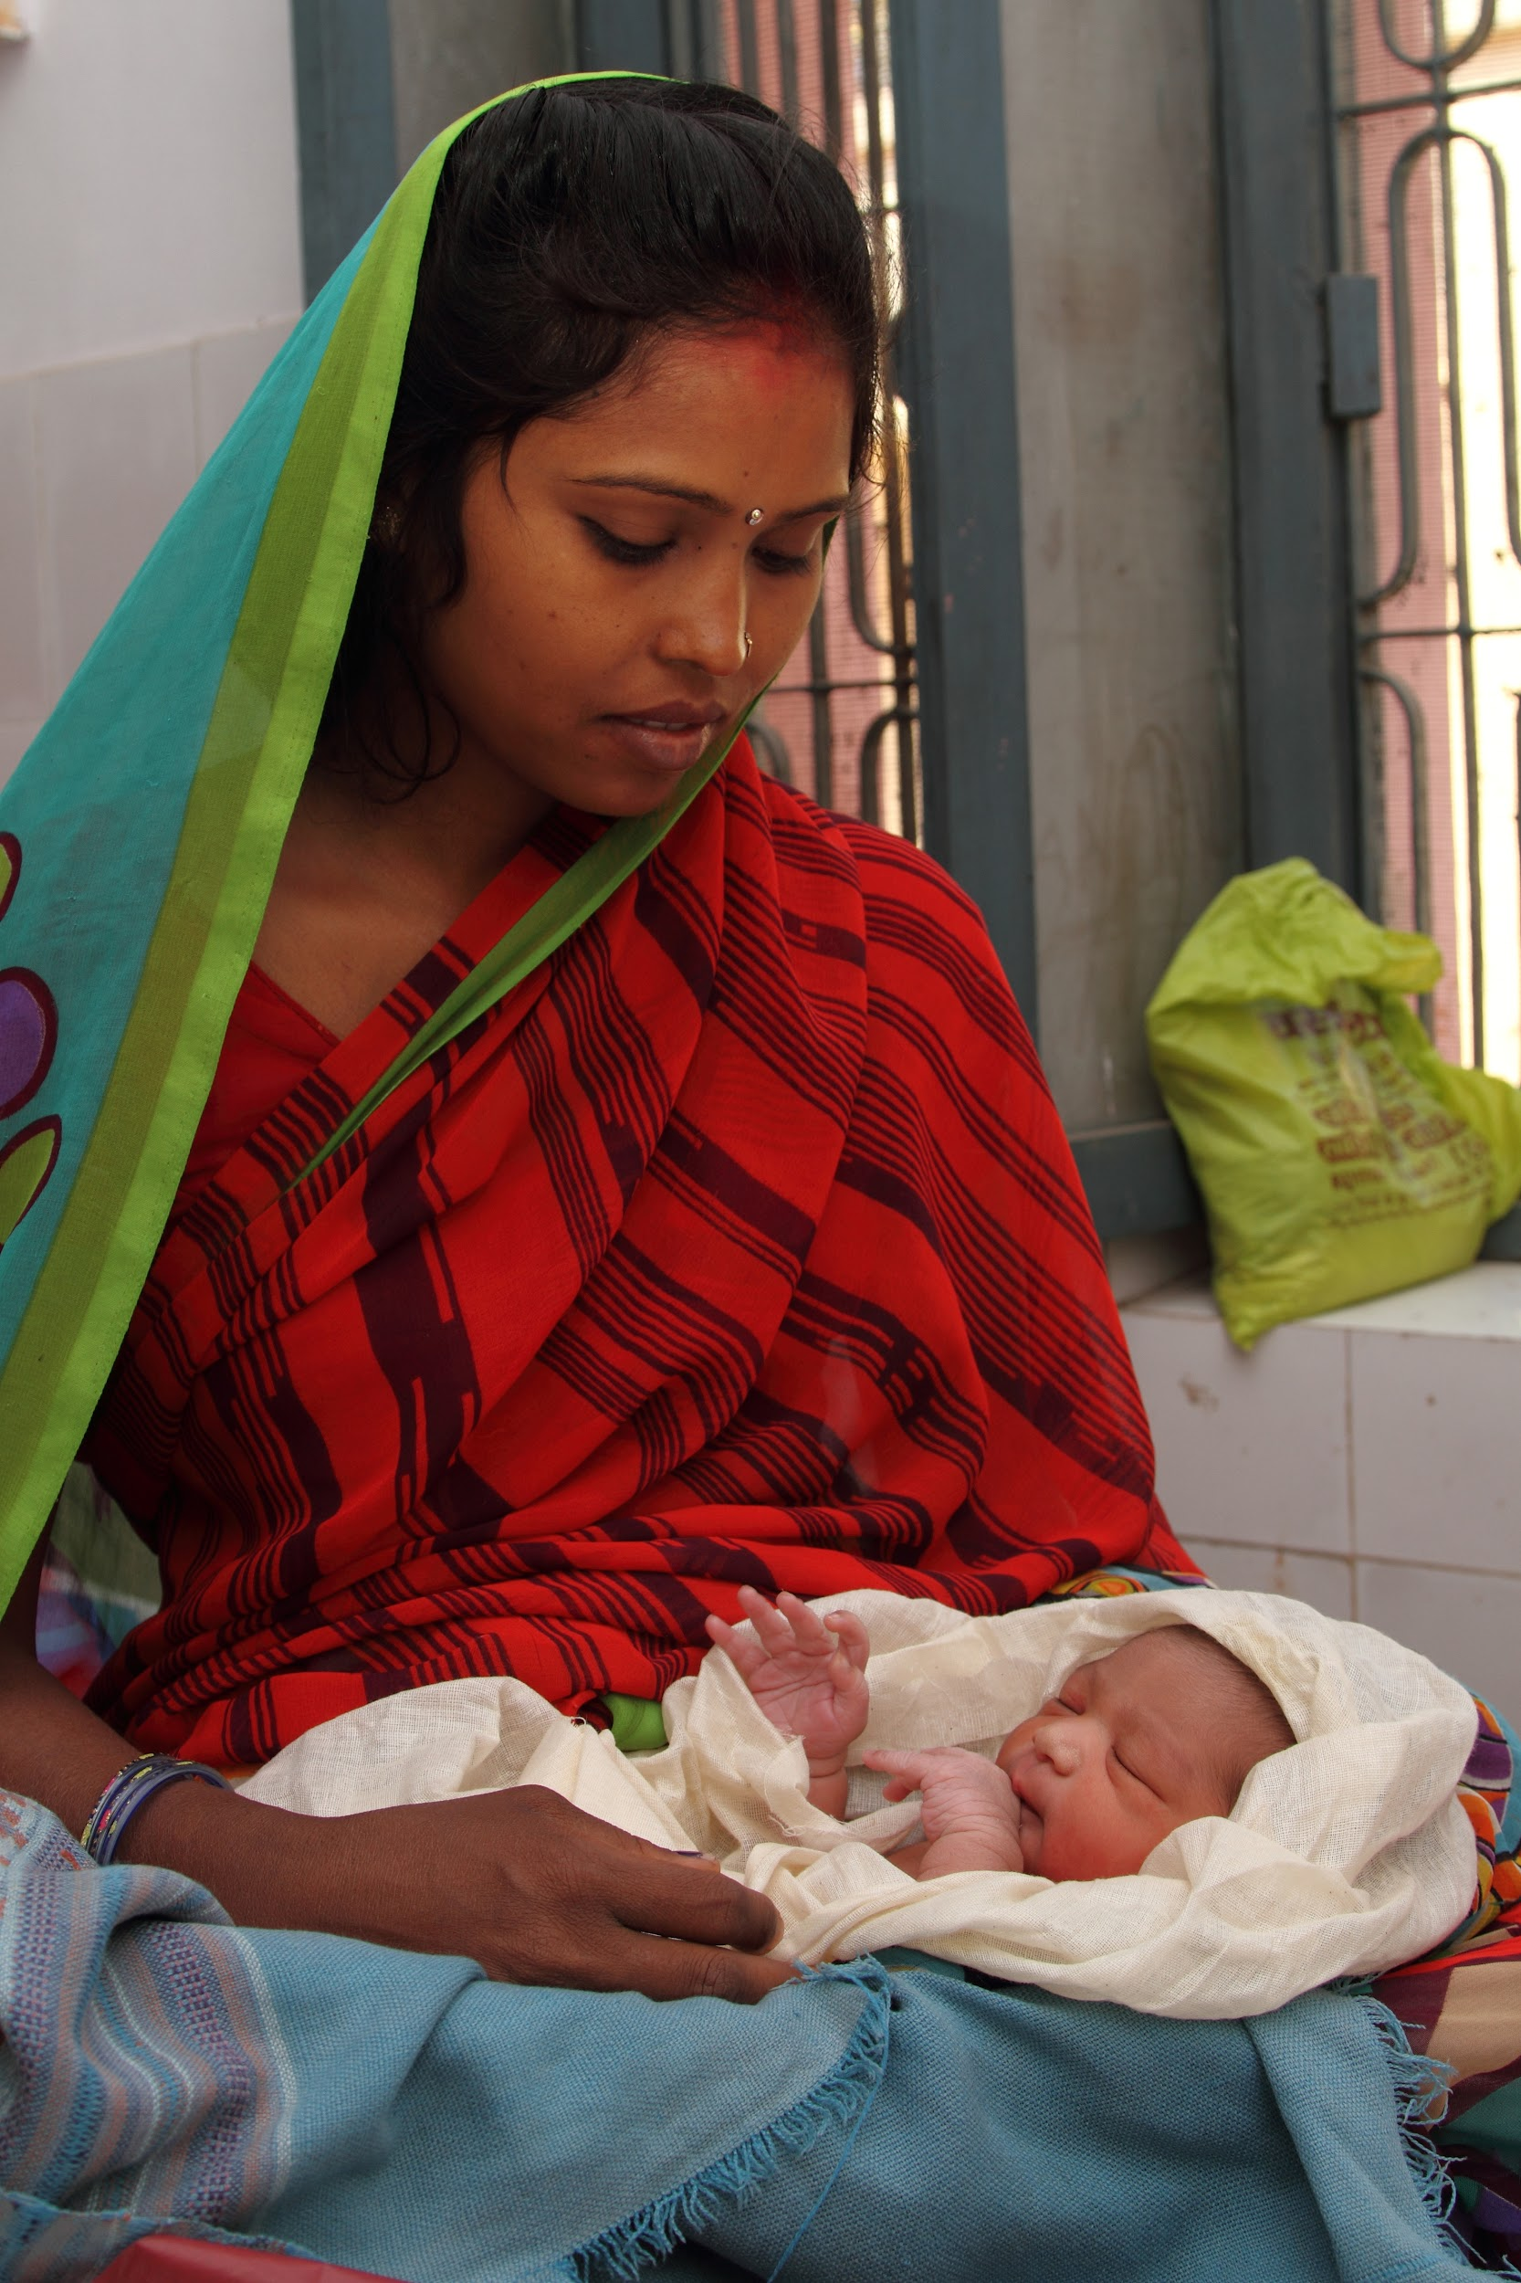
Morbidity for postpartum mothers and newborns is often invisible and uncounted
Lives are being saved through access to skilled birth attendance and improved complication management
Attendance at postpartum care visits for mothers and newborns remains at ~60%, missing key follow-up care after a complication
+
-
Mortality after birth is a major concern
36% of maternal deaths occur in the first 6 weeks after birth
Half of under-5 mortality occurs in the first month of life

Slide 5
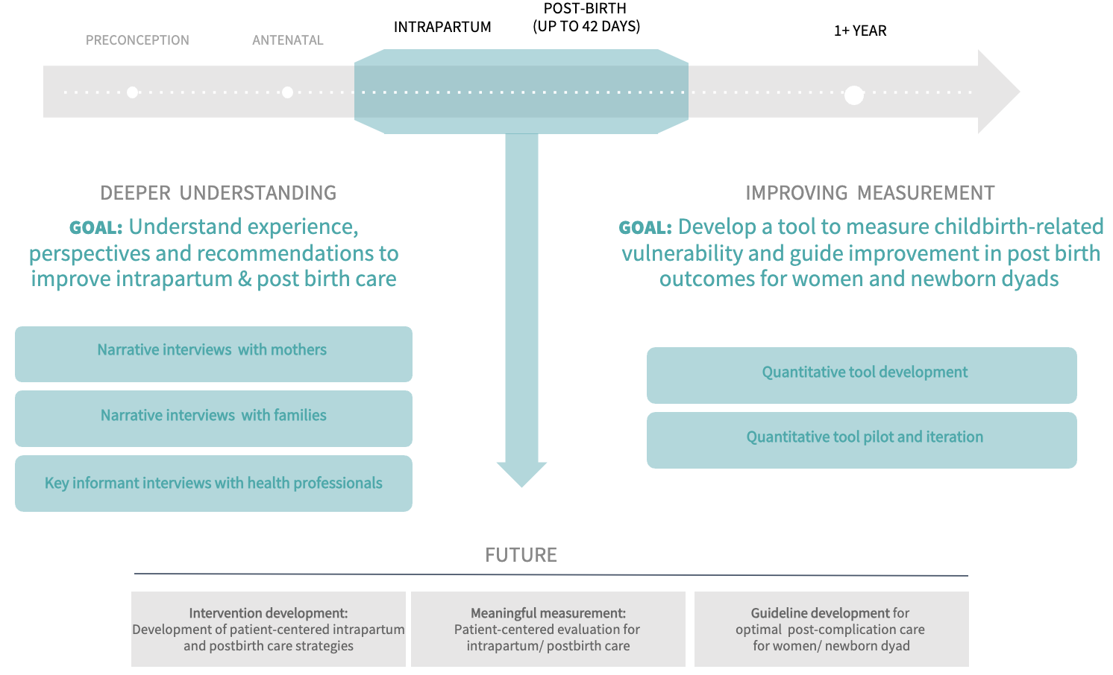
BEYOND SURVIVAL PROJECT SUMMARY Patient journeys of complications care from in-facility birth to 18 months postpartum
Notes:
3 sites in Kenya
On-going study—was up to 6 weeks, now up through 18 months

Slide 6
POTENTIAL OPPORTUNITIES TO CONTRIBUTE
Activities:
Qualitative analysis and synthesis
Background literature reviews for manuscripts
Ideal qualifications
Experience or training in qualitative coding and analysis
Experience with ata summarization and reporting (for example slides, blog posts, donor reports, etc)
If interested in learning more, please reach out to Megan Marx Delaney mmarxdelaney@ariadnelabs.org
Notes:
Qual would include pathways segmentations
Note: While co-authorship on a manuscript is not guaranteed, some contributions could lead to qualification as a co-author on a manuscript, as determined by ICMJE criteria

