Slide 1
MCH Leadership Lab Project opportunities related to preterm infant health and development
2024-2025 Academic Year
Mandy Brown Belfort, MD MPH
https://belfortlab.bwh.harvard.edu/

Slide 2
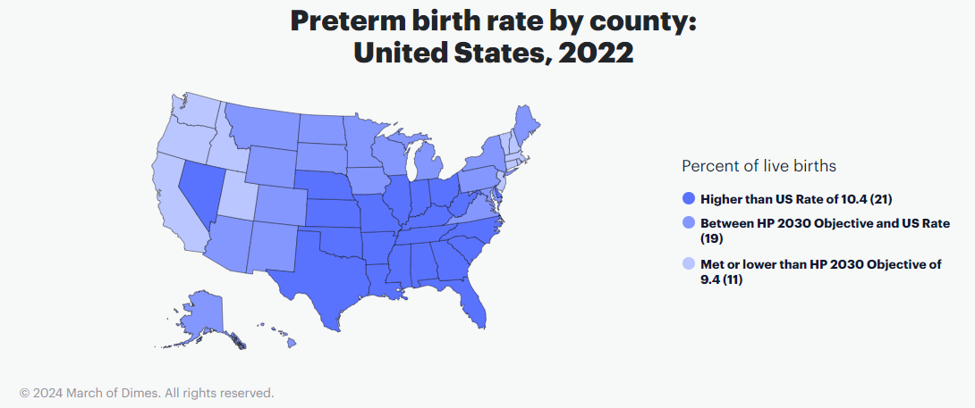
1 in 10 births is preterm (<37 weeks of gestation)
383,979 preterm births in 2021
Preterm birth is 2nd leading cause of infant death in U.S.

Slide 3
Racial inequities in preterm birth, United States
50% higher
%
2.6X
higher
Slide from H. Burris
Hamilton et al. Births: Final data for 2014. National Center for Health Statistics. 2015

Slide 4
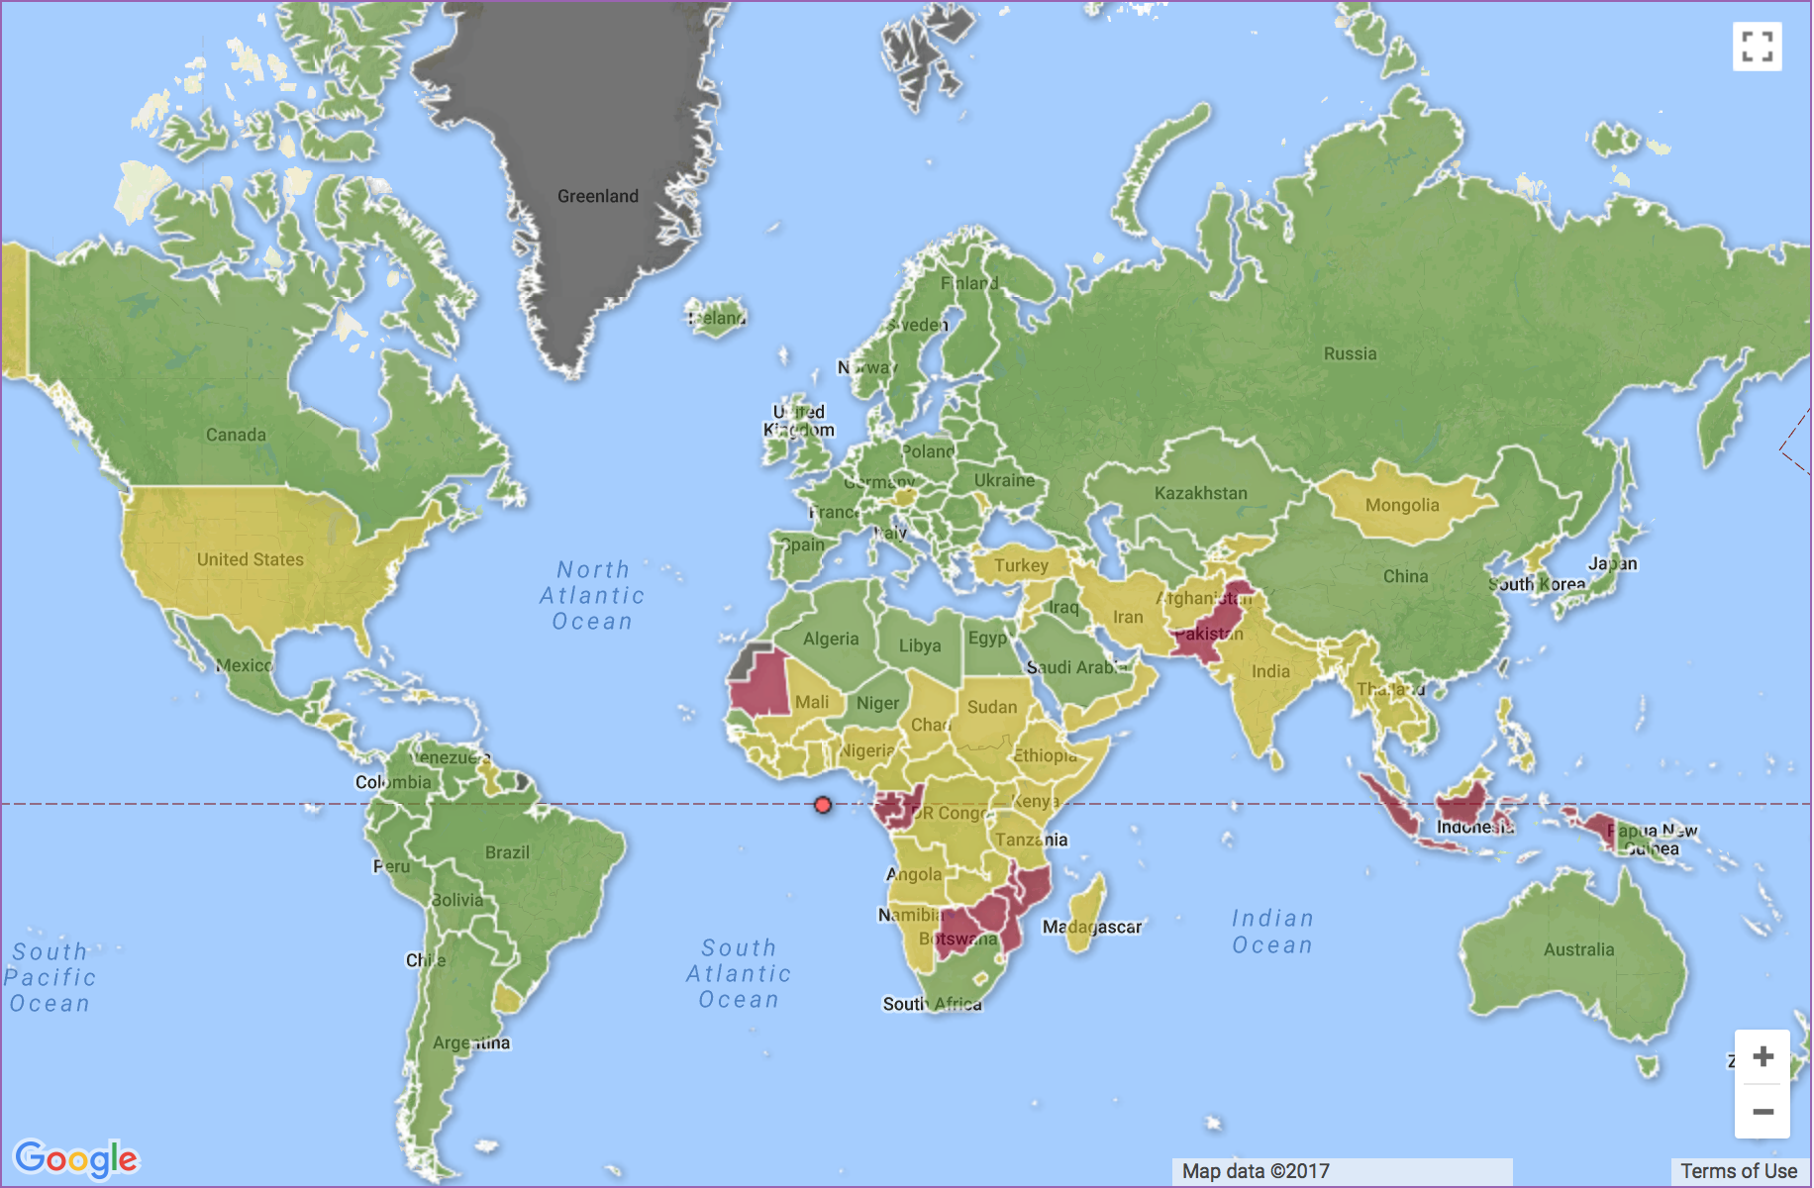
Worldwide
15 million preterm births/year
1.1 million infant deaths/year
Leading cause of neonatal mortality
75% of deaths preventable with basic (non-ICU) care
Born Too Soon Global Action Report on Preterm Birth (2012)

Slide 5
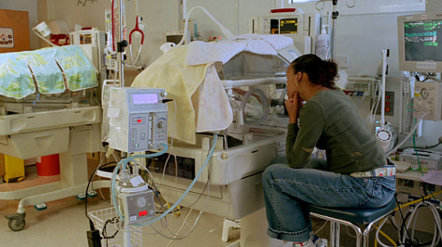
Many effective hospital based interventions
Mechanical ventilation
Thermoregulation
Medications
Nutrition support, human milk
Developmentally & family-centered care
https://www.gettyimages.com/detail/photo/mother-watching-premature-baby-in-incubator-high-res-stock-photography/sb10069399j-004?adppopup=true

Slide 6
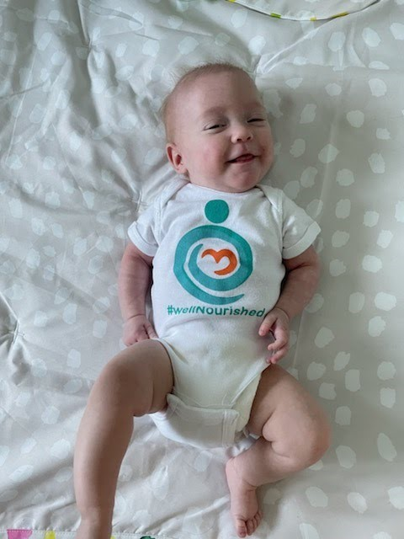
The overarching goal of our research is for very preterm infants to leave the NICU well-nourished, because this is a foundation for their lifelong health and well-being.

Slide 7
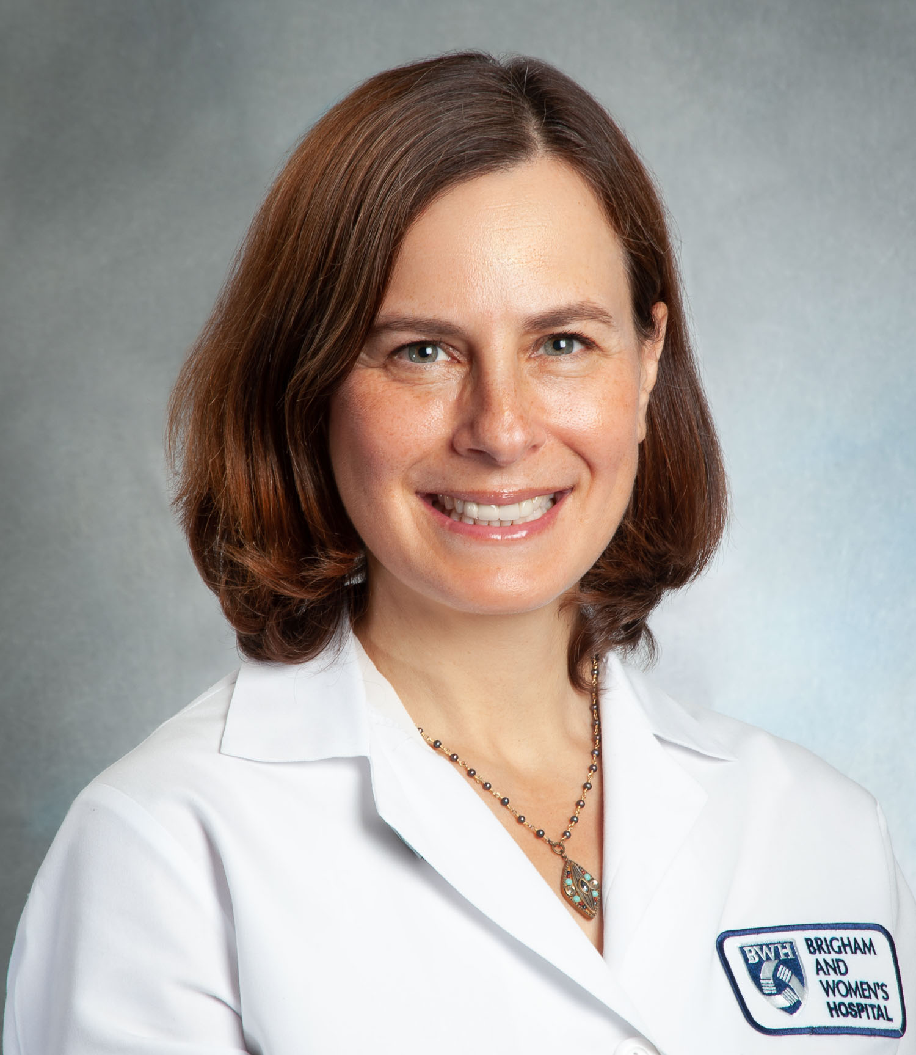
Belfort Lab
PI: Mandy Brown Belfort, MD MPH
Areas of Focus
Human milk/breastfeeding
Diet interventions
Milk bioactives
Infant growth assessment
Neurodevelopment
Neuroimaging (MRI)
Cardiometabolic outcomes
NICU nutrition quality
Methods
Mid-IR human milk analysis
Anthropometry
Air displacement plethysmography
Bioimpedance spectroscopy
Observational & interventional study designs
Quality improvement
Current Projects
Nourish RCT
Baby BEAN
Zinc exosomes
Milk bioactives & brain MRI
Neonatal Nutrition Collaborative
NICU Nutrition QI & dashboard
Environment
Weekly lab & ops meetings
WIPs – academic skills
Biospecimens & data
Neuroscience collaboration
Postdoctoral fellows
Early career faculty
RAs, research RNs
Project/data manager
T E A M S C I E N C E

Slide 8
MCH Leadership Lab student experience
Attend and participate in ~weekly Newborn Nutrition Lab meetings
Contribute to ongoing research or QI project
Analysis of existing data
1:1 mentor meetings
Opportunities for shadowing of clinical research teams
Best experience for student able to perform basic statistical analysis and interest in developing data analytic skills!
https://belfortlab.bwh.harvard.edu/
Email: mbelfort@bwh.harvard.edu

Slide 9
MCH Leadership Lab student experience
Attend and participate in ~weekly Newborn Nutrition Lab meetings
Contribute to ongoing research or QI project
Analysis of existing data
1:1 mentor meetings
Opportunities for shadowing of clinical research teams
Best experience for student able to perform basic statistical analysis and interest in developing data analytic skills!
https://belfortlab.bwh.harvard.edu/
Email: mbelfort@bwh.harvard.edu

Slide 10
Previous MCH LL student projects
Parent and infant quality of life after NICU discharge
Scored ITQOL, analyzed associations with parent & infant characteristics
Wrote and submitted AAP abstract
Lactoferrin exposure in human milk and preterm infant brain development
Analyzed lactoferrin & quantitative brain MRI data (year 1 + summer)
Drafted manuscript (year 2)
COVID-19 and breastfeeding
Analyzed statewide dataset (year 1)
Drafted, revised, submitted manuscript (year 2)

