Slide 1
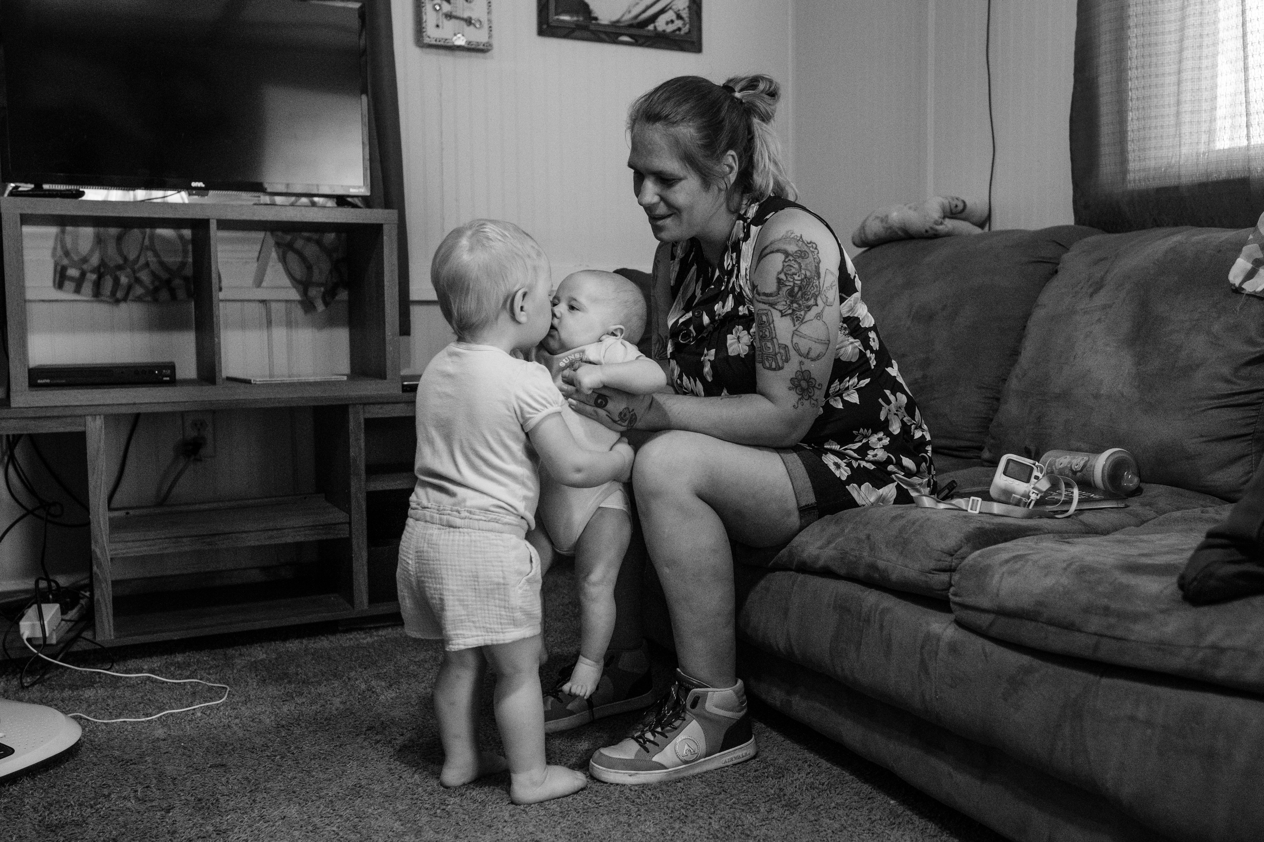
Birth Beyond Bars
MCH Leadership Lab Student Project
Bethany Kotlar, MPH

Slide 2
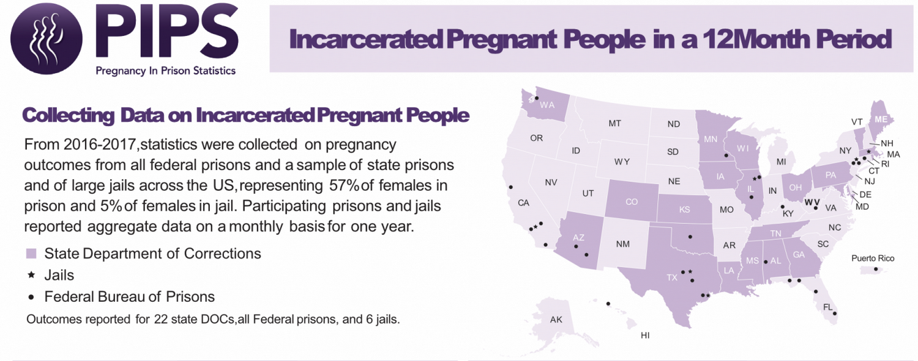
Notes:
The next couple of slides contain information from the Pregnancy in Prison Statistics project by Carolyn Sufrin, who looked at 22 state prisons and 6 jails to document basic information about the number of pregnant people, birth outcomes, and policies pertaining to pregnancy. This is the best data we have, but is both flawed and incomplete. Flawed, because it relied on carceral institutions themselves to report. From Georgia we know their numbers were not accurate. And it did not reach enough jails to provide a reliable estimate for this population. Still the best we have!

Slide 3
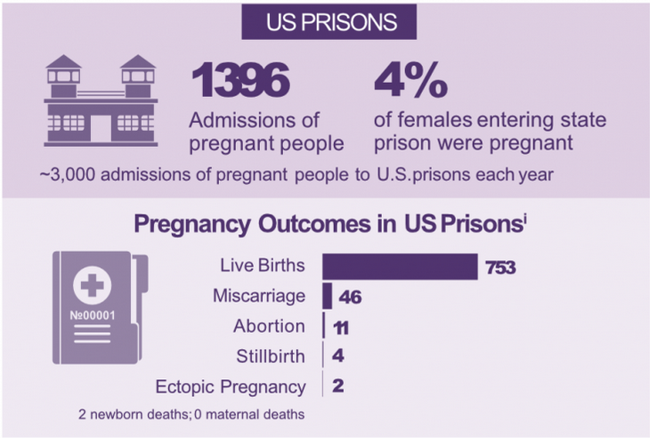

Slide 4
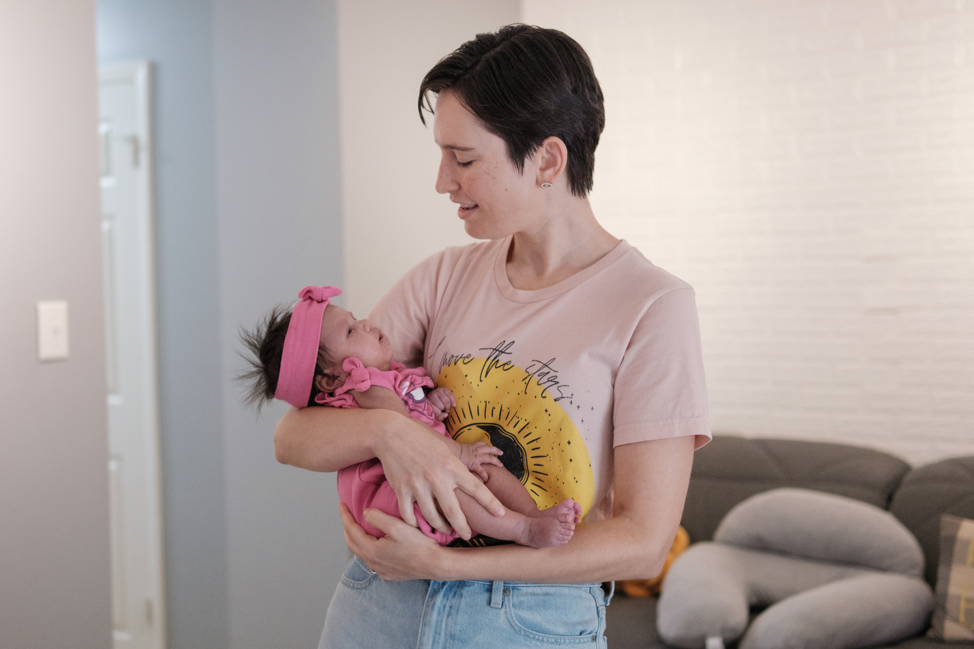
Birth Beyond Bars Cohort
Cohort of children exposed to incarceration in utero, their caregivers, and their mothers
Follow-up currently for 3 years
Pilot in Georgia, now expanding to other states
Mixed methods design

Slide 5
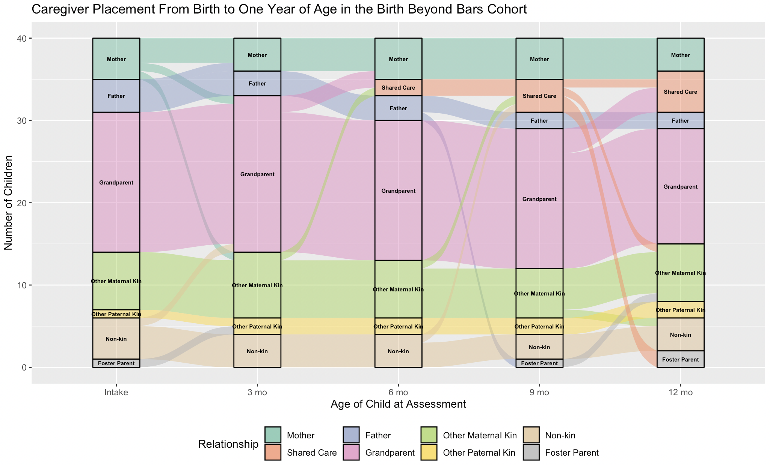

Slide 6
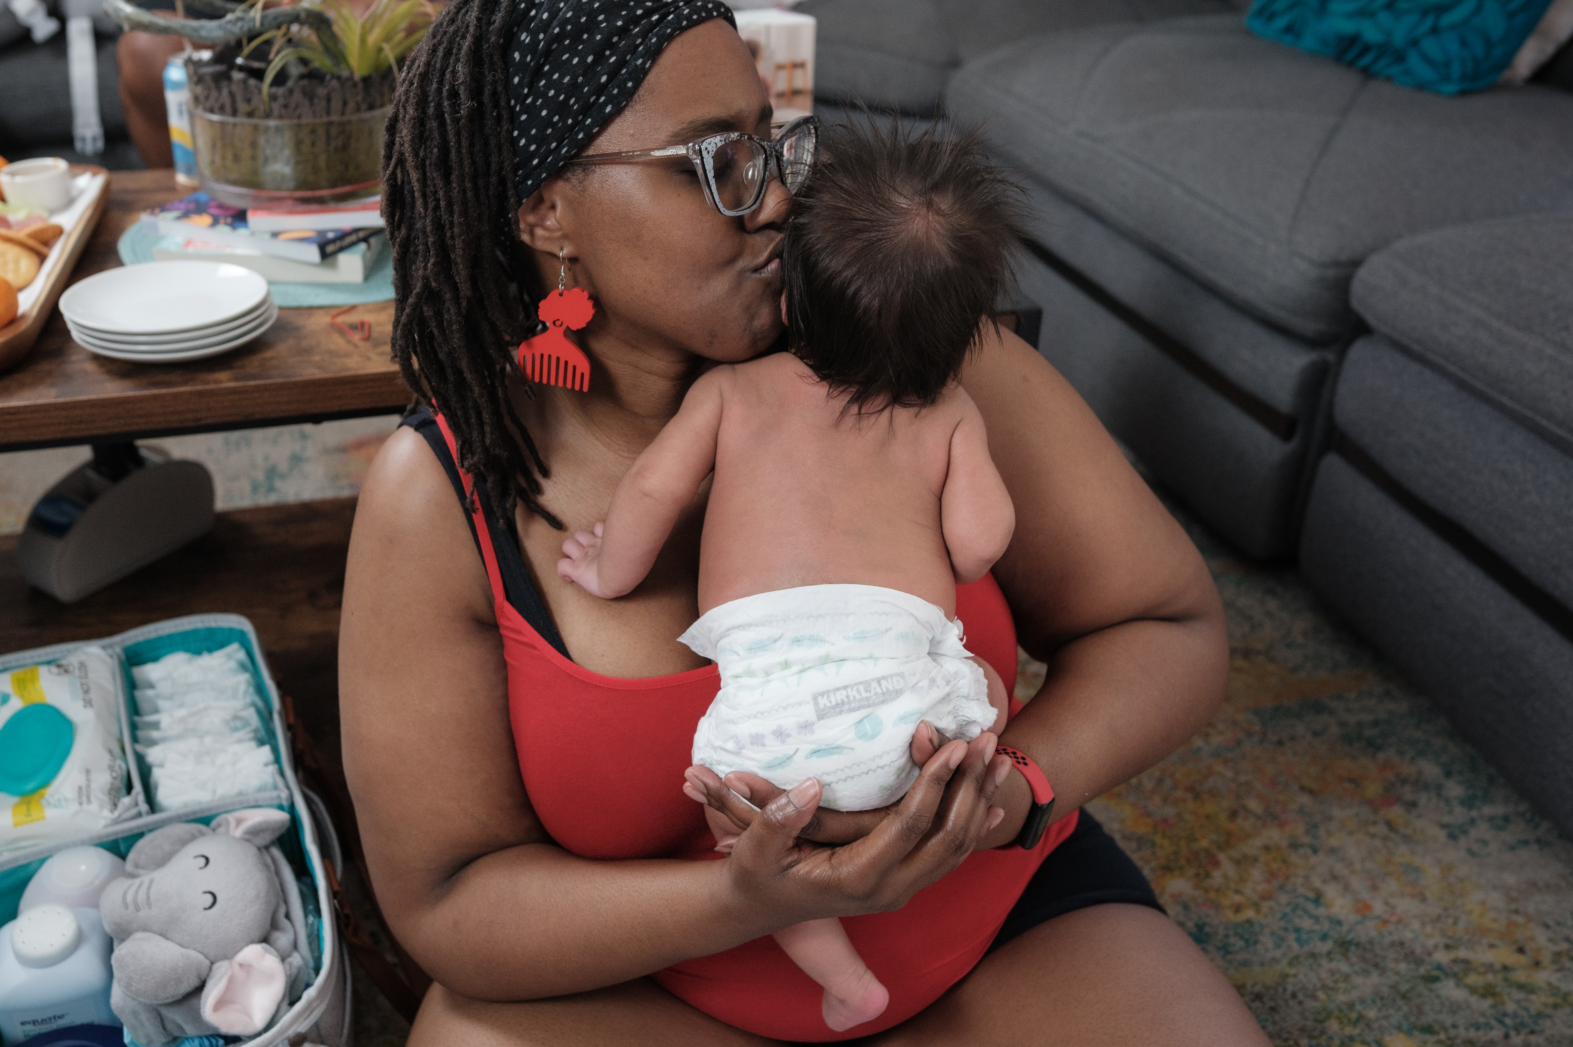
What have past students done?
Traveled to and presented an abstracts at a Correctional Healthcare Conference
Co-authored papers on nutrition policy for pregnant and postpartum incarcerated people, the death penalty and pregnancy, and caregiver experiences assuming care for newborns of incarcerated mothers
Ate ice cream

Slide 7
Student projects
Infant feeding practices
What are the feeding practices of caregivers of infants with incarcerated mothers? What are the barriers to recommended feeding practices?
Mixed methods analysis of primary cohort data
Pregnancy and postpartum accommodation
statutes and regulations
How do states and the federal government ensure pregnant and postpartum incarcerated women are not forced into dangerous work or housing assignments?
Policy review project
These can be down simultaneously if desired!

Slide 8
Activities
Conducting mixed-methods interviews with caregivers and mothers
Analyzing qualitative and/or quantitative data
Contributing to drafting papers on carceral policies impacting maternal and child health
Student qualifications
Some data analysis experience (practical or course) preferred
Interest in or experience with working with marginalized populations
Logistics
Commitment of at least 10 hours per week
Ability to join weekly Zoom meetings
Other work on your own schedule

Slide 9
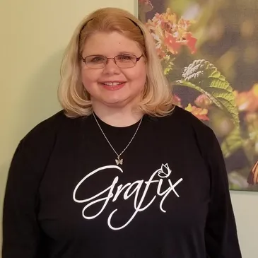
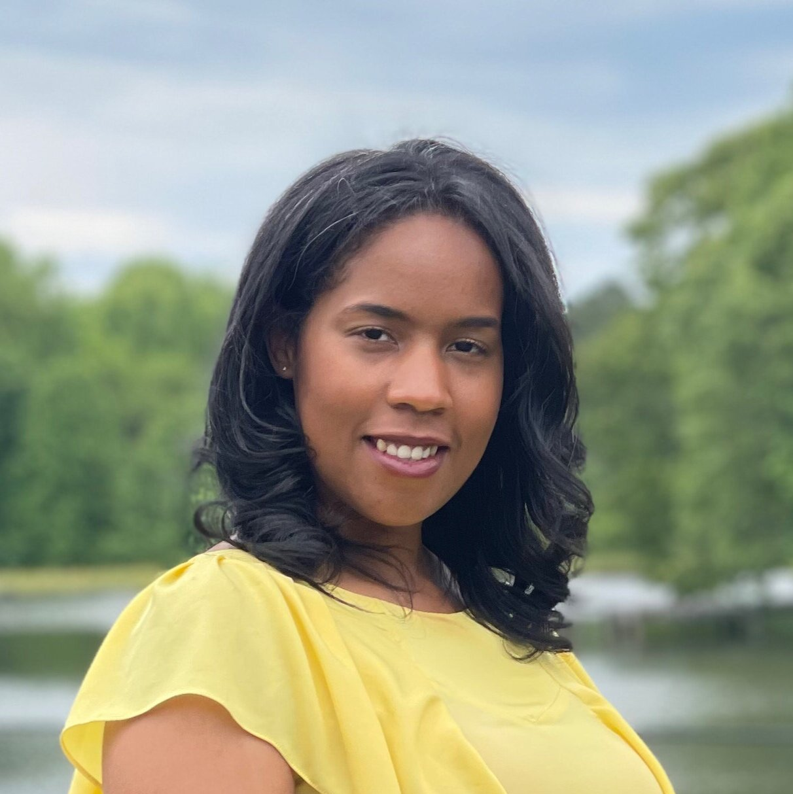
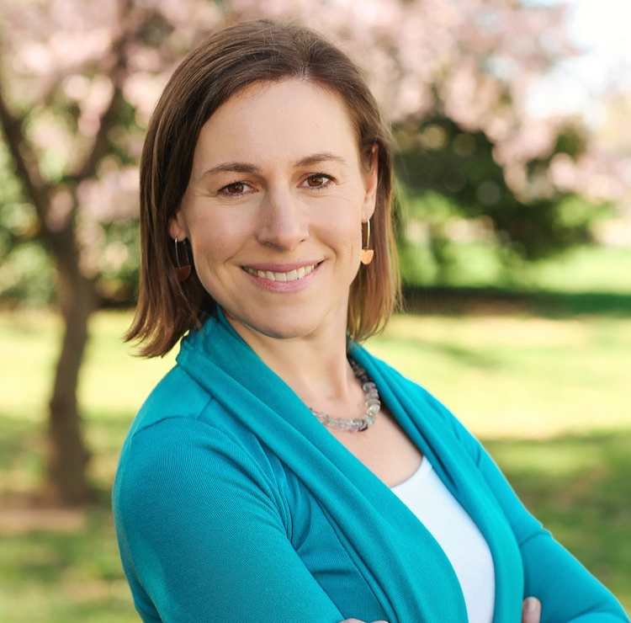
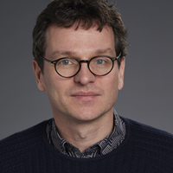
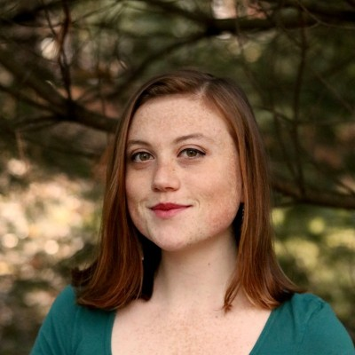
Join this amazing team!
Tara Gazzuolo, MBB
Vanessa Garrett, MBB
Sarah Perry, MBB
Amy Ard, MBB
Henning, known entity
Meg Matthews, Harvard
Notes:
First I wanted to share a bit about how I came to this work. Once upon a time I thought I wanted to be a pastor, and spent a year as a chaplaincy intern at Lee Arrendale State Prison, the largest prison for women in Georgia, which you can see in the first picture with the large watchtower. While I was there I heard the stories of women who had given birth during their incarceration, which changed the course of my career forever and led to the founding of Motherhood Beyond Bars, a nonprofit that supports this population. Since then, I have been working with pregnant and postpartum incarcerated people and more recently their extended families. I also have the immense pleasure of working with Amy Ard, and Vanessa Garrett who run Motherhood Beyond Bars and are also the most wonderful human beings to work with.

